Slide 1
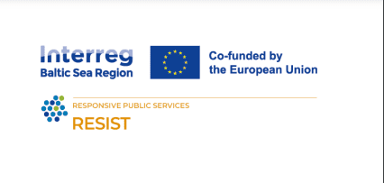
DIFFERENT FORMS OF BUSINESS MODELS
Train the trainers

Slide 2
01.
DEFINITION AND SIGNIFICANCE OF BUSINESS MODEL
02.
DIFFERENCE BETWEEN SOCIAL AND CONVENTIONAL ENTERPRISE
03.
INTRODUCTION TO SOCIAL ENTREPRENEURSHIP
04.
NTRODUCTION TO SOCIAL ENTREPRENEURSHIP
TABLE OF
CONTENT
05.
BUSINESS MODELS

Slide 3
Definition:
A business model defines how a company creates, delivers, and captures value. It's a blueprint that outlines the way a company generates revenue, delivers products or services to its customers, and how it manages its resources.
What is a Business Model?
Value Proposition:
What unique value does the company offer to its customers?

Slide 4
THE SIGNIFICANCE OF BUSINESS MODELS
VALUE CREATION:
ALIGNMENT:
OPERATIONAL STRUCTURE:
Business models are critical as they determine how a company creates value for its customers. The model impacts product or service design, customer experience, and ultimately, customer satisfaction and loyalty.
A well-defined business model ensures that all aspects of the company are aligned towards a common goal, facilitating strategic decision-making and fostering organizational coherence.
The chosen business model influences the company's structure, including its processes, tasks, and the flow of information. It dictates the operational strategies that drive efficiency and effectiveness.

Slide 5
The difference between social and conventional enterprise

Slide 6
Purpose and Objectives
CONVENTIONAL ENTERPRISE:
SOCIAL ENTERPRISE:
The primary goal is to generate profit for the owners or shareholders. While they may engage in social responsibility initiatives, these activities are often secondary to the main objective of financial gain.
The primary purpose is to address a social issue or fulfill a social mission. While they aim to be profitable or financially sustainable, their main goal is to generate a positive impact on society, the environment, or both. Profits are typically reinvested into the social mission.

Slide 7
Profit Distribution
CONVENTIONAL ENTERPRISE:
SOCIAL ENTERPRISE:
Profits are distributed to shareholders or reinvested into the business to drive growth, improve competitive positioning, and increase shareholder value.
Profits are mainly reinvested back into the business or directed towards their social mission. This reinvestment supports the sustainability and expansion of their social impact.

Slide 8
Decision-Making
CONVENTIONAL ENTERPRISE:
SOCIAL ENTERPRISE:
Decisions are primarily driven by financial considerations, market competitiveness, and shareholder value.
Decision-making is often guided by the enterprise’s social mission and the impact on its beneficiaries. Financial viability is considered with a view towards sustaining the social mission.

Slide 9
Performance Measurement
CONVENTIONAL ENTERPRISE:
SOCIAL ENTERPRISE:
Success is measured by financial performance indicators such as revenue, profit margins, and return on investment.
Success is measured not just in financial terms but also by the social impact achieved. Metrics may include social, environmental, and community impact alongside financial performance.

Slide 10
Funding and Investment
CONVENTIONAL ENTERPRISE:
SOCIAL ENTERPRISE:
Typically funded through traditional means such as equity, debt financing, and reinvested profits. Investors seek a financial return on their investment.
May access a mix of funding sources, including grants, social investment, and revenue from goods or services. Investors often expect a social return on investment (SROI) as well as, or instead of, a financial return.

Slide 11
Funding and Investment
CONVENTIONAL ENTERPRISE:
SOCIAL ENTERPRISE:
Typically funded through traditional means such as equity, debt financing, and reinvested profits. Investors seek a financial return on their investment.
May access a mix of funding sources, including grants, social investment, and revenue from goods or services. Investors often expect a social return on investment (SROI) as well as, or instead of, a financial return.

Slide 12
Stakeholder Engagement
CONVENTIONAL ENTERPRISE:
SOCIAL ENTERPRISE:
Stakeholders primarily include customers, employees, investors, and suppliers, with engagement strategies focused on maximizing customer satisfaction and shareholder value.
Stakeholders often include beneficiaries, community members, social investors, and other parties interested in the social mission. Engagement strategies may focus on collaborative impact and community involvement.

Slide 13
Market Orientation
CONVENTIONAL ENTERPRISE:
SOCIAL ENTERPRISE:
Market orientation is driven by demand, competition, and the pursuit of market share and profitability.
While they operate in the marketplace and may sell goods or services, their market orientation is often defined by the needs of their social mission, targeting underserved or disadvantaged groups.

Slide 14
In summary, the fundamental difference between social and conventional enterprises lies in their core objectives: social enterprises prioritize social impact alongside (or above) financial goals, while conventional enterprises focus on maximizing profit and shareholder value.

Slide 15
VALUE
A viable business model is one that allows a business to charge a price for the value it’s creating, such that the business brings in enough money to make it worthwhile and continue operating over time.
SHARED ASSETS
PRODUCT
SERVICE
SUBSCRIPTION
LEASE/RENTAL
INSURANCE
BASIC
AGENCY/
PROMOTION
RESELLING

Slide 16
Introduction to Social Entrepreneurship

Slide 17
Social entrepreneurship is the process by which individuals, startups and entrepreneurs develop and fund solutions that directly address social issues. A social entrepreneur, therefore, is a person who explores business opportunities that have a positive impact on their community, in society or the world.*
*CO— the U.S. Chamber of Commerce’s digital platform for small business

Slide 18
Social entrepreneurship
Scope and Impact
Growing Trend
Why It Matters
Covers a wide range of areas including healthcare, education, environmental protection, and community development. Social entrepreneurs work globally, targeting local issues with innovative solutions that can be scaled or replicated elsewhere.
Increasing recognition of the role of social entrepreneurship in solving global challenges has led to greater support from governments, investors, and the public.
Social entrepreneurs not only contribute to solving social problems but also inspire a shift towards more sustainable and ethical business practices globally.

Slide 19
Key features of Social business models
Non-dividend Distribution
Financial Sustainability
Social Problem Solving as Core Objective
Profits are reinvested into the business or community, not paid out to shareholders.
Maintains financial health to ensure long-term sustainability and ongoing social mission fulfillment.
Every decision is guided by the mission to resolve a social issue, shaping strategies and operations.

Slide 20
10 MILLION
Social
Enterprises
$2 TRILLION
Annual
Revenue
200 MILLION
Jobs
There are around 10 million social enterprises globally, united by the principle of putting purpose before profit.
Social enterprises are generating around $ 2 trillion in revenue each year while creating positive impact.
Social enterprises are creating 200 million jobs across various sectors, from agriculture to financial services.
The world Economic forum
The State of Social Enterprise 2024
https://initiatives.weforum.org/global-alliance-for-social-entrepreneurship/state-of-the-sector

Slide 21
Importance of Social Entrepreneurship
Social entrepreneurship is increasingly recognized for its role in solving complex social issues that have been overlooked or inadequately addressed by other sectors. By fostering innovation and applying business principles to social problems, social entrepreneurs provide new pathways for societal improvement, offering hope and tangible benefits to communities worldwide.

Slide 22
Challenges Faced by Social Entrepreneurs
Balancing Mission and Profitability
Funding
Measuring Impact
Striking the right balance between social impact and financial sustainability can be challenging.
Securing initial and ongoing funding without compromising the social mission.
Developing effective metrics to measure social impact alongside financial performance.

Slide 23
FIELDS OF SOCIAL ENTREPRENEURSHIP
Social entrepreneurship spans a wide range of fields, reflecting the diverse and complex nature of social challenges across the globe. Entrepreneurs in this sector apply innovative solutions to problems in various domains, aiming for a significant positive impact. Here are some of the key fields where social entrepreneurship is making strides:
EDUCATION
HEALTHCARE
ENVIRONMENTAL SUSTAINABILITY
SOCIAL JUSTICE AND HUMAN RIGHTS
FOOD SECURITY AND NUTRITION
SOCIAL INCLUSION
BASIC
TECHNOLOGY FOR SOCIAL GOOD
ECONOMIC DEVELOPMENT
ARTS AND CULTURE

Slide 24
Introduction to Conventional Enterprise

Slide 25
A traditional business model refers to the way in which a company uses its resources and people to deliver products and services to customers and generate revenue. Traditional business models focus on the interaction between the company, its customers, and its products, and often involve strategies for advertising and promoting products to a broad audience.*
*https://typeset.io/questions/what-is-a-traditional-business-model-352tep08km

Slide 26
Conventional Enterprise
Profit Orientation
Market Participation
Operational Efficiency
The foremost objective is to achieve financial gain, with success measured through metrics such as revenue, profit margins, and return on investment.
These businesses engage in competitive markets, striving to offer goods or services that meet consumer demand while outperforming competitors.
Efforts are made to streamline operations, reduce costs, and enhance productivity to maximize profitability.
Financial Investment
and Returns
Legal and Organizational Structure
Conventional enterprises attract investment based on their potential to generate financial returns for investors and shareholders.
They operate within legal frameworks that define their structure, responsibilities, and the protection of investor and owner interests.

Slide 27
Business models are fundamental frameworks that describe how a company creates, delivers, and captures value. They vary widely across different sectors and industries, reflecting the diversity in how businesses operate and generate revenue.
In the following slides several forms of business models that have gained prominence are presented.

Slide 28
BUSINESS MODELS
PRODUCT-BASED MODEL
SERVICE-BASED
MODEL
SUBSCRIPTION
MODEL
Description: Companies create and sell physical goods. This model focuses on manufacturing, inventory, and distribution.
Example: Consumer electronics manufacturers, apparel brands.
Description: Rather than tangible products, companies provide services. This model relies on expertise, performance, and time.
Example: Consulting firms, cleaning services.
Description: Customers pay a recurring fee to access a product or service. This model emphasizes customer retention and predictable revenue.
Example: Streaming services, software-as-a-service (SaaS) companies.

Slide 29
BUSINESS MODELS
FREEMIUM
MODEL
AFFILIATE
MODEL
FRANCHISE
MODEL
Description: Basic services are provided free of charge, while advanced features or premium services require payment. This model aims to convert free users into paying customers.
Example: Many mobile apps, cloud storage services.
Description: A company earns commissions by promoting other businesses’ products or services. This model relies on partnerships and marketing.
Example: Affiliate bloggers, price comparison websites.
Description: Franchisors license their business model and brand to franchisees, who then replicate the business in different locations. This model allows for rapid expansion.
Example: Fast-food chains, retail brands.

Slide 30
BUSINESS MODELS
ON-DEMAND
MODEL
MARKETPLACE
MODEL
ADVERTISING
MODEL
Description: Products or services are provided on an as-needed basis, often facilitated by digital platforms. This model caters to immediate customer needs.
Example: Ride-sharing services, food delivery apps.
Description: An intermediary platform that connects sellers with buyers, often taking a fee or commission for each transaction. This model scales by increasing the number of participants.
Example: E-commerce sites, booking platforms.
Description: Revenue is generated by displaying advertisements to users. This model often relies on high user traffic or engagement.
Example: Media websites, social networking platforms.

Slide 31
BUSINESS MODELS
CROWDSOURCING MODEL
SOCIAL ENTREPRENEURSHIP MODEL
SHARING
ECONOMY MODEL
Description: Leverages the collective knowledge or skills of a crowd to solve problems, create content, or develop products. This model taps into community resources.
Example: Crowdfunding platforms, open-source software projects.
Description: Facilitates the sharing or renting of resources among individuals, often through a platform. This model emphasizes utilization over ownership.
Example: Peer-to-peer lodging services, car-sharing platforms.
Description: Focuses on solving social, cultural, or environmental issues. While profit may be a motive, the primary aim is creating social value.
Example: Social enterprises, cooperative organizations.

Slide 32
Summary of selected business forms and examples
Freemium
Model
Offers basic services for free while charging for premium features.
LinkedIn, Dropbox
Attracts large user base
Conversion to paid plans is crucial
Sharing
Economy Model
Facilitates peer-to-peer sharing of access to goods and services.
TOMS Shoes, Warby Parker
Lowers ownership costs
Community-driven and scalable

Slide 33
Summary of selected business forms and examples
Social Entrepreneurship Model
Offers basic services for free while charging for premium features.
LinkedIn, Dropbox
Attracts large user base
Conversion to paid plans is crucial
Sharing
Economy Model
Addresses a basic unmet need or solves a social problem through a market-driven approach.
Airbnb, Uber
Balances profit and social mission
Innovative and impactful

Slide 34
Summary of selected business forms and examples
Franchise
Model
Allows individual owners to operate a branch of an established brand.
McDonald's, Subway
Requires adherence to franchisor rules
Built-in brand recognition
Subscription
Model
Customers pay a recurring price at regular intervals for access to a product or service.
Spotify, Adobe Creative Cloud
Predictable revenue stream
Focus on customer retention

Slide 35
The Business Model Canvas (BMC) is a strategic management tool used to visually depict the business model of an organization. It helps firms align their activities by illustrating potential trade-offs in a clear and structured manner. While the BMC framework is universally applicable across business types, its application and emphasis can vary significantly between social and conventional (commercial) entrepreneurship.
Here’s how the BMC typically differs between social and conventional entrepreneurship.

Slide 36
Customer Segments
CONVENTIONAL ENTERPRISE:
SOCIAL ENTERPRISE:
Targets customer segments that provide the most significant profitability and long-term viability for the business. The focus is primarily on market demand and spending power.
Focuses on serving underserved or disadvantaged groups who are often not the target market in traditional business models. The primary aim is to create social value for a community.

Slide 37
Channels
CONVENTIONAL ENTERPRISE:
SOCIAL ENTERPRISE:
Channels are selected based on efficiency, cost-effectiveness, and market reach, including retail outlets, online platforms, direct sales, wholesalers, etc.
Channels may include non-profit partnerships, community groups, social media, and other avenues that facilitate reaching a broader community or marginalized groups effectively.

Slide 38
Customer Relationships
CONVENTIONAL ENTERPRISE:
SOCIAL ENTERPRISE:
Focuses on customer retention and satisfaction to maximize repeat business. Relationships are often transactional, aimed at maximizing customer lifetime value.
Builds deeper, trust-based relationships focusing on community engagement and stakeholder involvement. The relationship often continues beyond the initial transaction to ensure lasting social impact.

Slide 39
Revenue Streams
CONVENTIONAL ENTERPRISE:
SOCIAL ENTERPRISE:
Revenue is primarily generated from sales of goods and services. Profit maximization is the typical focus, and financial sustainability is measured in terms of profit margins and returns on investment.
Revenue models in social enterprises might include donations, grants, sponsorships, and social impact investments, besides sales. Often, profitability is balanced with the necessity to achieve social goals.

Slide 40
Key Activities
CONVENTIONAL ENTERPRISE:
SOCIAL ENTERPRISE:
Includes activities that enhance product value, streamline operations, improve marketing effectiveness, and increase shareholder value.
Activities may include community training, advocacy, public education, and other actions that contribute to social welfare improvements.

Slide 41
Key Resources
CONVENTIONAL ENTERPRISE:
SOCIAL ENTERPRISE:
Focuses on financial resources, intellectual property, human capital, and physical assets that support the business's economic goals.
Includes networks of volunteers, partnerships with NGOs, community organizations, and access to governmental or non-profit funding.

Slide 42
Key Partnerships
CONVENTIONAL ENTERPRISE:
SOCIAL ENTERPRISE:
Partnerships are formed with suppliers, distributors, and sometimes competitors, primarily to enhance profitability and market position.
Partners are often aligned with the mission and include other social enterprises, non-profits, community organizations, and sometimes governments.

Slide 43
Cost Structure
CONVENTIONAL ENTERPRISE:
SOCIAL ENTERPRISE:
Costs are optimized for financial efficiency and scalability. Investments are often directed towards innovation, marketing, and expansion activities that will directly generate revenue.
Costs are carefully managed to fund service delivery with limited resources. Budgets may include a significant allocation for community projects and outreach programs.

Slide 44
Value Propositions
CONVENTIONAL ENTERPRISE:
SOCIAL ENTERPRISE:
Primarily focused on customer satisfaction and economic value, such as quality, price, service, and brand image. The core is to offer competitive advantages that appeal to the customer's personal or business needs.
The value proposition revolves around social impact. For instance, it could involve providing affordable healthcare, education, or improving environmental conditions. The goal is to address a social issue or meet a societal need that has been overlooked or inadequately addressed.

Slide 45
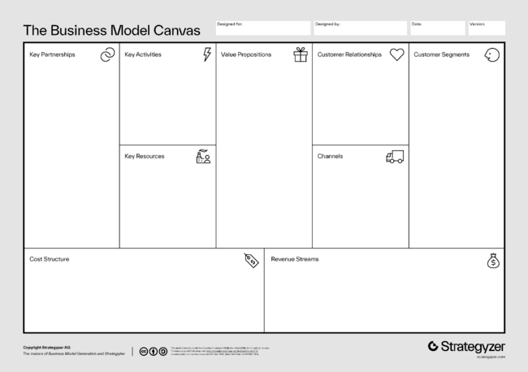
Business Model Canvas
Osterwalder
Business Model Canvas

Slide 46
BACKGROUND
Alexander Osterwalder (1974-)
Swiss entrepreneur and researcher developed the Business Model Canvas.
It is a practical framework to help entrepreneurs, startups, and established companies to visualise and innovate their business model.

Slide 47
KNOW YOUR BUSINESS
Key partnerships
Key activities
Key resources
Who are your existing partners, and what is the value?
What are the core activities in your business?
What resources are needed to deliver activities? Who are your key personnel?

Slide 48
KNOW YOUR BUSINESS
Value proposition
What is your business about? What is unique with your business? What problem do you solve?

Slide 49
KNOW YOUR BUSINESS
Customer relations
Customer segments
Channels
What is your relationship with your customers like? Are they loyal, or irregular?
Who are your customers? Can you distinguish between them?
How do you reach and interact with your customers, both existing and potential?

Slide 50
KNOW YOUR BUSINESS
Cost structure
Revenue streams
What are you paying for, and what are your key cost drivers?
From where do you derive your income?

Slide 51
There is plenty of possibilities for collaboration...
Osterwalder
Business Model Canvas

Slide 52
OVER TO YOU
Understand you own business
What is your core business? Which Sustainable Development Goals do you work towards?

Slide 53
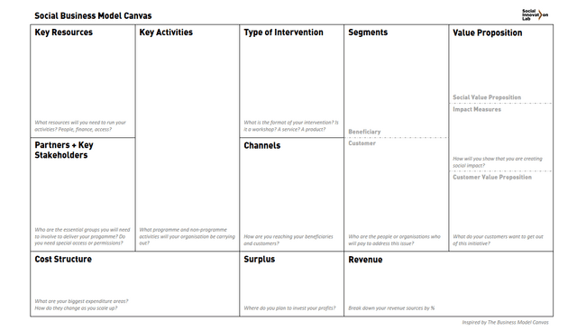
Business Model Canvas Example
When comparing social entrepreneurship with conventional entrepreneurship through the lens of the BMC, the primary differences lie in their core objectives, value propositions, and stakeholder relationships and extra section(s) of impact measurment is part of BMC for social enterprises. The Business Model Canvas (BMC) for social entrepreneurship often needs to adapt the standard model to better reflect the priorities and unique challenges of social ventures

Slide 54
THANK YOU

