Slide 1

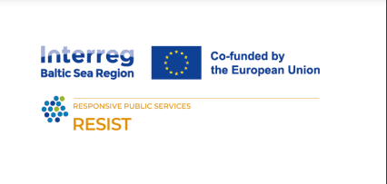
SOCIAL MINDSET AS A PART OF ORGANIZATIONAL CULTURE
Train the trainers

Slide 2


01.
What is organizational culture?
02.
Types of organizational values
03.
Aligning social values with organizational values
TABLE OF
CONTENT

Slide 3

Organizational culture consists of beliefs, values, and interaction methods that create an organization's environment.
Organizational culture reflects the foundational values of a company or business.
What is organizational culture?
Notes:
3

Slide 4


Why organizational culture is important?
- strong organizational culture helps to increase employee engagement.
- strong organizational culture helps to keep talent and decrease turnover.
- strong organizational culture makes recruitment easier.
- strong organizational cultures are more productive.

Slide 5

What are organizational values?
- these are core principles that guide an organization’s actions and decisions.
- they reflect the company’s mission, vision, and goals.
-they are serving as a framework for creating a cohesive and productive work environment.
Notes:
5

Slide 6







How to process social values alignment?
If personal values align, a person becomes culturally fit, contributing to the cohesive workplace where employers share common goals, communicate seamlessly and collaborate effectively.
Personal values interact with company's values and contribute to the overall culture of the company
When joining a company....

Slide 7

Current trends of organizational culture
COVID‘s biggest impact on organizational culture happened in early 2020 and now we have “a new normal“. *
What has changed?

Slide 8


New trends (challenges) in organizational culture
1. Working at the office is no longer a default
Traditionally, companies have assumed that all employees will regularly gather in a single physical office. This makes it easy to hold meetings, plan events, or just casually chat with people in the hallway. These interactions are the main drivers of your organizational culture.
Challenges:
-Have to think about hybrid teams and remote workers
-How to connect hybrid teams and fully remote workers
-Is it still one organizational culture or is necessary to develop a distinct one for remote staff?
Notes:
29

Slide 9

New trends (challenges) in organizational culture
2. Healthy work-life balance is as important as a salary
After the lockdown, the employees are not content to trade their well-being for a great salary. After spending more time at home during the pandemic, many people realize that they need to focus on their family and overall quality of life.
This means that fewer companies promote a result-focused culture.
Challenges:
To provide a safe and sustainable working environment with a lower rate of employee burnout
sary to develop a distinct one for remote staff?
Notes:
29

Slide 10
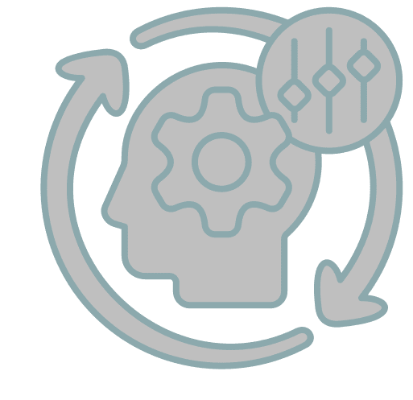
New trends (challenges) in organizational culture
3. Constant adaptability
The pandemic has shown that everyone must be able to adapt to changing circumstances. Ongoing challenges (like digital transformation, AI, etc.) make it more important to be flexible.
Challenges:
To make all of the teams to be more dynamic;
Focus on candidates with soft skills like adaptability, flexibility, willingness to learn, and critical thinking;
Communication is a key;
Notes:
29

Slide 11

New trends (challenges) in organizational culture
4. Honesty and trust
Open communication is a must-have quality in any organizational culture.
Things were already trending this way before the pandemic. Gen Z employees prefer non-hierarchical structures, which means that they want a manager who communicates openly
Notes:
29

Slide 12

Honesty has always been the best policy, but now it's the only policy“.
Benjamin Franklin
Notes:
29

Slide 13

How to align social values with organizational values?

Slide 14

Align social values with organizational values. Step by step:
1. Define organizational values:
Start by clearly defining the core values of the organization. These values should reflect what the company stands for, its purpose, and its commitment to various stakeholders, including customers, employees, and the community.

Slide 15

Align social values with organizational values. Step by step:
2. Define social values important to your organization:
Identify and understand what social values are relevant to your organization and your stakeholders. This may include f.e. environmental sustainability, community engagement, social justice, etc.

Slide 16

Align social values with organizational values. Step by step:
3. Access alignment:
Evaluate how well existing organizational values align with identified social values. Identify areas of alignment as well as gaps and any inconsistencies between these two sets of values.

Slide 17

Align social values with organizational values. Step by step:
4. Integrate social values into strategic values:
Integrate social values into your strategic planning process. Consider how social issues can transform business decisions, goals, and priorities across all functions and levels of organizations.

Slide 18
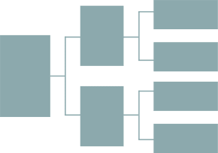
Align social values with organizational values. Step by step:
5. Develop policies and practices:
Formulate comprehensive policies strategies and initiatives that demonstrate the organization‘s dedication to societal principles. This may encompass the adoption of sustainable practices, advocating the diversity of inclusiveness in the recruitment process as well as backing community involvement programs.

Slide 19

Align social values with organizational values. Step by step:
6. Communicate and educate:
Develop effective communication strategy, and campaign showing dedication to social values both internally and externally. Develop training programs for employees, emphasizing the significance of social values and illustrating how they are harmonized with the organization‘s mission.

Slide 20

Align social values with organizational values. Step by step:
7. Measure and track progress:
Set KPIs to measure progress, track performance and make adjustments as needed, work together with outside organizations.

Slide 21

Align social values with organizational values. Step by step:
8. Set an example for others to follow:
Show your dedication to social values by leading with actions and decisions.
.

Slide 22


SUMMARY
Organizational culture is what holds an organization together, allowing it to stay focused on its goals.
In normal circumstances, organizational culture tends to be steady and stable, but sometimes an unforeseen event hits the organizational culture.
Notes:
28

Slide 23


THANK YOU

