Slide 1

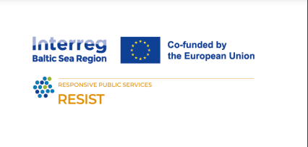

CRAFTING WIN-WIN COLLABORATIONS
IN SOCIAL ENTREPRENEURSHIP
Train the trainers

Slide 2

01.
HOW TO GET A WIN-WIN COLLABORATION
What it is? How to find the right partner?
02.
PRACTICAL EXAMPLES
What are some case studies?
03.
GUIDELINES FOR A GOOD EXPERIENCE
What to do? What not to do?
TABLE OF
CONTENT

Slide 3

01.
HOW TO GET A WIN-WIN COLLABORATION
What it is? How to find the right partner?

Slide 4
“A "win-win" collaboration is a cooperative arrangement
where all partners benefit
from the relationship. ”

Slide 5


WHY WIN-WIN?
01
02
03
04
LEVERAGE RESOURCES
SHARE EXPERTISE
INCREASE CREDIBILITY
RISK MITIGATION
Collaborations help social enterprises access partners' resources, enabling both to gain more than they could alone.
Partnerships facilitate knowledge transfer and skill exchange, fostering innovation and growth in social enterprises.
Collaborations with established organizations can boost credibility, enhancing public trust and attractiveness to investors.
Risks can be shared and managed, making ventures less uncertain and more resilient, particularly beneficial in high-risk projects.

Slide 6

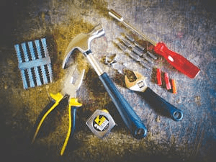

Alignment with Your Goals
The collaboration should align with and support the larger goals of your social business. This means that it should contribute to your enterprise's values and mission.
Partner's Resources and Capabilities
A potential partner's resources and capabilities should complement your enterprise's needs. This could be financial resources, human skills, technology, or market access.
Shared Objectives and Benefits
When choosing a partner, it's crucial to ensure that both parties share common objectives and that the collaboration offers mutual benefits.
CHOOSING COLLABORATION

Slide 7



Commitment
Both partners should be committed to the collaboration and the shared social mission. This commitment includes allocating necessary resources, time, and effort.
Communication
Open and regular communication is key to understanding expectations, discussing progress, and addressing issues. It ensures transparency and helps to build trust.
Trust
Trust is the foundation of any strong partnership. Each party must have confidence in the other's integrity and ability to fulfill promises.
NEEDED IN A COLLABORATION

Slide 8




MAPPING POTENTIAL PARTNERS
Step 1 - Identification
Step 3 - Analysis
Start by identifying critical stakeholders that you are already connected to or that you aim to connect with.
Analyze each member's influence, resources, and relevance to your social business.
Step 4 - Link Establishment
Step 2 - Categorization
Establish the links between these stakeholders and your social business. This could be current or possible partnerships, mentorship, funding relationships, etc.
Categorize these stakeholders based on their roles: partners, funders, advisors, etc.

Slide 9




EVALUATING POTENTIAL PARTNERS
Mission Alignment
Capabilities
The potential partner's mission should align with yours. A shared mission ensures common ground and mutual understanding.
Evaluate the capabilities of the potential partner - their skills, expertise, and resources. These should complement your enterprise's abilities and needs.
Reputation
Potential Synergies
A partner's reputation can impact your business. A well-regarded partner can enhance your credibility, while a poor reputation can harm your enterprise.
Look for potential synergies - areas where you can work together to achieve more than you could individually. This could be joint projects, shared markets, or resource pooling.

Slide 10
02.
PRACTICAL EXAMPLES
What are some case studies?

Slide 11



STORY OF
IMPACT DAY & SEB
Impact Day is Baltic’s & Nordic’s biggest sustainability festival, operating as a social business.
Impact Day & SEB have had a successful “win-win” collaboration for two years in a row and continuing it.
Let’s look into how it came to life.
SEB is a universal bank, offering full financial services to large, small and medium-sized companies, the public sector and private individuals.

Slide 12


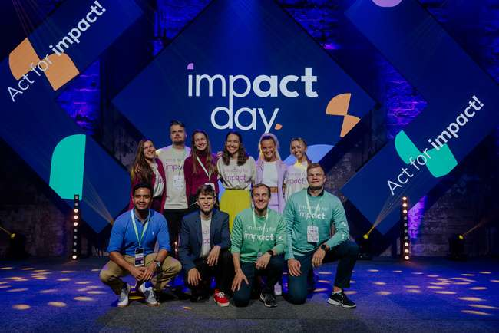
HOW IT STARTED
Impact Day began its operations in 2022 and wanted to have like-minded partners who would lead the way in sustainability topics.
So they compiled a list of companies who had been recognized for their efforts and/or dealing with the topic publicly.
SEB was one of those.

Slide 13
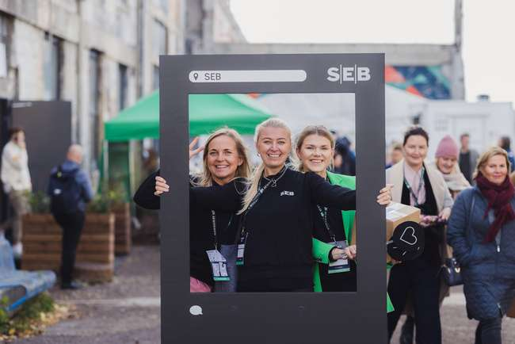
GETTING TO “WIN-WIN”
As one of the team members had already had a contact in SEB, he reached out and arranged a video meeting.
First they agreed that they had a common goal - to make sustainability a normality.
Through the calls they then evaluated what things SEB would like to achieve, but would need help for, and vice versa.

Slide 14
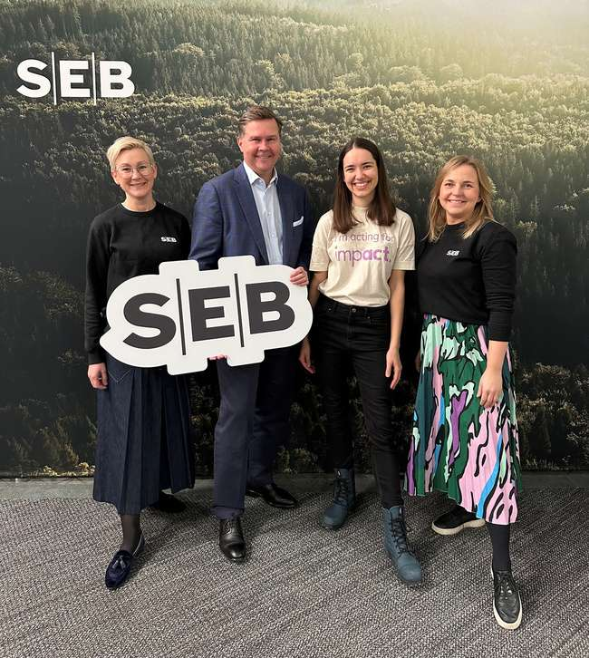
KEEPING THE GOOD FLOW
From the result of the calls, Impact Day agreed to help SEB with reaching a larger audience to position themselves as a brand who deals with sustainability & SEB in return supported financially and with spreading the word about the festival.
Thanks to a good experience, SEB & Impact Day have decided to continue their collaborationship.

Slide 15


STORY OF
RINGO ECO & ITELLA SMARTPOST
Ringo’s mission is to eliminate disposable packaging waste by developing open platform for reusable packages.
A good example of how to combine your expertise and gain value from it.
Together they established a project called “Tango” - first e-commerce packaging circulation system.
Itella Smartpost is an international logistics company.

Slide 16


STORY OF
FITLAP & PEETRI PIZZA
Fitlap is a virtual diet plan that helps people lose weight and teaches them how to eat healthily.
How one brand can help another and vice versa -
Fitlap & Peetri Pizza devised two new pizzas and pastas to Peetri Pizza’s menu that would be healthy and align with Fitlap’s recommendations.
Peetri Pizza is a franchise chain of nearly 50 pizzerias in Estonia.

Slide 17
03.
GUIDELINES FOR A GOOD EXPERIENCE
What to do? What not to do?

Slide 18
HOW TO BUILD RELATIONSHIPS?
INVEST IN IT
FOSTER RESPECT
PROMOTE CULTURE
Spend time getting to know your partners. Strong relationships are the foundation of a successful collaboration.
Respect each partner's expertise, perspectives, and contributions. This encourages open dialogue and fruitful cooperation.
Cultivate a culture that values collaboration, embraces diversity, and promotes shared decision-making.

Slide 19
HOW TO MAINTAIN MOMENTUM?
CELEBRATE
LEARNE
RESOLVE
Celebrate shared successes and milestones to foster a sense of accomplishment and reinforce the collaboration's value.
Treat the collaboration as a learning journey. Reflect on experiences, learn from challenges, and continually strive to improve.
Disagreements are natural. Address them openly and constructively, and seek mutually beneficial resolutions.

Slide 20
CLEAR COMMUNICATION
MUTUALLY BENEFICIAL TERMS
Transparency and open dialogue foster trust and ensure all parties are aligned throughout the partnership.
Ensure that all parties derive value from the collaboration to maintain engagement and commitment.
WHAT TO DO
Collaborations are more productive when all partners share a common goal and vision.
Regular engagement keeps stakeholders informed and invested in the collaboration.
HAVE A SHARED VISION
ENGAGE REGULARLY

Slide 21
IGNORE THE POWER DYNAMICS
UNDERESTIMATE TRUST
Power imbalances can undermine the collaboration; ensure all parties have equal say and participation.
Building trust takes time, but it's the foundation of any successful collaboration.
WHAT NOT TO DO
Clearly outline roles, responsibilities and expectations to avoid disputes.
Goals and objectives can evolve over time, ensure regular alignment check-ins.
SKIP THE AGREEMENTS
ASSUME STATIC DEVELOPMENT

Slide 22
04.
PRACTICAL PART
(Mapping YOUR potential partners and collaboration TODAY)

Slide 23
PRACTICAL PART: MAPPING YOUR POTENTIAL PARTNERS (1)
Step 1 - Identification
Who would You like to collaborate with?
Why would You like to collaborate with them?
Why would they like to collaborate with You?
What is Your united mission?
Who are the critical stakeholders that you are already connected to?
Any important networks of communities that You should
  - belong to before the collaboration?
  - ask advice from?

Slide 24
PRACTICAL PART: MAPPING YOUR POTENTIAL PARTNERS (2)
Step 2 - Categorization
Please categorize these stakeholders based on their roles. Are they:
partners,
funders,
advisors; also business support organizations and networks.
Describe their (and your):
skills,
expertize,
resources.

Slide 25
PRACTICAL PART: MAPPING YOUR POTENTIAL PARTNERS (3)
Step 3 - Analysis
Please map and think about the potential
influence;
outcome;
resources needed and provided;
relevance to Your business;
relevance to their business.
Describe the potentsial outcome
Joint projects?
Shared markets?
Resource pooling?

Slide 26
PRACTICAL PART: MAPPING YOUR POTENTIAL PARTNERS (4)
Step 4 - Link Establishment
Please make a communication plan concerning contacting
  Current or possible partners,
  mentors,
  funding relationships, etc.
  Set the deadline!

Slide 27
REMEMBER:
Mission Alignment
Capabilities
The potential partner's mission should align with yours. A shared mission ensures common ground and mutual understanding.
Evaluate the capabilities of the potential partner - their skills, expertise, and resources. These should complement your enterprise's abilities and needs.
Reputation
Potential Synergies
A partner's reputation can impact your business. A well-regarded partner can enhance your credibility, while a poor reputation can harm your enterprise.
Look for potential synergies - areas where you can work together to achieve more than you could individually. This could be joint projects, shared markets, or resource pooling.

Slide 28

SHARING COLLABORATION PLANS
(in pairs or in groups)

Slide 29
THANK YOU
What questions do you have?

