Slide 1

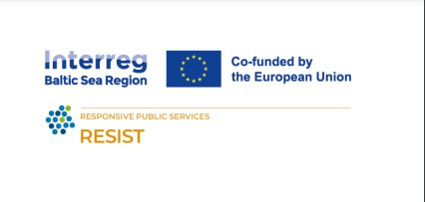

SOCIAL BUSINESS VS CORPORATE SOCIAL RESPONSIBILITY
SOCIAL BUSINESS AS A VALUE
Train the trainers
The RESIST project is co-financed by the European Union (European Regional Development Fund) under the Interreg Baltic Sea Region Programme.

Slide 2


01.
SOCIAL BUSINESS: DEFINITION
02.
CORPORATE SOCIAL RESPONSIBILITY: DEFINITION, MEANING, TYPOLOGY
03.
SIMILARITIES BETWEEN SB AND CSR
04.
DIFFERENCES BETWEEN SB AND CSR
TABLE OF
CONTENT

Slide 3



WHAT IS SOCIAL BUSINESS
Created and designed to address a social problem
Financially-self sustainable
Profits are reinvested in the business itself

Slide 4
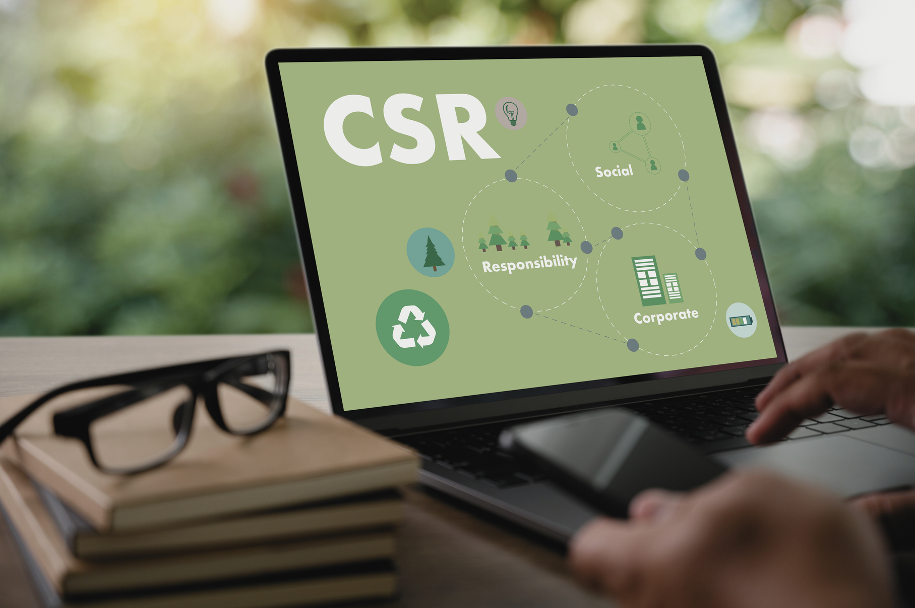
CORPORATE SOCIAL RESPONSIBILITY
A self-regulating business model that helps a company be socially accountable to itself, its stakeholders and the public.

Slide 5

WHAT SOCIALLY RESPONSIBLE MEANS
Organizations are often guided by a concept which dictates that a business should be committed to measuring its social and environmental impact, sustainability efforts, and profits.
A measure of success in today’s world includes corporate social responsibility

Slide 6


TYPES OF CORPORATE SOCIAL RESPONSIBILITY*
01
Philanthropic responsibilily
02
Ethical responsibility
03
Legal responsibilily
04
Economic responsibilily
*based on Carroll’s pyramid of CSR (found on .J Driver, 2021 https://selflessly.io/types-of-corporate-social-responsibility/

Slide 7

PHILANTHROPIC RESPONSIBILITY
Businesses are expected to give back to their communities.
This is not an obligation or law for most countries.
A company can donate part of the profits Philanthropic does not always have to be money that is donated: teams can donate time or products.

Slide 8

ETHICAL RESPONSIBILITY
Ethics go beyond a certain region’s laws and follow the social or cultural norms of that area.
A company should not just obey the law, but also be willing to do business ethically. Although this is not an obligation for the company, it is in the best interests.

Slide 9

LEGAL RESPONSIBILITY
This defines a company’s responsibility to follow all the laws and regulations that apply to the business operations

Slide 10

ECONOMIC RESPONSIBILITY
CSR includes the need to be profitable. The economic responsibility creates a balance between the next 3: ethical, legal, and philanthropic responsibilities. A company needs to survive in order to support the community. Economic responsibility is overall a positive. We see the negative side to this layer when a company maximizes profits above all other responsibilities.

Slide 11

ENVIRONMENTAL RESPONSIBILITY
(OUT OF typology but also important)
Environmental responsibility is the belief that organizations should behave in as environmentally friendly a way as possible. It’s one of the most common forms of CSR.

Slide 12
Social business and corporate social responsibility (CSR) share several similarities

Slide 13

SIMILIARITIES
Focus on social impact
Stakeholders engagement
Integration of environmental and social objectives

Slide 14

FOCUS ON SOCIAL BUSINESS
Aiming to address societal challenges, such as poverty, inequality, environmental degradation and community development through their business activities and initiatives

Slide 15

STAKEHOLDERS ENGAGEMENT
Importance of engagement with various range of stakeholders, including employees, customers, suppliers, communities, and investors in decision-making processes

Slide 16

INTEGRATION OF ENVIRONMENTAL AND SOCIAL OBJECTIVES
Business success is not solely measured by profitability but also by its contribution to social welfare and environmental sustainability

Slide 17
SIMILIARITIES (II)
Transparency and accountability
Innovation and collaboration
Ethical business practices

Slide 18

TRANSPARENCY AND ACCOUNTABILITY
Open communication about their social and environmental performance, including successes, challenges, and areas for improvement for stakeholders

Slide 19

ETHICAL BUSINESS PRACTICES
Integration of ethical principles such as honesty, fairness, respect for human rights, and legal and regulatory requirements into daily work, and setting positive examples for others.

Slide 20

INNOVATION AND COLLABORATION
Encourage innovation and collaboration to address societal and environmental challenges and to develop sustainable solutions that benefit both organization and society

Slide 21



MAIN DIFFERENCES BETWEEN SOCIAL BUSINESS AND CSR

Slide 22


DIFFERENCES
Purpose and core focus
Ownership and structure
Business model
Long term sustainability
Accountability and governance

Slide 23


PURPOSE AND CORE FOCUS
Social business
CSR
Designed to address social or environmental issues through its core activities
Refers to voluntary initiatives and activities that organizations undertake to improve social and environmental outcomes beyond their core business operations

Slide 24


BUSINESS MODEL
CSR
Focused on maximizing profitability for shareholders

Slide 25

BUSINESS MODEL
SOCIAL BUSINESS
Prioritize social impact over profit maximization

Slide 26

OWNERSHIP AND STRUCTURE
SOCIAL BUSINESS
Various legal structures

Slide 27

OWNERSHIP AND STRUCTURE
CSR
Typically implemented by corporations

Slide 28

SUSTAINABILITY
Social business
Prioritize long-term sustainability for reinvesting profit into the business

Slide 29

SUSTAINABILITY
CSR
Initiatives may not by financially sustainable in a long term as they are often funded through f.e. donations

Slide 30

ACCOUNTABILITY AND GOVERNANCE
Social business
Accountable for a broader range of stakeholders, including investors, beneficiaries and the community.

Slide 31
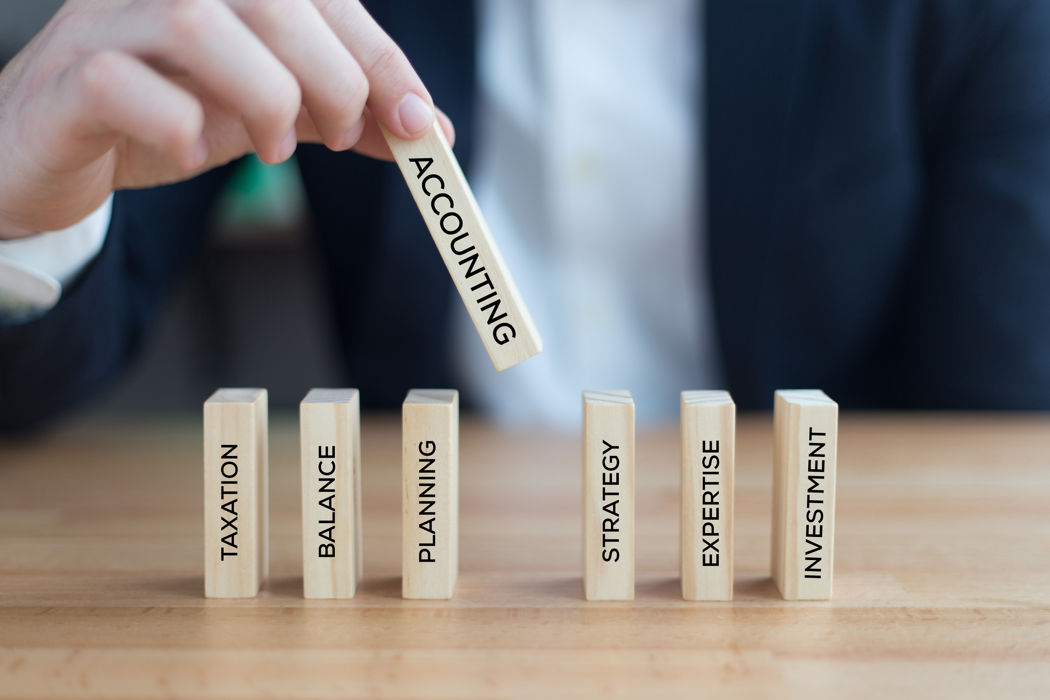
ACCOUNTABILITY AND GOVERNANCE
CSR
Initiatives are typically governed internally by the leadership

Slide 32

SUMMARY
While both social business and corporate socially responsible companies aim to contribute to asocial and environmental well-being, they differ in their primary focus, business models, ownership structures, sustainability approaches, and governance mechanisms.

Slide 33

SUMMARY (II)
Social business integrates social impact into its core business model, while CSR involves supplementary initiatives that may or may not be directly linked to the organization's profitability.

Slide 34

THANK YOU

