Slide 1

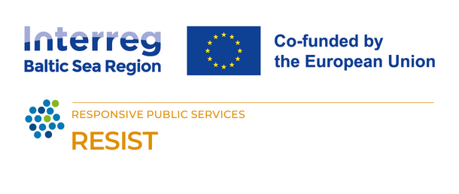

DIFFERENT FORMS OF SOCIAL ENTERPRISE
Train the trainers
The RESIST project is co-financed by the European Union (European Regional Development Fund) under the Interreg Baltic Sea Region Programme.

Slide 2
01.
SOCIAL ECONOMY AND ITS DEVELOPMENT
02.
CONVENTIONAL VS SOCIAL ENTERPRISE
03.
LEGAL FORMS AND TYPES OF SOCIAL ENTERPRISES
04.
MARKET & TREND
TABLE OF
CONTENT

Slide 3
01.
SOCIAL ECONOMY AND ITS DEVELOPMENT

Slide 4

WHAT IS SOCIAL ECONOMY?
The social economy is an important part of the European social-economic model. It includes a large variety of stakeholders, such as cooperatives, foundations, social start-ups, social enterprises etc.
They operate a broad number of activities, provide a wide range of products and services across the European market and generate millions of jobs.

Slide 5

The term “social entrepreneurship” for a long time has been perceived as a synonym of charity.
Over the past years, social entrepreneurship has received great recognition not only in the academic environment but also in the business field, especially among those entrepreneurs who are looking for meaningful business ideas as well as the possibility to impact social processes.

Slide 6


Social entrepreneurship is a form of business that aims to solve social or environmental problems while creating value for both society and the bottom line.
It is not just about donating money or volunteering time, but about finding innovative and sustainable solutions that can benefit multiple stakeholders.

Slide 7

SOCIAL ECONOMY IN EUROPE
Social enterprises play a substantial role in employment across the EU. They provide jobs to millions of people, including vulnerable or marginalized groups such as individuals with disabilities or long-term unemployed individuals. Estimates suggest that social enterprises employ millions of people across the EU, contributing to job creation and economic growth.
10%
OF COMPANIES IN EUROPE
Employing more than 11 million

Slide 8


EU definition of a social enterprise defines a social enterprise as an enterprise that combines a social mission with entrepreneurship and focuses on achieving wider social, environmental or community objectives.
Its main objective is to have a social impact rather than make a profit for its owners or shareholders (European Commission, 2021).
This definition of a social enterprise is common for all EU Member States. However, each country has the right to implement legislation in which all aspects related to social entrepreneurship as well as social enterprises are defined.

Slide 9
02.
CONVENTIONAL VS SOCIAL ENTERPRISE

Slide 10
Conventional enterprises and social enterprises differ primarily in their primary objectives and how they prioritize the use of their profits.
SOCIAL
Social enterprises have a dual mission: to achieve social or environmental objectives while also generating revenue. Their primary goal is to create a positive social or environmental impact, and any profits generated are typically reinvested back into the enterprise or used to further its social mission.
CONVENTIONAL
The primary objective of a conventional enterprise is to generate profits for its owners or shareholders. While they may engage in corporate social responsibility (CSR) initiatives, their primary focus is on maximizing financial returns.

Slide 11
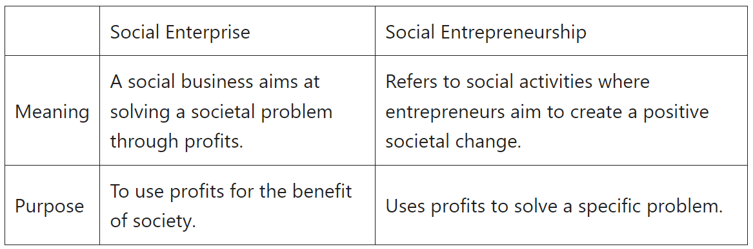

Slide 12




Social impact
Employment
Profit generation
Parent company

Slide 13
TYPES OF OWNERSHIP
Public ownership
Private ownership
In most counties nonprofits are considered "public good" or property of the public
Social enterprise offers benefits of equity financing
Becomes an issue if the owner(s) wants to sell the social enterprise, or close it
For-profits limiting the type and purpose of the enterprise to more productive and financially driven models
To serve for a social need, yet to run at a deficit

Slide 14

Do you have a social purpose?
Is it important to be closely aligned with and striving towards social, political, or environmental causes?
How important is it for you?
How will you raise your income?
Grants? Donations? Loans?
Who do you want to have control or ownership?
Do you want to have firm control over the organisation? Do you want to involve others? Do you want to give employees some ownership?
Look at the questions, some will be vital to your project, others more peripheral, and some may not matter to you at all.
What message do you want to give?
Do you want to be “branded” as a social enterprise? Do you want to be seen to be charitable? Or maybe you don’t want your clients to be “charity cases”?
Getting tax benefits
Are there tax benefits that you need to access? Are they vital or just nice if you can get them?
Ongoing bureaucracy
Can you cope with the relevant bureaucracy – can you risk getting fined if you fail to?

Slide 15

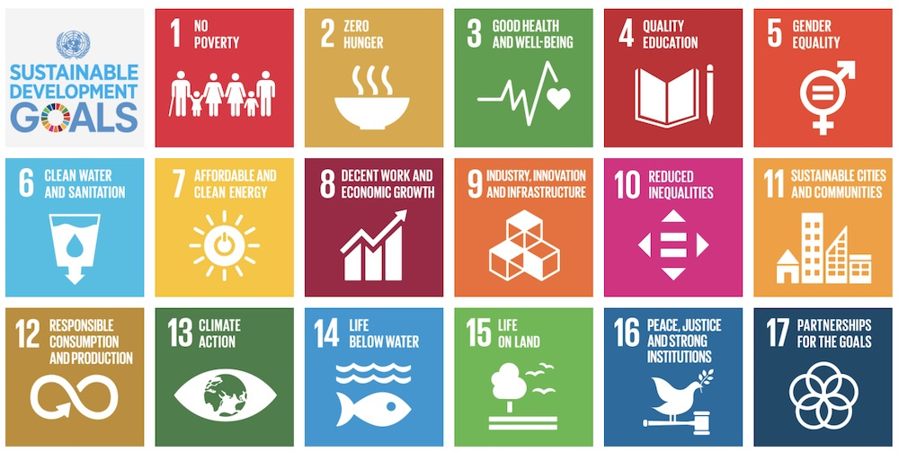


SOCIAL ENTERPRISE OR NON-PROFIT?
Income meets social causes
Earns profit by selling a product or service
Raising money for a social venture through investors

Slide 16




How different it can be?
Non-profit organizations
Socially responsible business, not centring their entire business model around their cause
Non-Governmental organizations
Social firm
Cooperative
(business organized by and for its members. )
For-profit organizations

Slide 17
03.
LEGAL FORMS AND TYPES OF SOCIAL ENTERPRISES

Slide 18





  Non-profit social enterprises
  For-profit social enterprises
  Hybrid models

Slide 19

  NON-PROFIT SOCIAL ENTERPRISES
  Nonprofit social entrepreneurs focus on the organization’s social, not financial, impact.
  Social entrepreneurs start a non-profit organization to answer a need in the community or a larger cause.
  Instead of making significant amounts with their organization, they’ll reinvest the profits into the business to ensure its long-term success.

Slide 20

CHARITIES
Organizations rely on donations, grants, and fundraising efforts to support their social mission.
They often provide services or aid to address specific social issues or community needs.

Slide 21

FOUNDATIONS
Foundations use endowments or donations to fund social initiatives, such as educational programs, healthcare services, or poverty alleviation projects.

Slide 22

SOCIAL ADVOCACY ORGANIZATIONS
Organizations that work to promote social causes or advocate for policy changes.
They may generate revenue through donations, membership fees, or grants.

Slide 23

2. FOR-PROFIT SOCIAL ENTERPRISES
  For-profit social enterprises are businesses created to further a social purpose in a financially sustainable way.
  For-profit social enterprises seek to maximize profits while maximizing benefits to society and the environment.
  A for-profit company exists to make a profit for its owners or shareholders.

Slide 24

SOCIALY RESPONSIBLE BUSINESS
Businesses that integrate social and environmental considerations into their operations, aim to minimize negative impacts and maximize positive contributions to society.

Slide 25

COOPERATIVES
Worker-owned cooperatives or consumer cooperatives operate for the benefit of their members, who share ownership and decision-making.
Often prioritize social goals alongside financial sustainability.

Slide 26

SOCIALLY CONSCIOUS CONSUMER PRODUCTS
Companies produce and sell goods that address specific social or environmental issues. Examples include fair-trade products, organic foods, and eco-friendly consumer goods.
Often prioritize social goals alongside financial sustainability.

Slide 27

SOCIAL ENTERPRISES WITH A "BUY-ONE-GIVE-ONE" MODEL
Businesses that donate a product or service to a person in need for every product or service sold.

Slide 28

3. HYBRID MODELS
  A hybrid business model combines elements of different types of business models, such as for-profit, nonprofit, or cooperative, to achieve social and environmental impact as well as financial sustainability.
  A hybrid business model addresses complex social problems, creates value for multiple stakeholders, and diversifies their revenue streams

Slide 29

SOCIAL FRANCHISES
Organizations replicate successful social enterprise models across different locations or communities.
Franchisees may operate as for-profit businesses while adhering to the social mission and operational guidelines set by the franchisor.

Slide 30

COMMUNITY INTEREST COMPANIES
Social enterprises that operate as limited companies with a social purpose.
Required to reinvest their profits for the benefit of the community and have asset locks to ensure their assets are used for social good.

Slide 31
04.
MARKET & TRENDS

Slide 32

HAVE YOU NOTICED MORE GREEN, ECO-FRIENDLY, RECYCLABLE PRODUCTS?
The growth of sustainability and sustainable products and services has dramatically increased in the past few years.
Consumers are becoming increasingly aware of the impact of their purchasing decisions on the environment and are looking for more sustainable options. About 57% of consumers are willing to change their purchasing behaviour to help the environment, and 66% of consumers are willing to pay more for more sustainable brands, which explains the rise in demand for products that are more sustainable.

Slide 33

Social entrepreneurship and innovative and sustainable solutions is a dynamic and diverse field that spans different regions and industries, and that responds to the changing needs and opportunities of society.
It presents a significant opportunity for businesses to tap into this growing market, meet the demands of consumers and anticipate regulations to mitigate the impacts of industry on the environment.

Slide 34

From regenerative agriculture and sustainable fashion tech to eco-friendly packaging, circular services, and decentralized energy systems, these trends highlight the capacity of innovation to address pressing global challenges.
The success stories of companies like ImagiLabs, Ecouture, Euphonia, Walk15, and GreenGrid Energy demonstrate that sustainability is no longer an option but necessary for a more resilient and equitable future.
By embracing these trends and fostering collaborative efforts, you can pioneer a sustainable path towards a better world.

Slide 35
THANK YOU

