Slide 1



ASSESMENT OF CAPACITY
Train the trainers
The RESIST project is co-financed by the European Union (European Regional Development Fund) under the Interreg Baltic Sea Region Programme.

Slide 2

01.
NECESSITY AND TERMINOLOGY - TOOLS & METHODS
Know the challenge
02.
ASSESSMENT PROCESS
Learn to adapt
03.
KEY FEATURES AND TOOLS FOR CAPACITY ASSESMENT
SWOT, PESTLE and Value chain creation tools
04.
IMPLEMENTING OCA TOOLS
Steps taken to implement tools
TABLE OF
CONTENT

Slide 3

Key Takeaway: Understanding the critical role of capacity assessment in enhancing organizational effectivnes

Slide 4

Context
In a rapidly evolving business landscape, 63% of CEOs in a recent global survey stated that capacity assessment is crucial for their strategic planning and risk management.
The Necessity of Capacity Assessment in Today's Organizations
Global Trends
Organizations that conduct regular capacity assessments are 30% more likely to successfully adapt to market changes and technological advancements.
Future Outlook
With the rise of AI and machine learning, predictive analytics in capacity assessment is becoming a game-changer, offering deeper insights into organizational strengths and potential areas for growth.

Slide 5

Data Integration
Modern tools integrate data from diverse sources, providing a 360-degree view of organizational capacity. Companies leveraging integrated data report a 33% improvement in strategic decision-making.
Advanced Analytics in Capacity Assessment
Predictive Insights
Tools equipped with predictive analytics can forecast future capacity challenges, enabling proactive strategy adjustments. Organizations using these tools report a 20% reduction in unexpected operational bottlenecks.
Benchmarking Capabilities
Advanced tools now offer benchmarking against industry standards or competitors, with businesses using benchmarking reporting a 40% faster alignment with industry best practices.

Slide 6

Tailored Solutions
Customizable tools that adapt to specific organizational needs are on the rise, with a 50% increase in customization requests noted over the past two years.
Customization and Flexibility in Capacity Assessment Tools
Sector-Specific Insights
For instance, in the non-profit sector, tailored assessment tools have helped organizations increase their impact efficiency by up to 35% by identifying precise capacity-building areas.
User-Centric Design
Emphasis on user-friendly design in assessment tools has led to increased engagement and accuracy in self-assessments, with organizations noting a 25% increase in participation rates.

Slide 7
Adaptability Index
Develop an adaptability index to gauge the organization's responsiveness to market changes, with top quartile organizations showing 30% faster adaptation to new trends.
Measuring Adaptability for Sustainable Organizational Growth
Innovation Audit
Evaluate the organization's capacity to innovate, linking it to market competitiveness. Enterprises with high innovation scores report a 45% better market penetration.
Change Management Proficiency
Assess the effectiveness of change management protocols. Organizations with proficient change management report a 60% higher success rate in achieving transformational goals.

Slide 8

Capacity assesment - tools & methods
Let's discuss the difference?

Slide 9
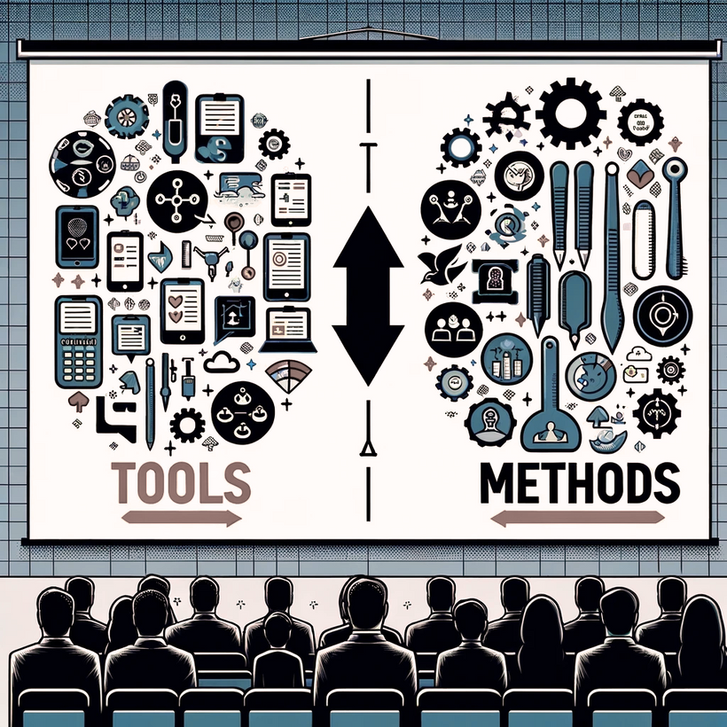
Capacity assesment methods & tools

Slide 10
Assesment methods
Capacity assessment methods encompass broader approaches or frameworks used to systematically evaluate and improve organizational capacity. Methods may involve strategic planning, continuous improvement models, or scenario planning.
Assesment tools
Capacity assessment tools typically refer to specific instruments, surveys, or software designed to quantitatively measure various aspects of an organization's capacity, such as performance metrics, employee engagement surveys, or technological analytics.

Slide 11
Defining capacity assessment
A capacity assessment within an organization refers to the systematic and strategic process of evaluating the organization's abilities, resources, and readiness to perform and achieve its goals.
Capacity
assessment
Why do we do that?
The aim is to understand the current capabilities and identify gaps that need to be addressed to enhance performance, efficiency, and effectiveness in meeting its objectives.

Slide 12


Methods
Qualitative Assessments: methods like interviews, focus groups, and expert panels to gather in-depth insights into organizational dynamics and nuances.
01
More generalised approaches characterised by specific tools or techniques.
Quantitative Assessments: Use surveys, statistical analysis, and KPI evaluations to quantify aspects of organizational capacity and benchmark against quantifiable standards.
02
03
Mixed-Methods Assessments: Combine both qualitative and quantitative approaches for a robust and holistic understanding of organizational capacity.
Document Analysis: Review historical performance data, strategic plans, and operational documents to assess the alignment of resources with organizational goals.
04

Slide 13






Capacity assessment steps
01
02
03
04
ANALYZE
IDENTIFY
DEVELOP
IMPLEMENT
existing capabilities against the desired outcomes.
gaps between current capacities and those needed to achieve strategic goals (e.g. spider/radar chart; PESTEL etc.).
a plan to address identified gaps, which may include training, restructuring, or resource allocation.
changes and monitoring progress to ensure continuous improvement.

Slide 14
CAPACITY ASSESMENT tools
Organizational Capacity Assessment (OCA) tools are instruments used to evaluate an organization's ability to fulfil its mission effectively.
They help in identifying areas of strength and pinpointing opportunities for growth. These tools can be questionnaires, checklists, interviews, or software applications designed to measure various aspects of organizational health and readiness.

Slide 15




Four most often used Organizational Capacity Assessment (OCA) Tools
Self-Assessment Questionnaires:
360-Degree Feedback Systems:
Performance Metrics Dashboards:
SWOT/PESTEL
A strategic planning framework(s) used to identify external and internal capabilities, opportunities,gaps and challenges (details to follow).
Facilitate internal review and reflection on organizational practices and policies.
Gather comprehensive feedback from all levels of the organization, including peers, subordinates, and supervisors.
Visual tools that track and display key performance indicators (KPIs) over time.

Slide 16
Key features of effective OCA Tools
What Makes an OCA Tool Effective?
Comprehensive: Covers all critical areas of organizational function, from leadership to financial management.
User-Friendly:
Easy to use and understand, facilitating widespread participation and accurate responses.
Adaptable:
Can be customized to fit the unique context and needs of different organizations.
Action-Oriented: Provides clear guidance on how to address identified weaknesses and build on strengths.

Slide 17





Future of OCA Tools
The Evolving Landscape of OCA Tools
01
Technology Integration: Leveraging AI and machine learning for predictive analytics and more nuanced assessments.
02
Customization and Flexibility: The shift towards more adaptable tools that cater to diverse organizational needs.
03
Employee Engagement: New tools focusing on employee satisfaction and retention as key capacity indicators.
04
Sustainability Metrics: Incorporation of environmental and social governance (ESG) factors into capacity assessments.

Slide 18

Tools for internal and external capacity assessment (focus on SWOT & PESTEL)

Slide 19
SWOT and PESTEL and numerous other tools and methodologies designed to assess and enhance internal capacity, from resource audits and performance metrics to advanced analytical software are capacity assessment tools.
We will explore some of these tools to provide a holistic approach to internal capacity assessment.
What are Classical Internal and external capacity assessment Tools?

Slide 20

Conducting SWOT Analysis:
Conducting a SWOT analysis involves gathering and evaluating pertinent data through diverse methods including surveys, interviews, document reviews, or direct observations.
Subsequently, categorize this data into four segments: strengths, weaknesses, opportunities, and threats. Utilizing a table or matrix can be effective for presenting this categorized information.
The concluding step entails identifying the key or pivotal factors and formulating strategies to capitalize on strengths, address weaknesses, seize opportunities, and counteract threats.

Slide 21
SWOT
Analysis
STRENGTHS:
OPPORTUNITIES:
Identification of Core Competencies: It helps in identifying the core competencies and resources of the organization or team, such as skilled workforce, intellectual property, efficient processes, etc.
Market and Environmental Opportunities: It identifies external opportunities such as emerging market trends, technological advancements, or changes in regulatory landscapes that the organization or team can capitalize on.
WEAKNESSES:
THREATS:
Identifying Areas for Improvement: Recognizing the internal areas where the organization or team is lacking, provides a clear direction for capacity building and resource allocation.
Identifying Potential Challenges: It identifies external challenges that could pose a risk to the organization or team, including competitive pressures, market volatility, and regulatory changes.

Slide 22
PESTEL analysis is another strategic tool that can be used for capacity assessment, focusing on macro-environmental factors that could impact an organization's operations.

Slide 23
PESTEL Analysis
POLITICAL FACTORS:
SOCIAL FACTORS:
ENVIRONMENTAL FACTORS:
Government Policies and Stability: Evaluate how government policies, political stability or instability, and interventions (like trade tariffs, fiscal policy, etc.) could affect the organization.
Cultural and Demographic Trends: Analyzes social trends, including shifts in demographics, consumer behaviours, and cultural attitudes, that could affect the market and organizational capacity.
Sustainability and Environmental Regulations: Considers environmental issues such as climate change, recycling requirements, and carbon footprint management, affecting operational capacity.
ECONOMIC FACTORS:
TECHNOLOGICAL FACTORS:
LEGAL FACTORS:
Market Trends and Economic Indicators: Considers the impact of economic trends, such as inflation rates, interest rates, economic growth patterns, and exchange rates, on organizational capacity.
Innovation and Technological Advancements: Identifies new technologies, innovation, and the rate of technological change that could impact the organization’s operations and market.
Compliance and Legal Obligations: Identifies legal landscapes, including employment laws, health and safety regulations, and consumer protection laws, that the organization must navigate.

Slide 24
Value chain analysis. This tool assesses internal activities to understand where value is added within an organization and where inefficiencies lie, providing insights into internal operations.

Slide 25
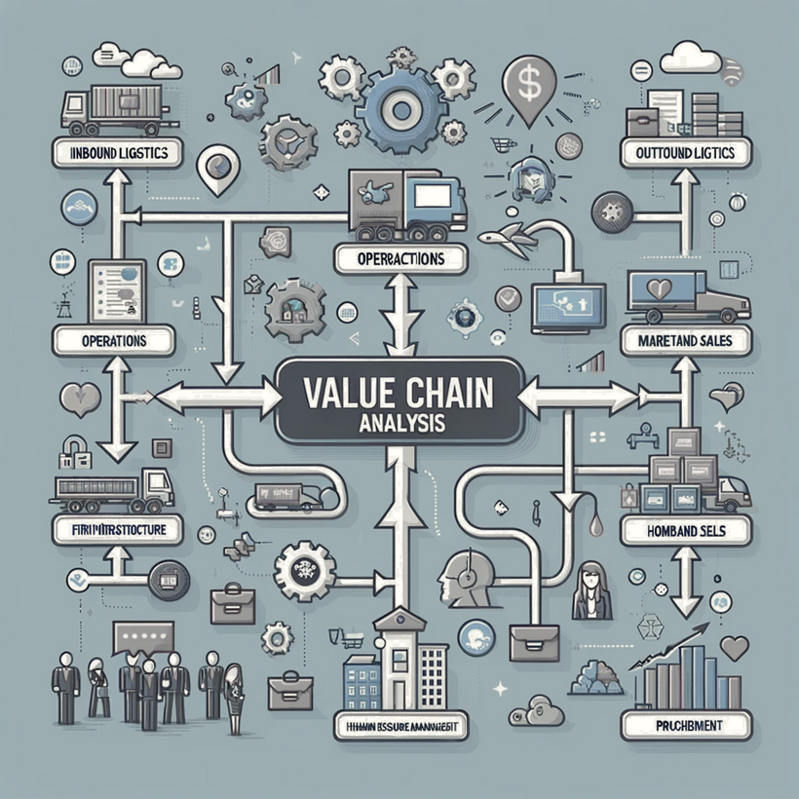
Value chain analysis
Value Chain Analysis is a strategic tool that dissects an organization's activities to identify where value is added and where efficiencies can be improved, aiming to enhance competitive advantage and operational effectiveness.
Editable version: https://online.visual-paradigm.com/knowledge/strategic-analysis/best-online-value-chain-analysis-diagram-tool/

Slide 26
Organizational Capacity Assessment Tool (OCAT). Developed by McKinsey for nonprofit organizations, this tool can also offer valuable insights for social enterprises. It helps organizations assess their strengths and areas for improvement across several dimensions.

Slide 27

Organizational Capacity Assessment Tool (OCAT)
The Organizational Capacity Assessment Tool (OCAT) is designed to help organizations, particularly nonprofits, evaluate their strengths and weaknesses across various functional areas. This comprehensive tool enables organizations to identify areas where they need to build capacity to improve their effectiveness and achieve their strategic goals.
Online English version: https://online.visual-paradigm.com/knowledge/strategic-analysis/best-online-value-chain-analysis-diagram-tool/

Slide 28
Capacity assessment tool for micro and small enterprises (CANARI). A capacity assessment tool for micro and small enterprises is designed to evaluate the internal capabilities and readiness of these businesses to achieve their goals, manage growth, and respond to challenges. Given their size, such enterprises often face unique challenges and opportunities, making a tailored approach to capacity assessment vital.

Slide 29
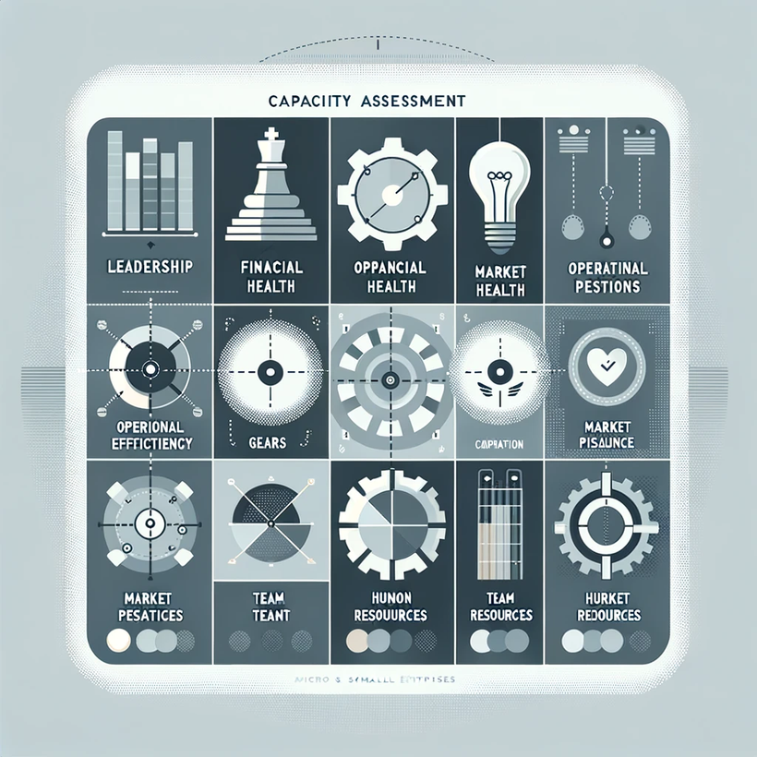
Capacity assessment tool for micro and small enterprises (CANARI)
Focused on addressing the unique challenges and leveraging the strengths of micro and small enterprises, CANARI provides a comprehensive assessment across key areas.
This tool aids in identifying gaps, highlighting strengths, and formulating targeted strategies for sustainable growth and resilience.
Online English version: chrome-extension://efaidnbmnnnibpcajpcglclefindmkaj/https://canari.org/wp-content/uploads/2020/06/CANARI-LGE-Radar-Toolkit.pdf

Slide 30
Capacity building toolkit

Slide 31
Toolkit for capacity development. The Toolkit for capacity development is a set of eight instruments, generally structured as a matrix, aimed at assessing sector and/or institutional capacity (actors, roles, processes and results).

Slide 32
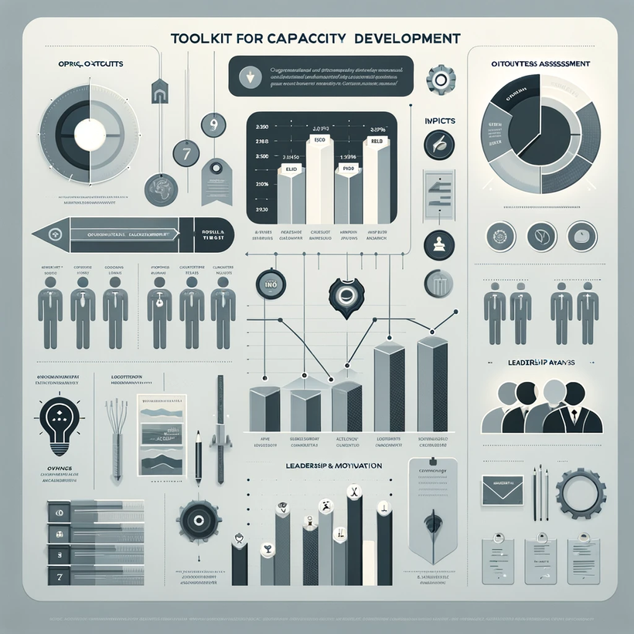
Toolkit for capacity development (focus on the Tool2)
The tool aims to ensure that the most critical areas of organisational capacity are considered when an assessment
is planned.
The checklist provides a structured approach for organizations to assess critical internal components, helping identify strengths and areas for improvement within the context of capacity building.
Online English version: chrome-extension://efaidnbmnnnibpcajpcglclefindmkaj/https://canari.org/wp-content/uploads/2020/06/CANARI-LGE-Radar-Toolkit.pdf (page 23)

Slide 33
What is the best approach to choose assessment tools ?
Let's discuss!

Slide 34
Implementing OCA Tools
Best Practices for Implementing OCA Tools
Inclusive Approach: Involve a broad range of stakeholders to get a full perspective.
Clear Communication: Ensure everyone understands the purpose and process of the assessment.
Regular Reviews: Conduct assessments at regular intervals to monitor progress and adapt strategies.
Follow-Up Actions: Develop and implement a plan to address the findings of the assessment for continuous improvement.

Slide 35





PRE-ASSESSMENT PREPARATIONS
Laying the Groundwork for Capacity Assessment
  OBJECTIVE SETTING
  TOOL SELECTION
  TEAM ASSEMBLY
  COMMUNICATION PLAN
  TIMELINE ESTABLISHMENT
  Clearly define what the assessment aims to achieve, aligning with the organization's strategic goals
  Choose the right OCA tools that suit the organizational context and the objectives of the assessment.
  Form a dedicated assessment team with a mix of skills and organizational knowledge to drive the process (may not be relevant for the micro companies).
  Develop a communication strategy to inform all participants about the purpose and process of the assessment.
  Set a realistic timeline for the assessment, allowing adequate time for each phase of the process.

Slide 36





Analyzing Assessment Results
Recognizing Weaknesses:
Benchmarking:
Objectively identify and acknowledge areas where the organization falls short in capacity.
Compare results against industry standards or similar organizations to contextualize performance.
Highlighting Core Competencies
Balanced Viewpoint:
Employee Insight Incorporation:
Utilize data to pinpoint the organization's inherent strengths and areas of competitive advantage.
Strive for a balanced assessment that appreciates positive aspects while being candid about areas needing enhancement.
Incorporate feedback from employees at all levels to ensure a multi-dimensional view of organizational capacity.

Slide 37

THANK YOU
Have any question?

