Slide 1



TECHNOLOGY FOR GOOD
Train the trainers
The RESIST project is co-financed by the European Union (European Regional Development Fund) under the Interreg Baltic Sea Region Programme.

Slide 2

01.
OVERVIEW OF TECHNOLOGIES
02.
THE IMPORTANCE OF TECHNOLOGIES
03.
CREATING A NEW TECHNOLOGICAL SOLUTION
04.
PROTOTYPING
05.
THE NEED FOR CHANGE
AGENDA

Slide 3




01
Understand the importance of technologies
One of the main goals is to help you understand why technologies are important and necessary nowadays.
02
When to use which tools and technologies
Key Goals
In order not to waste any time, it's important to understand when to use which specific technologies.
What are the planned outcomes of what we will discuss today.
03
How to select the best tools and technologies
What are the main principles based on which to choose tools and technologies that could benefit your organisation.
04
Effectively implementing tools and technologies
What are the steps to take in order to effectively implement new tools and technologies within an existing organistation.

Slide 4

What technologies do you already use?
Join at menti.com | use code 3595 6700

Slide 5

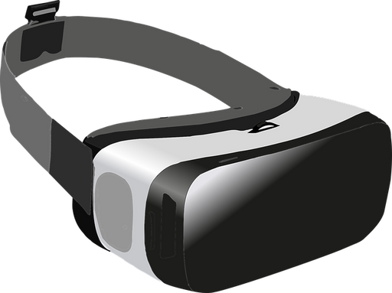


Overview of technologies
Modern technologies, current trends and the fear of the “new”.

Slide 6










Early 20th century
The early 20th century was a period marked by significant technological advancements that reshaped society and laid the groundwork for modern innovation. Some key developments include the widespread adoption of electricity, the invention of the telephone, radio and the assembly line that led to mass production, and way more.

Slide 7



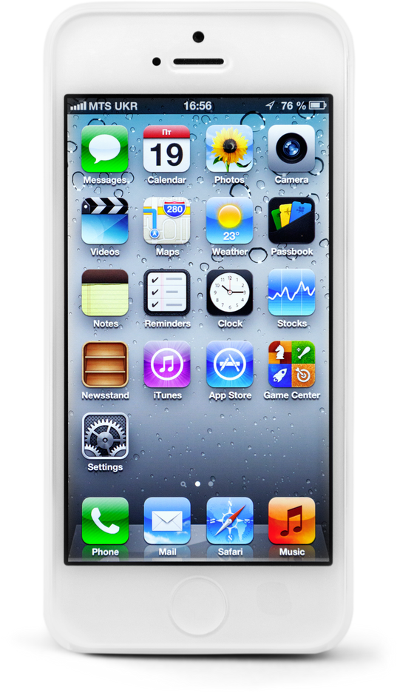
Early 21st century
Once again our society has been reshaped due to the introduction of the internet, computers, smart technologies, robotics, and more. But even though, when compared, the changes are vast, we were able to adapt and even get used to the things that only 20 years ago would have seemed futuristic.

Slide 8


Why should you care?
Social entrepreneurs have a powerful ally in modern technology. From automating tasks and reaching wider audiences to gathering data for smarter interventions and creating innovative solutions, tech can significantly boost their impact. Social media fundraising, compelling data visualizations, and even cutting-edge tools like VR can all be harnessed to raise awareness, attract support, and ultimately create lasting positive change.
However, navigating the digital divide and ensuring responsible data use are crucial considerations. Social entrepreneurs must find ways to ensure inclusivity and prioritize the safety of beneficiary information to maximize tech's potential for good.

Slide 9
01.
EFFICIENCY AND SCALE:
04.
STAYING RELEVANT:
Technology can automate tasks, streamline processes, and amplify reach. Imagine an AI-powered platform connecting underprivileged communities with educational resources, impacting far more people than traditional methods.
The landscape of social issues is constantly evolving. Social entrepreneurs can anticipate challenges and proactively develop solutions by understanding tech trends.
02.
DATA-DRIVEN DECISIONS:
05.
CROWDFUNDING AND ADVOCACY:
Data analytics can identify specific needs within beneficiary groups. Social entrepreneurs can leverage this to tailor interventions and measure their effectiveness, maximizing their social good.
Platforms like social media and crowdfunding can help raise awareness and funds for social causes. A compelling online campaign can garner widespread support and resources.
03.
NEW SOLUTIONS:
06.
STORYTELLING AND IMPACT MEASUREMENT:
Emerging technologies like virtual reality or blockchain can lead to groundbreaking solutions.
VR could create immersive training simulations for underprivileged communities, while blockchain could ensure transparency in supply chains for ethically sourced goods.
Technology allows for powerful storytelling. Social entrepreneurs can use data visualizations and interactive platforms to showcase the impact of their work, attracting more donors and volunteers.
WHY SHOULD YOU CARE?

Slide 10

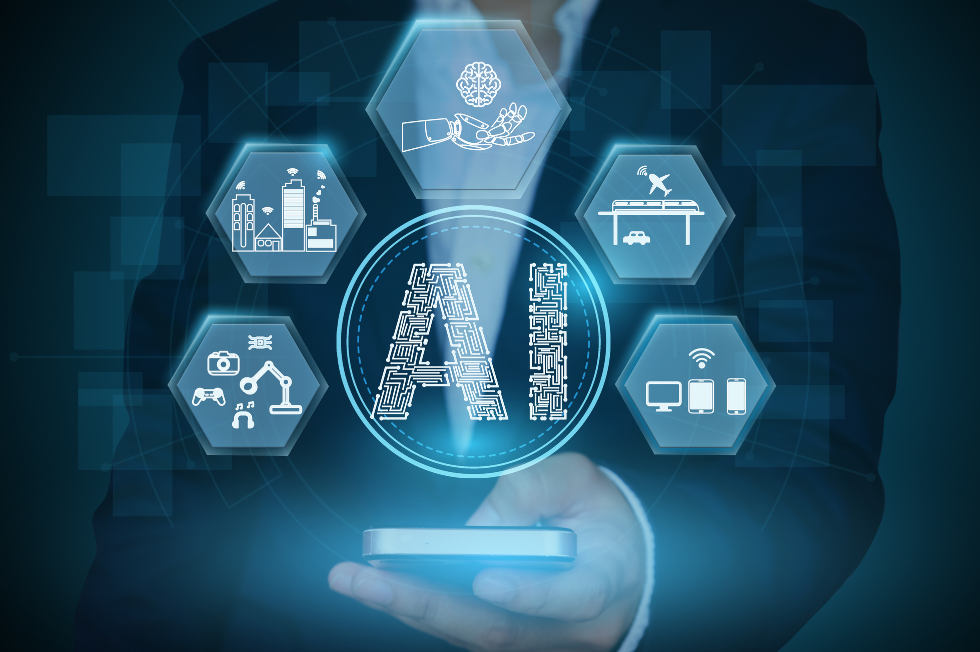
ARTIFICIAL INTELLIGENCE (AI)
Artificial intelligence (AI) is a wide-ranging branch of computer science concerned with building smart machines capable of performing tasks that typically require human intelligence. While AI is an interdisciplinary science with multiple approaches, advancements in machine learning and deep learning, in particular, are creating a paradigm shift in virtually every industry.
Artificial intelligence allows machines to model, or even improve upon, the capabilities of the human mind. And from the development of self-driving cars to the proliferation of generative AI tools, AI is increasingly becoming part of everyday life.

Slide 11

EXAMPLE: CHAT GPT
ChatGPT is a free-to-use AI system that's become a master of conversation. Think of it as a super-powered chat assistant that's both informative and engaging. ChatGPT can answer your questions in a comprehensive way, generate different creative text formats like poems or code, and even translate languages on the fly. It's recently gotten even more impressive, gaining the ability to understand and respond to images you show it. Additionally, you can now have voice conversations with ChatGPT, making it a versatile tool for tasks like getting information, sparking creative ideas, or simply having a stimulating chat. While there's a free version, OpenAI also offers a paid tier with access to their most powerful language model, GPT-4.
Preview: https://youtu.be/oc6RV5c1yd0?si=nJujPZuTRbLAwkKK

Slide 12

WEB 3.0
Web3 is an umbrella term for technologies like blockchain that decentralize data ownership and control on the internet. Most internet applications are controlled by centralized entities that determine how they save and use end-user data.
Instead of centralized management structures, Web3 (also called Web 3.0, decentralized web, or semantic web) technologies allow for community-driven projects. In these projects, end users control data, determine pricing, directly contribute to technical development, and have a more significant say in a project's direction. The technologies have mechanisms that automatically regulate how users interact with one another. So, there’s no requirement for a centralized entity to govern those interactions.

Slide 13

EXAMPLE: BRAVE
This privacy-focused browser blocks ads and trackers by default, keeping your data safe and speeding up browsing. Built on the familiar Chromium foundation (think Chrome), Brave integrates Basic Attention Tokens (BAT), a cryptocurrency. Opt-in users view privacy-preserving ads and earn BAT, which they can use to tip creators or keep for themselves. Brave prioritizes security with automatic HTTPS upgrades and anti-fingerprinting measures. Transparency is key, with open-source code and a passionate user community.
Preview: https://youtu.be/RL8QEXcQZE8?si=nCQFT7nwZuJMuZPT

Slide 14

EXTENDED REALITY (XR)
XR is an emerging umbrella term for all immersive technologies. The ones we already have today—augmented reality (AR), virtual reality (VR), and mixed reality (MR) plus those that are still to be created. All immersive technologies extend the reality we experience by either blending the virtual and “real” worlds or by creating a fully immersive experience.

Slide 15

EXAMPLE:
META QUEST
Meta Quest, formerly known as Oculus Quest, is a leading brand of virtual reality (VR) headsets developed by Meta Platforms (formerly Facebook). These standalone VR headsets are a popular choice for beginners and enthusiasts alike. Unlike some VR systems that require a powerful computer to function, Meta Quest headsets operate independently. This eliminates the need for expensive setups and tangled wires, making VR more accessible. Users can strap on the headset, grab the wireless controllers, and be transported to immersive digital worlds for gaming, watching movies in virtual theaters, exploring virtual destinations, or even getting a virtual workout. The Meta Quest offers a vast library of VR experiences, catering to various interests and preferences.
Preview: https://youtu.be/Exu7r2vZpcw?si=B97Ot-3CD4104Igq

Slide 16

SPATIAL COMPUTING
Spatial computing is a generic term that describes a highly complex subject. It is based on an immense range of technologies, which in turn form the basis for modern technology in general. Spatial computing has fundamentally changed the way people interact with static computers. Special tools like spatial computing glasses expand the possibilities and make it possible to dive directly into mixed realities. In other words: Spatial computing interweaves reality and the computing landscape. Since many features are quite small, the considerable progress of spatial computing companies is not always apparent. But their importance is certainly increasing in everyday life, thanks to voice-controlled assistants, smart speakers, and AR filters that are applied on social media channels.

Slide 17
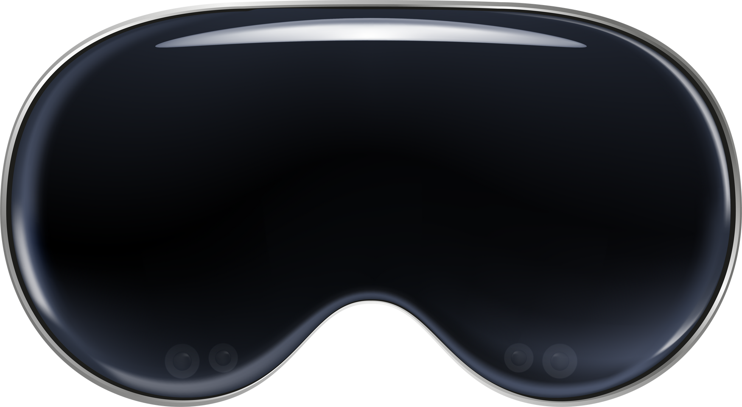
EXAMPLE:
APPLE VISION PRO
Apple's Vision Pro headset represents a leap into spatial computing. It goes beyond traditional VR by seamlessly blending digital content with your real-world environment. Imagine seeing your favorite apps floating in your workspace, manipulated with just your eyes, hands, or voice. This innovation allows for a more natural and interactive experience, perfect for creative endeavors, entertainment, or even visualizing 3D data in a physical space.
Preview: https://youtu.be/IY4x85zqoJM?si=uVdsJRP36_5iMgMu

Slide 18
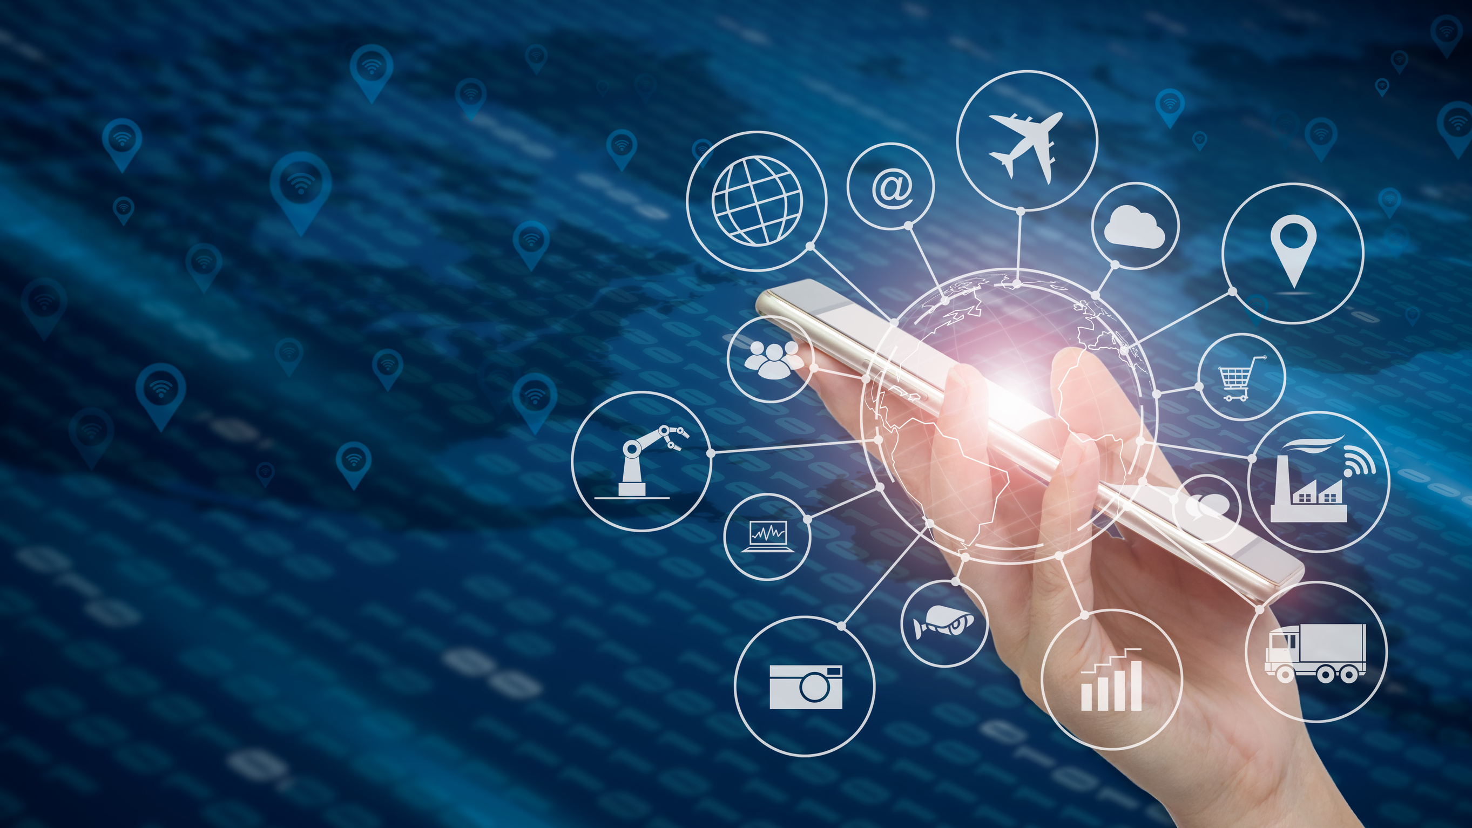
INTERNET OF THINGS (IOT)
The Internet of Things (IoT) refers to a network of physical devices, vehicles, appliances, and other physical objects that are embedded with sensors, software, and network connectivity, allowing them to collect and share data.
IoT devices—also known as “smart objects”—can range from simple “smart home” devices like smart thermostats, to wearables like smartwatches and RFID-enabled clothing, to complex industrial machinery and transportation systems. Technologists are even envisioning entire “smart cities” predicated on IoT technologies.

Slide 19

EXAMPLE:
NEST LEARNING THERMOSTAT
The Nest Learning Thermostat by Google is a prime example of an IoT device. It uses built-in sensors to monitor room temperature and connects to your Wi-Fi network. This allows you to remotely adjust heating and cooling or set automated schedules through a smartphone app. By learning your preferences over time, the Nest thermostat optimizes comfort and saves energy by reducing unnecessary heating or cooling cycles, showcasing the power of data and automation within the Internet of Things.
Preview: https://youtu.be/4jp1axFycgQ?si=45gEcnaGjFrx1HPF

Slide 20
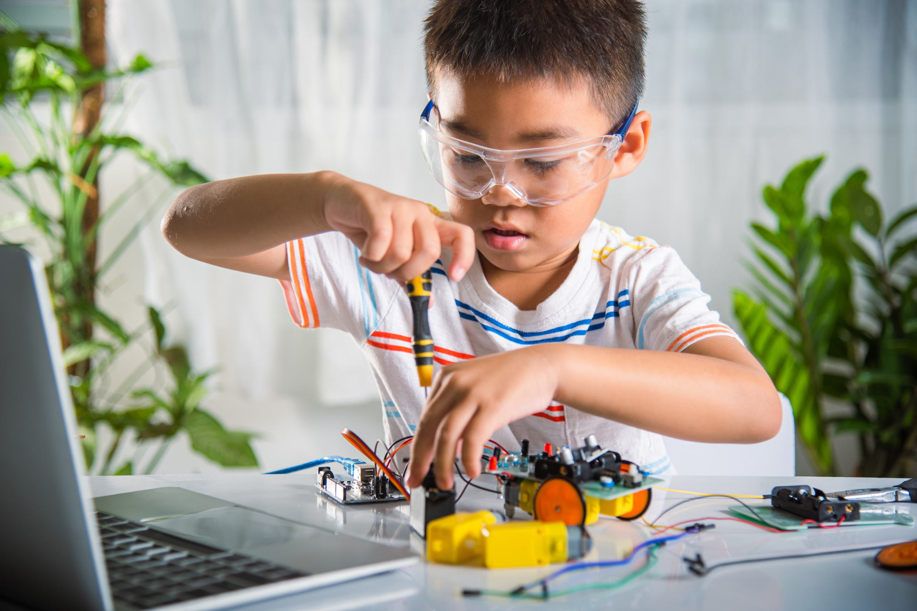
ROBOTICS
Robotics is the intersection of science, engineering and technology that produces machines, called robots, that replicate or substitute for human actions. Robots perform basic and repetitive tasks with greater efficiency and accuracy than humans, making them ideal for industries like manufacturing. However, the introduction of artificial intelligence in robotics has given robots the ability to handle increasingly complex situations in various industries.

Slide 21

EXAMPLE:
BOSTON DYNAMICS
Boston Dynamics is a leader in robotics development, known for creating highly mobile robots that mimic animal-like movements. Their innovative designs, like the agile Spot quadruped or the humanoid Atlas, push the boundaries of what robots can achieve. These robots are designed for challenging tasks in various industries, potentially taking over dangerous, repetitive, or physically demanding jobs.
Preview: https://youtu.be/tF4DML7FIWk?si=MpA_yDyy8Iu-9-tx

Slide 22
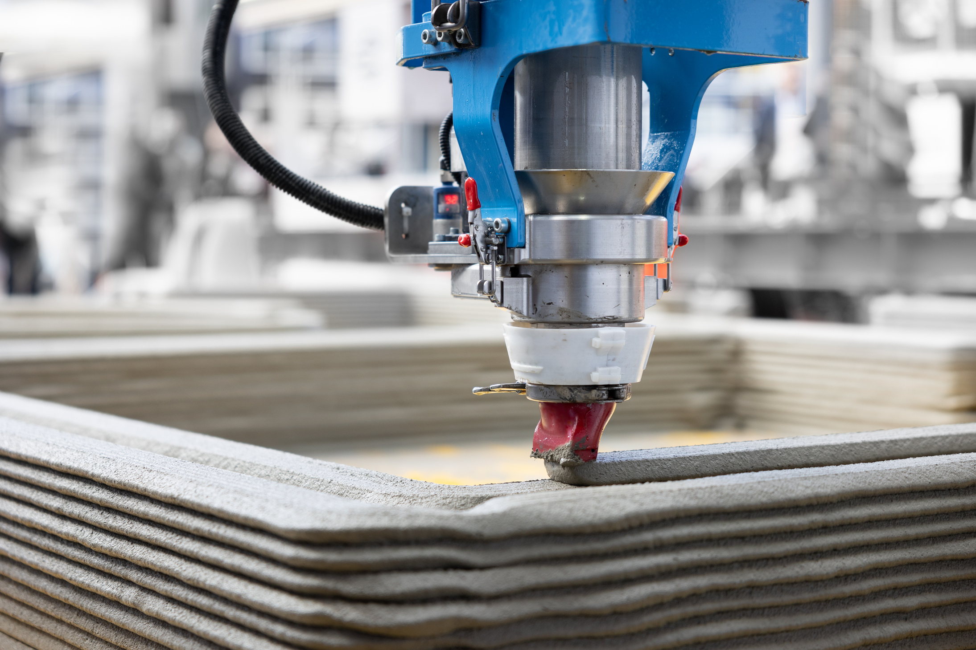
3D PRINTING
3D printing or additive manufacturing is a process of making three-dimensional objects from a digital file.
The creation of a 3D-printed object is achieved using additive processes. In an additive process, an object is created by laying down successive layers of material until the object is created. Each of these layers can be seen as a thinly sliced cross-section of the object.
There is one exception though, and it’s called volumetric 3D printing. With volumetric printing entire structures can be formed at once without the need for layer-by-layer fabrication. It’s worth noting, however, that as of now, volumetric technology is primarily in the research phase.

Slide 23
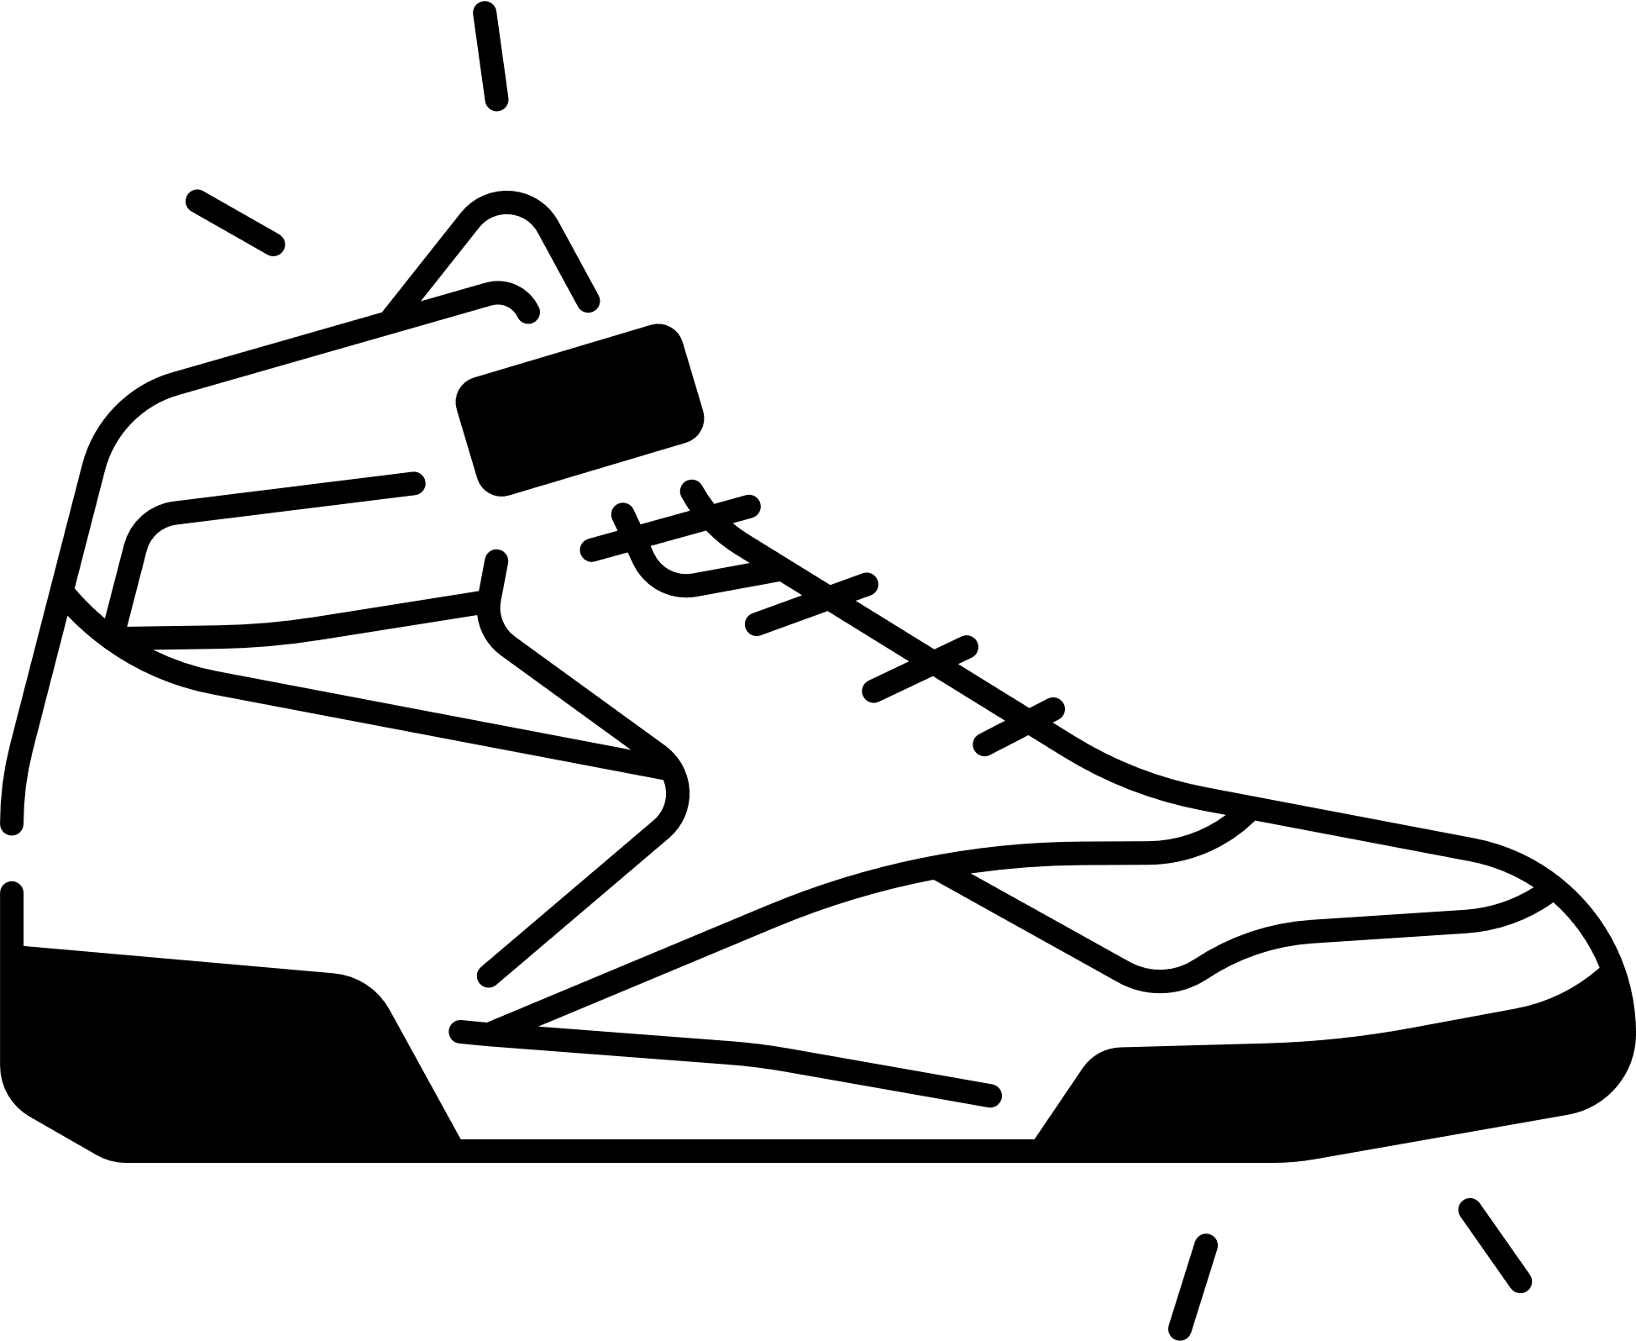
EXAMPLE:
REEBOK
Reebok hasn't just dipped its toes into 3D printing; they've dived headfirst with their innovative "Liquid Factory" project. Partnering with material specialists BASF, Reebok developed a proprietary 3D printing process using a special high-rebound liquid material. This liquid is layered onto a platform, building the outsole and potentially even parts of the upper of the shoe in a single, form-fitting piece. This technology allows for complex geometries and potentially more responsive cushioning compared to traditional methods. While initial releases were limited, Reebok recently opened a dedicated factory to scale up production, suggesting their commitment to making 3D-printed footwear a mainstream reality.
Preview: https://youtu.be/2_Mz8saTcRI?si=Cu5S9jroEnytGdWD

Slide 24

CURRENT TRENDS

Slide 25
A match made in AI
People are asking generative AI chatbots for information – transforming the business of search today, and the future of software and data-driven enterprises tomorrow.
Our relationship with data is changing—and with it, how we think, work, and interact with technology. The entire basis of the digital enterprise is getting disrupted.
The search-based “librarian” model of human-data interaction is giving way to a new “advisor” model. Rather than running searches to curate results, people are now asking generative AI chatbots for answers. Case in point: OpenAI launched ChatGPT in November 2022, and it became the fastest-growing app of all time. Large language models (LLMs) had been around for years, but ChatGPT’s ability to answer questions in a direct and conversational manner made a huge difference.
Data is one of the most important factors shaping today’s digital businesses. And the new chatbots—that can synthesize vast amounts of information to provide answers and advice, use different data modalities, remember prior conversations, and even suggest what to ask next—are disrupting that undercurrent. Ultimately, these chatbots can operate as LLM-advisors, allowing companies to put one with the breadth of enterprise knowledge at every employee’s fingertips. This could unlock the latent value of data and finally let enterprises tap into the promise of data-driven business.
*Accenture Technology Vission 2024

Slide 26
Meet my agent
AI is taking action, and soon whole ecosystems of AI agents could command major aspects of business. Appropriate human guidance and oversight is critical.
AI is breaking out of its limited scope of assistance to engage more and more of the world through action. Over the next decade, we will see the rise of entire agent ecosystems—large networks of interconnected AI that will push enterprises to think about their intelligence and automation strategy in a fundamentally different way.
Today, most AI strategies are narrowly focused on assisting in task and function. To the extent that AI acts, it is as solitary actors, rather than an ecosystem of interdependent parts. But as AI evolves into agents, automated systems will make decisions and take actions on their own. Agents won’t just advise humans, they will act on humans’ behalf. AI will keep generating text, images, and insights, but agents will decide for themselves what to do with it.
*Accenture Technology Vission 2024

Slide 27
The space we need
The spatial computing technology landscape is rapidly growing, but to successfully capitalize on this new medium, enterprises will need to find its killer apps.
Spatial computing is about to change not just the course of technology innovation, but also the ways people work and live. Whereas desktop and mobile used screens as portals to the digital world, spatial will finally combine our disparate realities, fusing digital and physical together. Apps built for this medium will let people immerse themselves in digital worlds with a physical sense of space, or layer content on top of their physical surroundings.
*Accenture Technology Vission 2024

Slide 28
Our bodies electronic
A suite of technologies – from eye-tracking to machine learning to BCI – are starting to understand people more deeply, and in more human-centric ways.
Failing to understand people is a limiting factor for many of technologies we use today. Just think about the robots and drones that humans can only control if we translate what we want into commands they recognize. The fact is, when tech struggles to connect with us, it’s often because people—what they want, expect, or intend—are an enigma.
Now, innovators are trying to change that. Across industries, they’re building technologies and systems that can understand people in new and deeper ways. They’re creating a “human interface,” and the ripple effect will go far beyond, say, improving smart homes.
Consider technologies that read body movement, like eye and hand tracking. In 2023, Apple’s Vision Pro introduced visionOS, which lets users navigate and click with just their gaze and a simple gesture, bypassing the need for a handheld controller.
*Accenture Technology Vission 2024

Slide 29



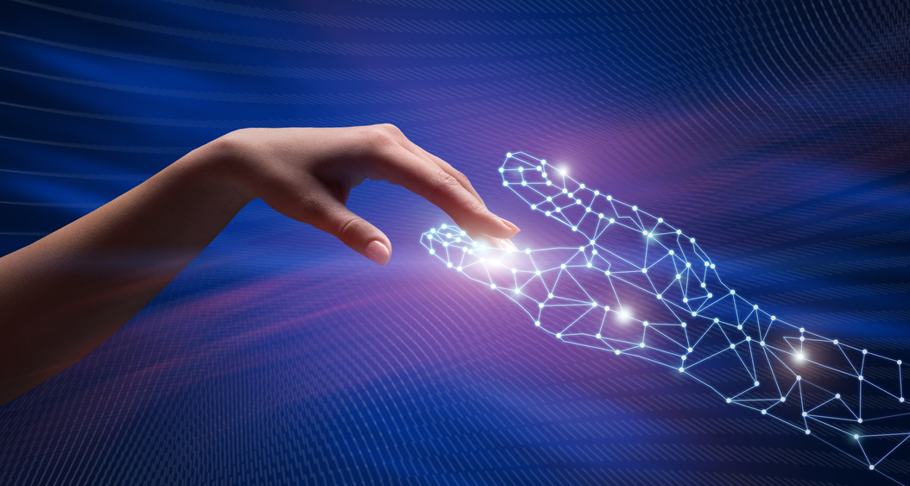

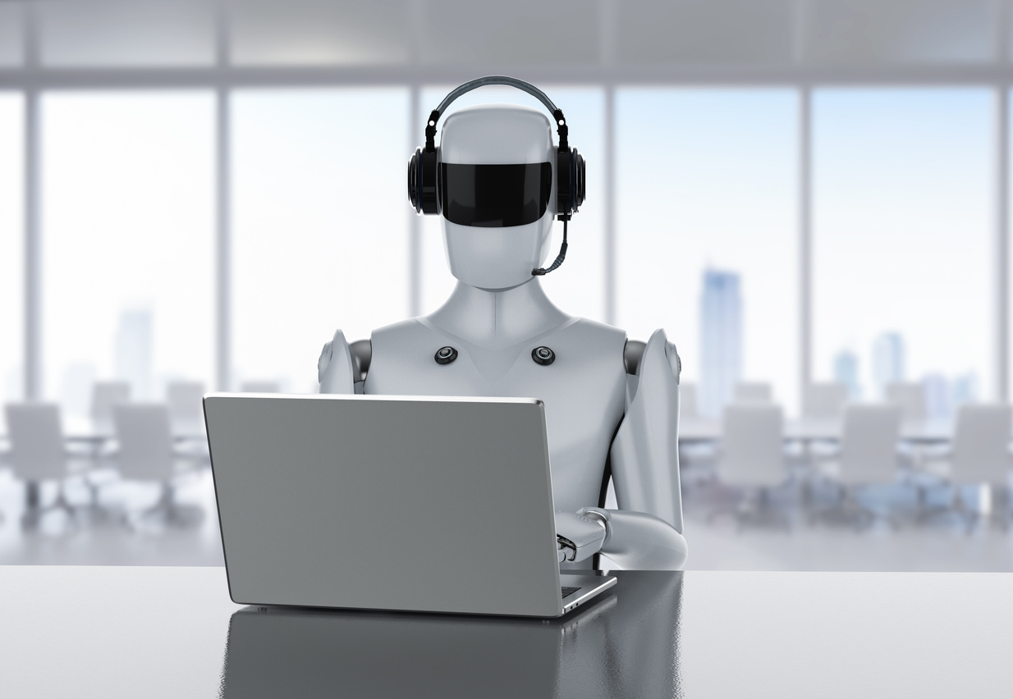
Future predictions
by 2029
by 2030
by 2034
Human-like AI is reality
6G standard is released
Service robots number a billion worldwide
futuretimeline.net

Slide 30
Task: share with everyone (15 min)
What was the most challenging technology/tool you've had to learn how to use?
What methods did you use to make the learning as effective as possible?

Slide 31
THANK YOU!

Slide 32
BREAK (15 MIN)

