Slide 1


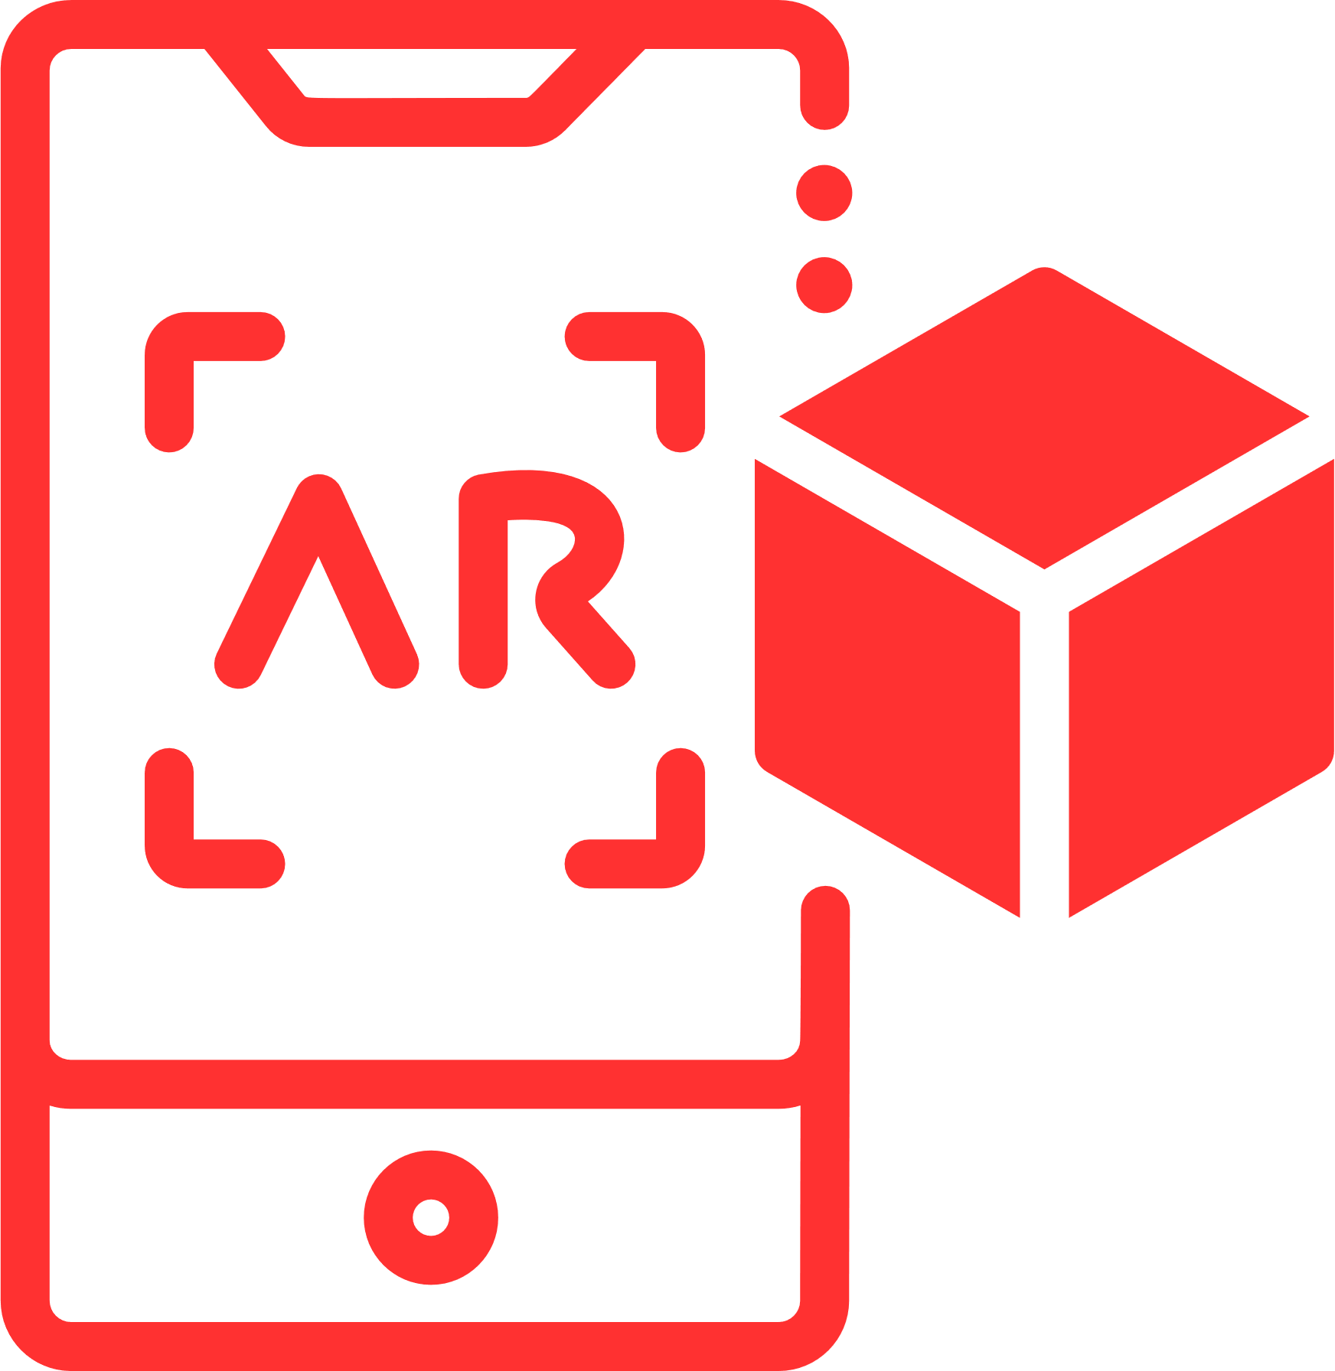


The importance of technologies
How different technologies can and are being used for good
The RESIST project is co-financed by the European Union (European Regional Development Fund) under the Interreg Baltic Sea Region Programme.

Slide 2



The importance of
AI
AI's significance today goes beyond just one area. It's revolutionizing how we approach problems by automating repetitive tasks, freeing up human potential for more complex endeavours. AI can crunch vast amounts of data to identify patterns and trends invisible to the human eye, enabling better decision-making in fields like finance, healthcare, and scientific research. Additionally, AI is fostering innovation by assisting in areas like drug discovery and creative content generation. From streamlining daily activities to tackling complex global challenges, AI is rapidly transforming our world.

Slide 3
The importance of
AI
01
Healthcare - diagnostic tools, predict outcomes, discover new drugs
02
Environment - predict natural disasters, track deforestation, monitor wildlife
03
Education - assistance to students, personalised study styles
04
Mental health support - emotional support, provides resources to those in need

Slide 4



Environment
Education
AI
USE CASES
Ellipsis Earth uses AI and machine learning to categorize waste by type, weight, volume, environmental impact, residence time, carbon footprint, material, brand and recycling value.
The technology builds a profile of marine litter hotspots and uses data to target interventions that reduce environmental damage. It has been used in the UK and Italy to reduce beach littering by up to 75%, which ultimately leads to less waste getting into the sea.
Socratic by Google tackles educational inequality. This AI-powered platform acts as a personalized virtual tutor for students in under-resourced areas. The AI can answer questions, provide feedback, and recommend resources, bridging the gap in teacher availability. Unlike some platforms, Socratic focuses on mastery, ensuring students understand concepts before moving on. Google offers the platform at a reduced cost or free of charge, making quality education more accessible and empowering students to learn at their own pace.

Slide 5
The importance of
WEB 3.0
Web3.0's significance lies in its potential to revolutionize the internet by prioritizing decentralization and user empowerment. This could lead to a more secure, private, and personalized web experience, paving the way for the metaverse and fundamentally reshaping how we interact online. However, it's still under development with challenges to address.

Slide 6
The importance of
WEB 3.0
01
Improved engagement - incentives for active participation in online communities
02
Enhanced privacy - individual user determines who has access to their data
03
Democratized communication - removes geographical, political, and corporate barriers to communication

Slide 7


Funding
Economy
WEB 3.0
USE CASES
Giveth is a platform that utilizes blockchain to facilitate direct, transparent donations between individuals and social causes. Donors can track their money and support recurring micro-donations, creating a sustainable funding model. Giveth empowers local, grassroots movements by reducing reliance on traditional platforms, fostering a more democratic and impactful approach to social entrepreneurship.
Worldcoin is designed to become the world's largest privacy-preserving human identity and financial network, giving ownership to everyone. Worldcoin aims to provide universal access to the global economy no matter your country or background, establishing a place for all of us to benefit in the age of AI.

Slide 8
The importance of
XR
XR (Extended Reality) is gaining importance nowadays for its ability to bridge the gap between the physical and digital worlds. It offers immersive experiences for various fields, from training simulations and design prototyping to remote collaboration and even entertainment. This technology has the potential to revolutionize how we learn, work, and play by creating engaging and interactive experiences that enhance understanding, efficiency, and accessibility.

Slide 9
The importance of
XR
01
Healthcare - immersive experience for patients, training and assistance for doctors
02
Retail and e-commerce - virtual shopping and try-on experiences
03
Education - hard and soft skills training in various industries
04
Accessibility - people with limitations can experience more of the world otherwise inaccessible for them

Slide 10


Healthcare
Education
XR
USE CASES
SyncVR Medical provides an all-in-one VR/AR platform for healthcare organizations. Through their App Store, healthcare organizations get access to the world’s best XR apps for healthcare, from pain management to education and rehabilitation. Scientifically validated, CE-certified and fully implemented by their team.
Ukwenza VR is a social enterprise that focuses on creating educational Virtual Reality (VR) content to complement classroom learning and offer additional learning on social and environmental issues e.g. conservation and plastic pollution.
They work with schools & educators to create and deliver the content to ensure it meets learning standards that serve the community.

Slide 11
The importance of
Spatial Computing
Spatial computing is emerging as a game-changer, transforming how we interact with technology. By understanding the physical world around us, it creates a more intuitive and immersive computing experience. This can revolutionize fields like education and design with interactive 3D models, enhance training with realistic simulations, and even improve collaboration by allowing people to virtually work together in shared spaces. Spatial computing holds the potential to blur the lines between the physical and digital, creating a richer and more interactive world around us.

Slide 12
The importance of
Spatial Computing
01
Driving and navigation - accurate directions and real-time information about traffic hazards such as accidents or construction
02
Design of physical spaces - virtual designs of building projects
03
Education - hard and soft skills training in various industries

Slide 13

Building projects
SPATIAL COMPUTING USE CASES
Microsoft Mesh, a mixed reality collaboration platform, is being used by Habitat for Humanity to improve efficiency and communication in affordable housing projects. Architects, engineers, and volunteers from various locations can virtually collaborate on 3D building models using MR headsets, allowing for remote design reviews, faster problem-solving, and improved volunteer training. This project demonstrates how spatial computing can bridge geographical limitations and empower collaboration in social good initiatives.

Slide 14
The importance of
IoT
The Internet of Things (IoT) is rapidly transforming our world by seamlessly connecting devices and machines. This web of data collection and analysis unlocks a treasure trove of benefits: from automating tasks and optimizing processes for efficiency, to providing data-driven insights for smarter decision-making. IoT is making our lives more convenient, personalized, and innovative, with applications constantly emerging that impact everything from our homes and health to entire cities.

Slide 15
The importance of
IoT
01
Improved efficiency - can be used to monitor equipment performance and detect or even resolve potential issues
02
Data-driven decision-making - businesses can gain insights into customer behavior, market trends, and operational performance
03
Cost-savings - reduction of manual processes and automation of repetitive tasks
04
Enhanced customer experience - businesses can create more personalized and engaging experiences for their customers

Slide 16

Health
IOT
USE CASES
Bboxx partners with Jibu, a social enterprise providing clean water access, to leverage IoT. Jibu's water stations use sensors that monitor water production and other factors. This IoT data cuts operational costs by eliminating the need for manual data collection, allowing Jibu to keep its clean water solution affordable for off-grid communities in Sub-Saharan Africa. Bboxx's involvement highlights how IoT can enhance social impact initiatives like providing clean water access.

Slide 17
The importance of
Robotics
Robotics is having a profound impact on our world today. By automating tasks, robots are boosting efficiency and productivity across industries. They're taking on dangerous or repetitive jobs, keeping humans safe, and performing tasks with incredible precision. From medical procedures to manufacturing, exploration, and even customer service, robots are augmenting human capabilities and driving innovation. This technology is transforming how we work, live, and explore the world around us.

Slide 18
The importance of
Robotics
01
Manufacturing - assemble products, sort items, perform welds and paint objects
02
Healthcare - transport medical supplies, perform surgical procedures and offer emotional support
03
Companionship - support children with learning disabilities and act as a therapeutic tool for people with dementia
04
Search and Rescue - save those stuck in flood waters, deliver supplies to those stranded in remote areas and put out fires

Slide 19


Search & Rescue
Companionship
ROBOTICS
USE CASES
Boston Dynamics Spot, a nimble dog-like robot, is making waves in search and rescue. Equipped with cameras, sensors, and even thermal imaging, Spot can navigate hazardous environments too dangerous for humans. It can create a 360-degree view of its surroundings, locate survivors through dust and debris, and even allow rescuers to communicate with them remotely. This makes Spot a valuable tool for search and rescue teams, helping them save lives in disaster zones around the world.
PARO, a robotic baby harp seal created by PARO robotherapy, is a social robot designed to aid people with dementia. PARO's soft fur, lifelike movements, and responses to touch and voice prompts can provide comfort, encourage interaction, and potentially stimulate cognitive function, offering a potential tool to improve emotional well-being and reduce anxiety in dementia patients.

Slide 20
The importance of
3D printing
3D printing's importance today lies in its ability to revolutionize manufacturing and design. It allows for rapid prototyping, enabling designers to test and iterate on ideas quickly. 3D printing also facilitates complex and intricate designs that would be difficult or impossible with traditional methods. Furthermore, it empowers on-demand production and customization, reducing waste and offering new possibilities for personalized products. Overall, 3D printing is transforming how we create objects, fostering innovation, efficiency, and customization across various industries.

Slide 21
The importance of
3D printing
01
Healthcare - prosthetics, human organs and biomedical implants
02
Education - can bring objects out of textbooks and off computer screens
03
Fashion - on-demand tailored clothing
04
Construction - emergency response structures and regular buildings

Slide 22


Aid
Construction
3D PRINTING
USE CASES
Field Ready, a humanitarian organization, utilizes 3D printing for social good in disaster zones. They leverage this technology to create crucial tools and supplies on-site, such as medical equipment or prosthetic limbs. By training locals to operate the printers, Field Ready empowers communities to become self-sufficient in meeting their needs while fostering local economic development.
New Story Project, a non-profit focused on affordable housing, is at the forefront of exploring 3D printing's potential for social good. While not their primary method, 3D printing offers the possibility of constructing low-cost, disaster-resistant homes. In partnership with ICON, they've brought the world’s first community of 3D-printed homes to Mexico - all for low-income families without adequate housing.

Slide 23
Task: work in pairs (30min)
Choose one of the technologies below and come up with a new product or service (imagine anything):
  AI
  AR/VR/XR
  Spatial computing
  Blockchain
  BCI
  Robotics
  3D printing

Slide 24



THANK YOU!

Slide 25
BREAK (1 H)

