Slide 1
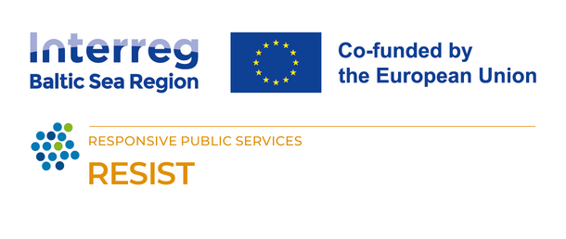





Creating a technological solution
Tips & tricks, building in-house vs outsourcing, and where to begin
The RESIST project is co-financed by the European Union (European Regional Development Fund) under the Interreg Baltic Sea Region Programme.

Slide 2



Regardless of what you want to create, always ask yourself why you are doing that - what good will it bring you and others around you?
Once you have a clear reason, if it is a technological solution you aim to create, there are to ways to go about it - building it in-house or outsourcing.

Slide 3


Building in-house
In-house software development refers to the process where a company relies on its internal team to create, maintain, and update software solutions. This approach involves utilizing the company's resources, including personnel, technology, and infrastructure, to develop software tailored to the organization's specific needs and goals.

Slide 4
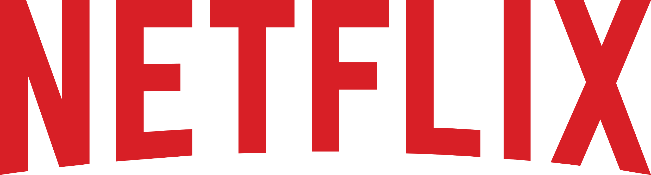
IN-HOUSE
To ensure the reliability of its streaming service, Netflix created Chaos Monkey, an in-house software tool. This digital "monkey" intentionally disrupts internal systems, simulating outages and helping engineers proactively identify weaknesses before they impact millions of users. Developing Chaos Monkey in-house allowed Netflix to tailor it to their specific needs, leading to a more resilient infrastructure and a smoother streaming experience for their customers. This example highlights the potential of in-house development for creating innovative solutions that address a company's unique challenges.

Slide 5

Outsourcing
To outsource the development of a technological solution means engaging external entities, such as freelance developers or specialized firms, to handle software projects. This approach allows businesses to leverage external expertise and technology, often at a lower cost and with greater flexibility compared to in-house development.

Slide 6

OUTSOURCED
In its early stages, Skype, the video calling giant, outsourced development of its core software to a team in Estonia. This strategic move allowed them to focus on user experience and business strategy while leveraging external expertise at a potentially lower cost. The success of this collaboration showcases how outsourcing can be a powerful tool for companies to access specialized skills and accelerate development, giving them a competitive edge.

Slide 7


BUILDING IN-HOUSE
VS
OUTSOURCING

Slide 8






In-house pro's
Control and Customization
01
Building in-house gives you full control over the development process, allowing you to tailor the solution to your exact requirements.
Intellectual Property Protection
Keeping development in-house can help protect sensitive information and proprietary technology.
02
Better Integration
In-house solutions can often be better integrated with existing systems and processes since the development team has direct access to all relevant information.
03
Long-Term Cost Savings
While initial costs might be higher, long-term, maintaining and scaling an in-house solution can be more cost-effective than paying ongoing fees to an external vendor.
04

Slide 9




In-house con's
Resource Intensiveness
Developing in-house requires significant time, money, and human resources, including hiring and retaining skilled developers and maintaining infrastructure.
01
Expertise Requirements
Your team may not have the necessary expertise in all areas of development, leading to potential delays or suboptimal solutions.
02
Risks of Delays
03
In-house projects are susceptible to delays due to unforeseen challenges, such as technical issues or resource constraints.
Opportunity Cost
Resources spent on developing an in-house solution could be allocated to other core business activities.
04

Slide 10

Outsourcing pro's
Cost Efficiency
Outsourcing can be more cost-effective, especially for short-term projects, as you're not responsible for hiring full-time staff or maintaining infrastructure.
01
Access to Expertise
Outsourcing allows you to tap into specialized skills and experience that may not be available in-house.
02
Faster Deployment
03
External vendors often have dedicated teams and established processes, allowing for faster development and deployment.
Reduced Risk
By outsourcing development, you may mitigate certain risks associated with technology projects, as the responsibility for delivery lies with the vendor.
04

Slide 11




Outsourcing con's
Loss of Control
Outsourcing means relinquishing some control over the development process, which could lead to misunderstandings or misaligned expectations.
01
Dependency on Vendor
Relying on an external vendor means your organization is dependent on their availability, reliability, and performance.
02
Communication Challenges
Working with an external team, especially if they're located in a different time zone or speak a different language, can present communication challenges.
03
Quality Concerns
Without proper due diligence, there's a risk of receiving subpar work from an outsourced vendor, leading to additional costs and delays.
04

Slide 12
BUILDING IN-HOUSE

Slide 13

01.
DEFINE CLEAR OBJECTIVES
06.
CREATE A PROJECT PLAN
Clearly articulate the problem you are solving and set measurable, and achievable goals.
Develop a project plan outlining key milestones, deliverables, timelines, and resources.
02.
CONDUCT THOROUGH REQUIREMENTS ANALYSIS
07.
ESTABLISH DEVELOPMENT PROCESSES
Gather requirements from everyone involved and prioritize them.
Define development methodologies, processes, and workflows.
03.
ALLOCATE RESOURCES
08.
PROTOTYPE AND VALIDATE
Identify and allocate the necessary resources, including budget, personnel, and time.
Build prototypes or minimum viable products (MVPs) to validate the idea.
04.
FORM CROSS-FUNCTIONAL TEAMS
09.
ADDRESS LEGAL AND COMPLIANCE CONSIDERATIONS
Create a team with diverse skills relevant to the project (developers, designers, and PM's).
Identify and address requirements relevant to the project (data privacy, security, and intellectual property rights).
05.
CHOOSE THE RIGHT TECHNOLOGY STACK
10.
COMMUNICATE AND MANAGE EXPECTATIONS
Evaluate different technologies, frameworks, and tools to determine the most suitable.
Maintain open and transparent communication with everyone involved.
NECESSARY STEPS

Slide 14
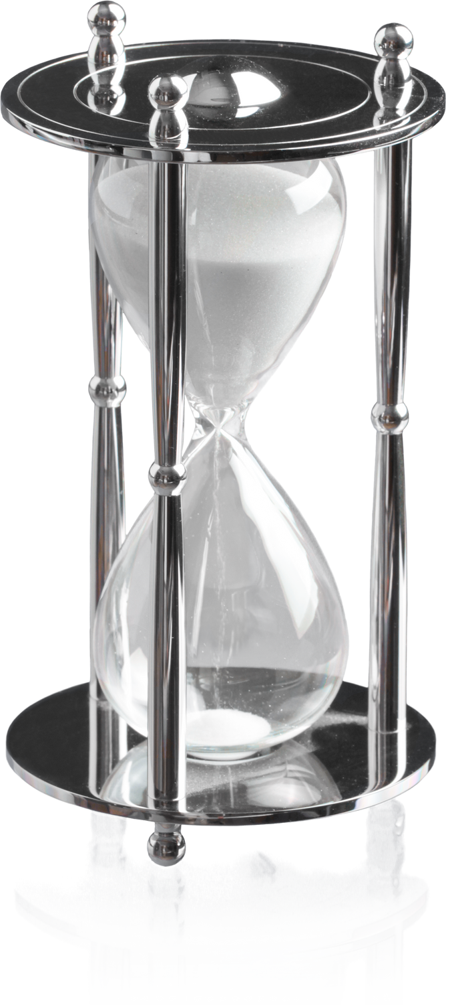
What to consider long-term?
When building a technological solution in-house, it's important to consider long-term maintenance, scalability, security, user feedback, talent management, as well as total cost of ownership.
Allocate resources for maintenance and support, design the product for scalability, ensure security and compliance, solicit user feedback for improvement, invest in talent, and continuously evaluate costs for optimization. These factors contribute to the solution's sustainability and value over time.

Slide 15

Tips & Tricks
1.
Research existing solutions (both off-the-shelf software and open-source options) before diving into development. Is building something new truly necessary?
2.
Don't try to build everything at once. Begin with a Minimum Viable Product (MVP) that addresses core needs. Gather user feedback and iterate based on their input.
3.
Embrace agile development methodologies that promote quick iterations, continuous testing, and adaptation based on feedback.
4.
Integrate security best practices from the beginning of development to protect user data and system integrity.
5.
Consider how your solution will handle future growth in users or data volume. Design with the future in mind.

Slide 16
OUTSOURCING

Slide 17
01.
DEFINE CLEAR OBJECTIVES
06.
ESTABLISH CLEAR COMMUNICATION CHANNELS
Clearly articulate the problem you are solving and set measurable, and achievable goals.
Clarify roles and responsibilities and designate key points of contact.
02.
IDENTIFY SUITABLE VENDORS
07.
SET UP PROJECT GOVERNANCE AND MANAGEMENT
Evaluate vendors based on technical skills, industry knowledge, portfolio, client testimonials, cultural fit.
Define project management processes, roles, responsibilities, and set up necessary mechanisms.
03.
REQUEST FOR PROPOSALS OR QUOTES
08.
DEFINE PROJECT REQUIREMENTS AND SPECIFICATIONS
Prepare a detailed request for proposals or request for quotes based on project requirements, objectives, and expectations.
Ensure a shared understanding of the project scope, objectives, deliverables, and timeline.
04.
EVALUATE VENDOR PROPOSALS
09.
KICK OFF THE PROJECT
Consider vendor reputation, communication capabilities, and alignment with your values and goals.
Conduct a project kickoff meeting to introduce key stakeholders, clarify project goals and expectations.
05.
SELECT THE RIGHT VENDOR
10.
MONITOR PROGRESS AND MANAGE RISKS
Negotiate contract terms: pricing, deliverables, milestones, timelines, intellectual property rights, and dispute resolution mechanisms.
Monitor the vendor's progress against project milestones and deliverables, and address any issues or concerns promptly.
NECESSARY STEPS

Slide 18
What to consider long-term?
When outsourcing the creation of a technological solution, in the long-term you should consider maintaining communication, ensuring scalability, managing support, enforcing security, evaluating vendor performance, and planning for changes.
Clear contracts, positive vendor relationships, and contingency plans are crucial for sustained success.

Slide 19

Tips & Tricks
1.
Choose a partner with good communication practices and a culture that aligns with yours. Consider time zone differences and potential language barriers.
2.
Utilize project management tools like Asana or Trello to facilitate communication, task allocation, and track progress.
3.
Establish clear criteria for what constitutes a successful project completion. This avoids misunderstandings later.
4.
Consider outsourcing a smaller initial project to test the waters before committing to a larger endeavour.
5.
Clearly outline your data security requirements in the contract. Ensure the vendor has robust security practices in place.

Slide 20
IMPLEMENTING A NEW TECHNOLOGICAL SOLUTION

Slide 21

When you've created a new solution, regardless of whether in-house or by outsourcing and whether for your team or clients, you need to keep in mind that the implementation of the solution won't happen overnight. Change is good but change also takes time so there are certain do's and don'ts you should remember.

Slide 22
Do's and dont's
Do's
Dont's
Always dedicate time for training. The learning curve is going to look a little different for everyone on your team.
Underestimate Change Resistance. Expect some resistance to change. Address concerns, provide support, and highlight the benefits of the new solution.
1.
1.
Focus on User Experience (UX). Make sure the new solution is user-friendly and intuitive.
Neglect Training. Inadequate training is a recipe for disaster. Invest in comprehensive training programs.
2.
2.
Plan for Change Management. Implementing new tech disrupts workflows. Develop a change management plan to ease the transition.
Overlook User Needs. Don't force a solution that doesn't fit user needs. Prioritize user experience and gather feedback to make adjustments.
3.
3.
Start Small & Iterate. Begin with a pilot program in a specific department, gather feedback, and iterate based on learnings.
Go All-In Too Quickly. A big-bang approach can be overwhelming. Start small, pilot the solution, and gradually scale up based on success.
4.
4.
Consider Security. Protect user data and system integrity throughout the development and implementation phases.
Neglect Communication. Silence breeds fear. Keep everyone informed throughout the process. Address concerns proactively and answer questions openly.
5.
5.

Slide 23

CAUTIONARY TALE
JCPenney's attempt to revamp its internal inventory management system in 2015 backfired due to a triple threat: inadequate employee training on the new software, glitches causing inaccurate stock counts, and a communication breakdown between management, IT, and store staff. This fumbled implementation led to stockouts, pricing issues, and ultimately hurt customer satisfaction, forcing them to revert to the older system and costing them dearly.

Slide 24

THANK YOU!

