Slide 1


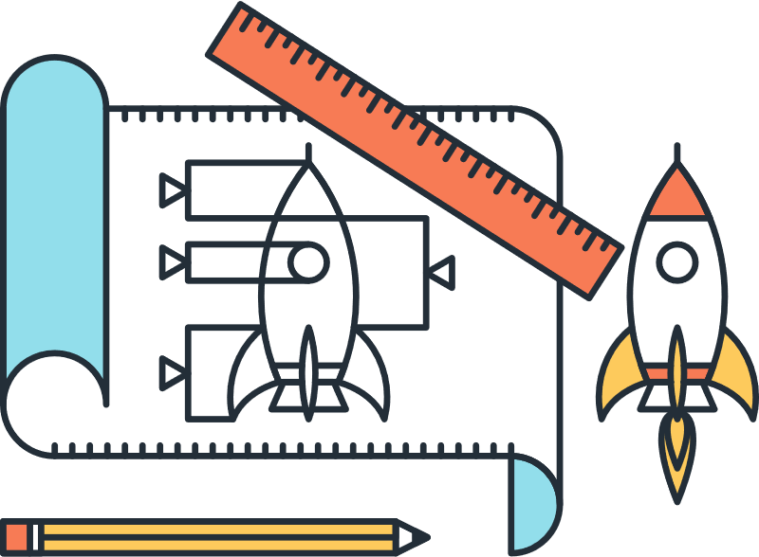

Prototyping
Basics of prototyping
The RESIST project is co-financed by the European Union (European Regional Development Fund) under the Interreg Baltic Sea Region Programme.

Slide 2


A PROTOTYPE IS A PHYSICAL OR DIGITAL EMBODIMENT OF critical elements of the intended design, and an iterative tool to enhance communication, enable learning, and inform decision-making at any point in the design process.

Slide 3
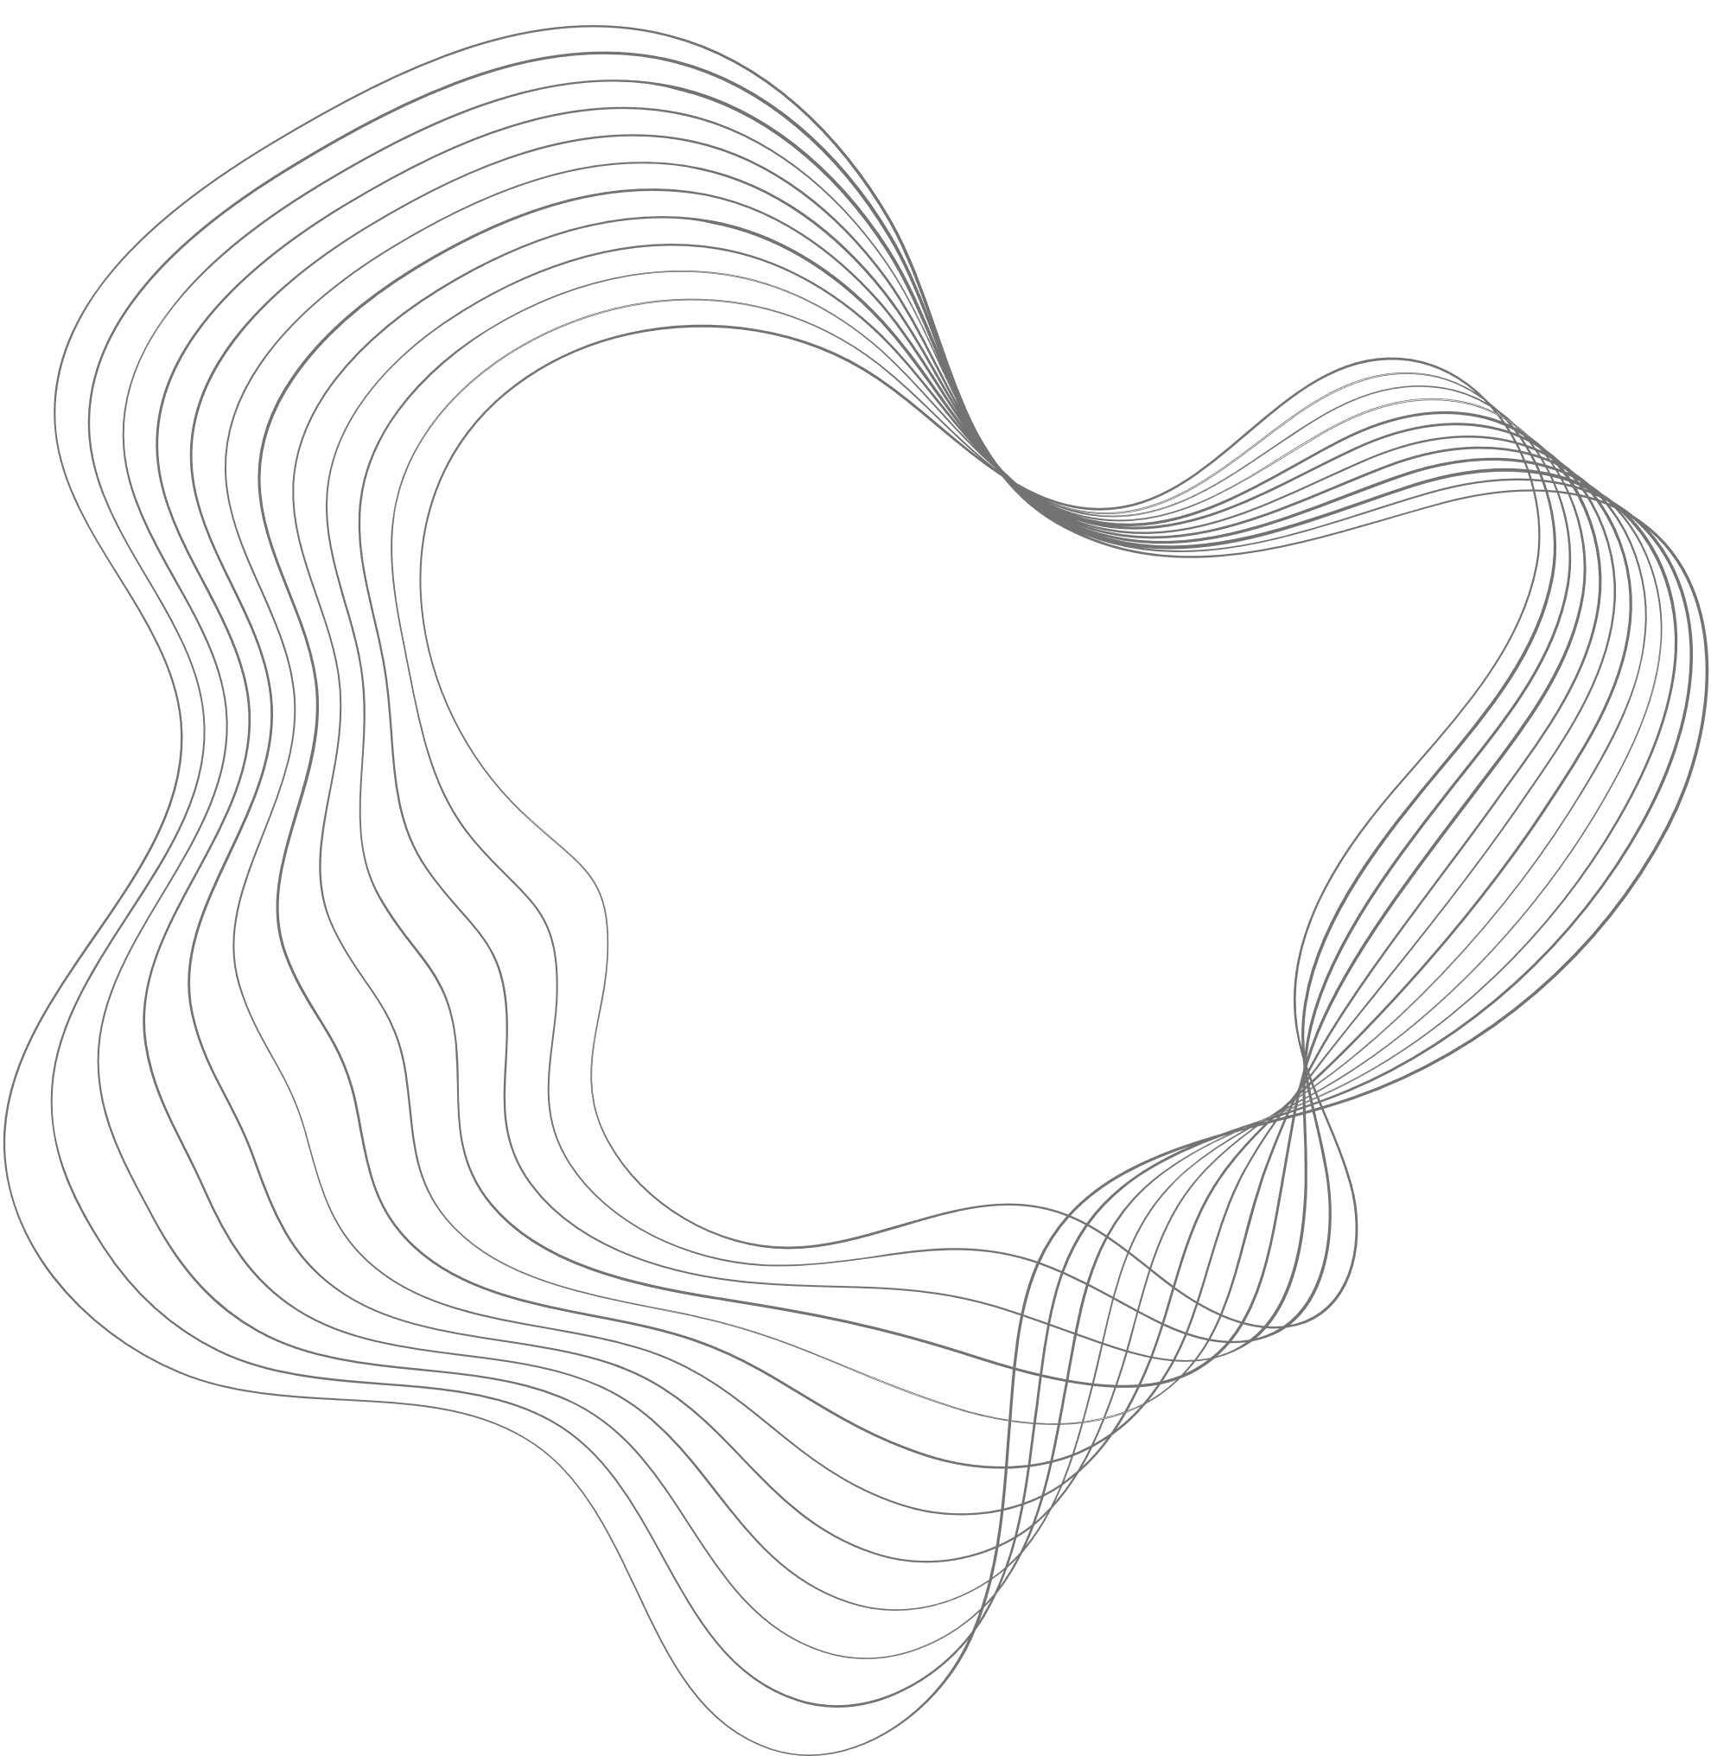


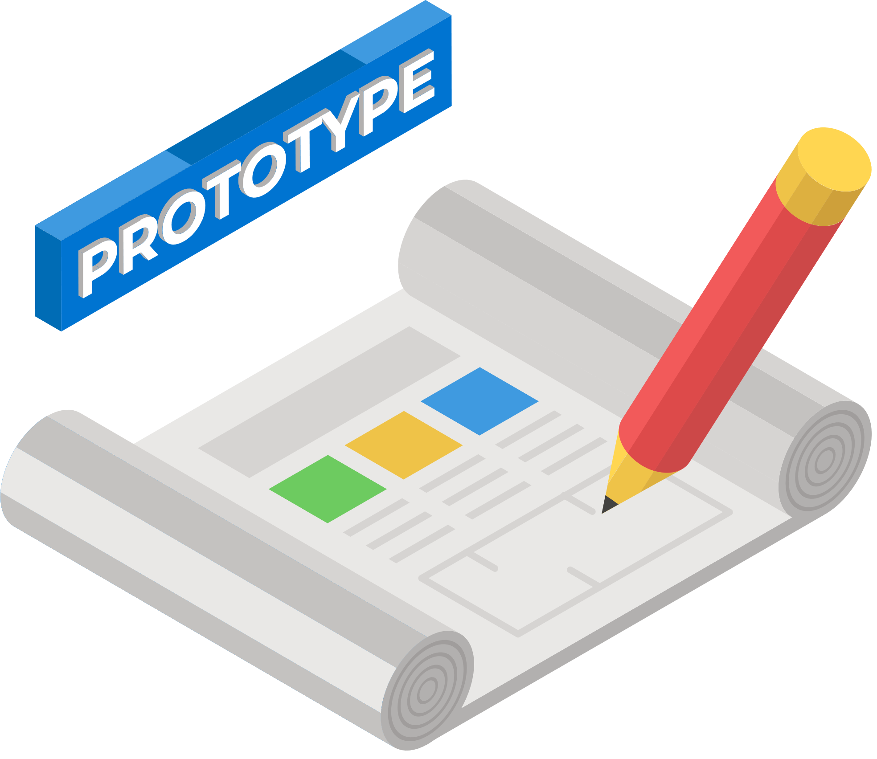
Why prototype?
Fail fast and cheap! Also:
TO MAKE YOUR IDEAS VISIBLE (PHYSICAL)
TO ALIGN THE IDEA WITH YOUR TEAM
TO FEEL WHAT YOUR PRODUCT IS LIKE

Slide 4
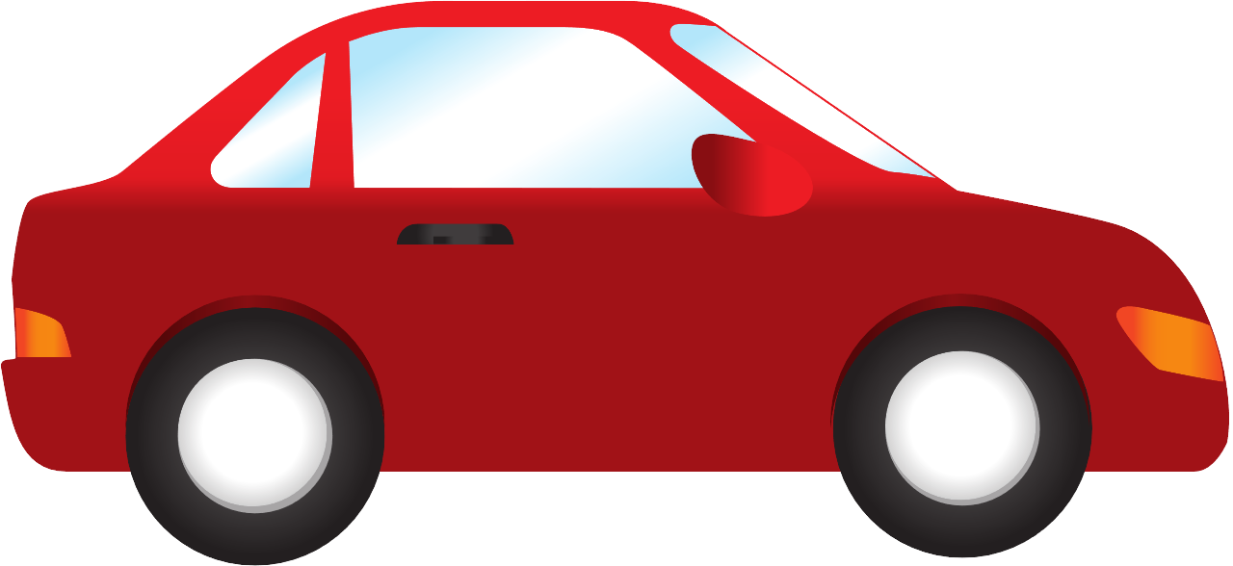
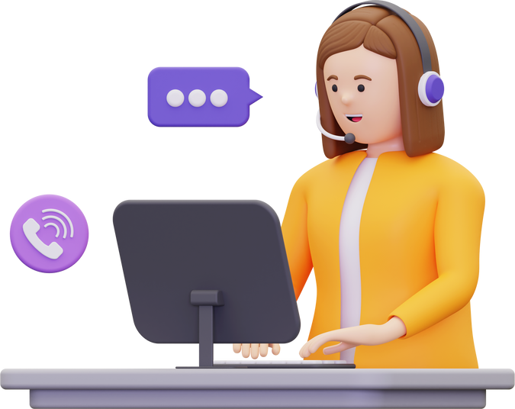
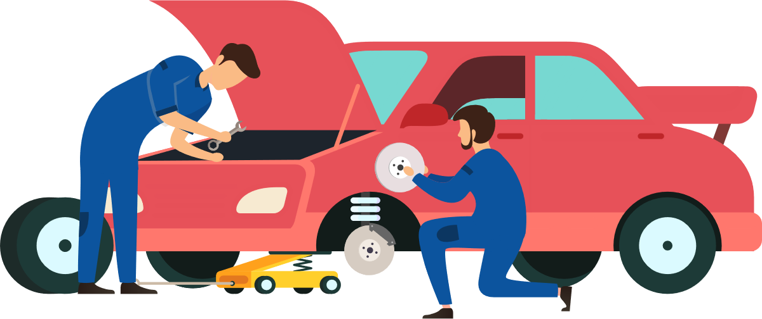
You can prototype:
PRODUCT
SERVICE
PROCESS

Slide 5
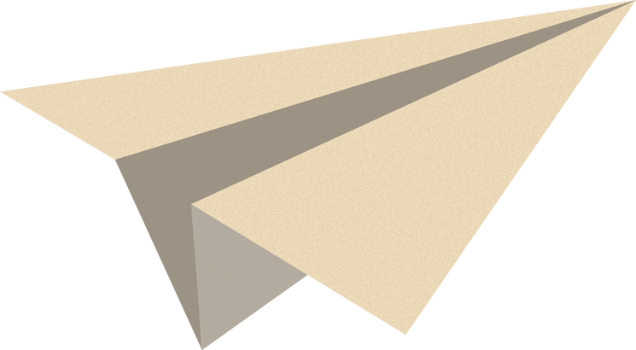
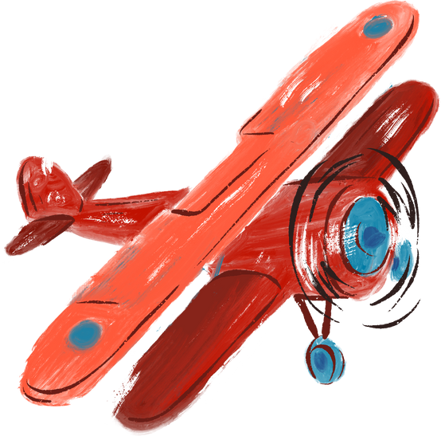
FIDELITY*
Low fidelity
You test functionality not the visual appearance
High fidelity
Prototypes appear and function as close as possible to the actual product
*How close the prototype is to a real product.

Slide 6
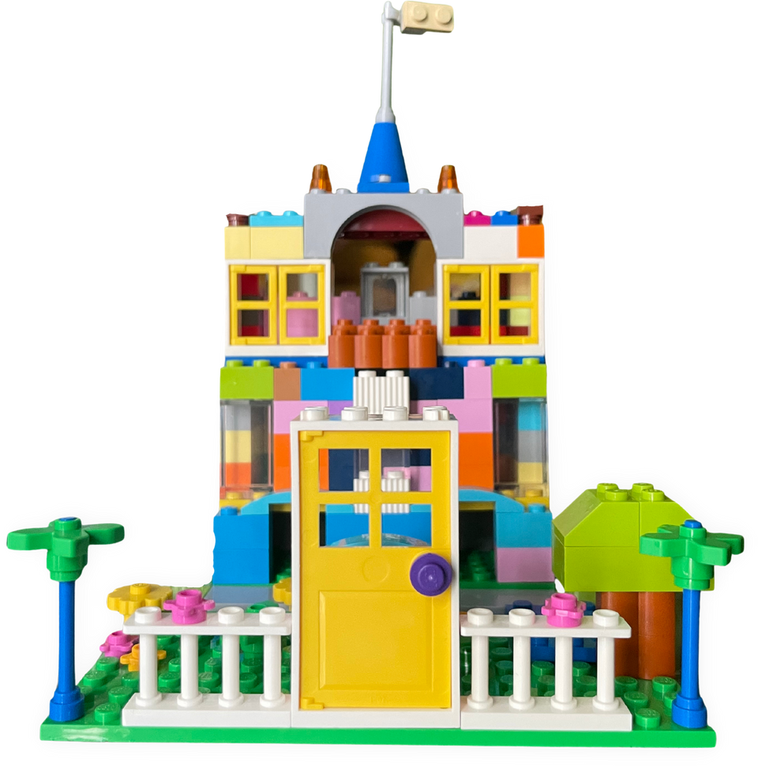

Different ways to prototype
01
Paper prototyping
02
Desktop walkthrough
03
Lego Serious play
04
Cardboard prototyping
05
Digital wireframes & interactive prototypes

Slide 7

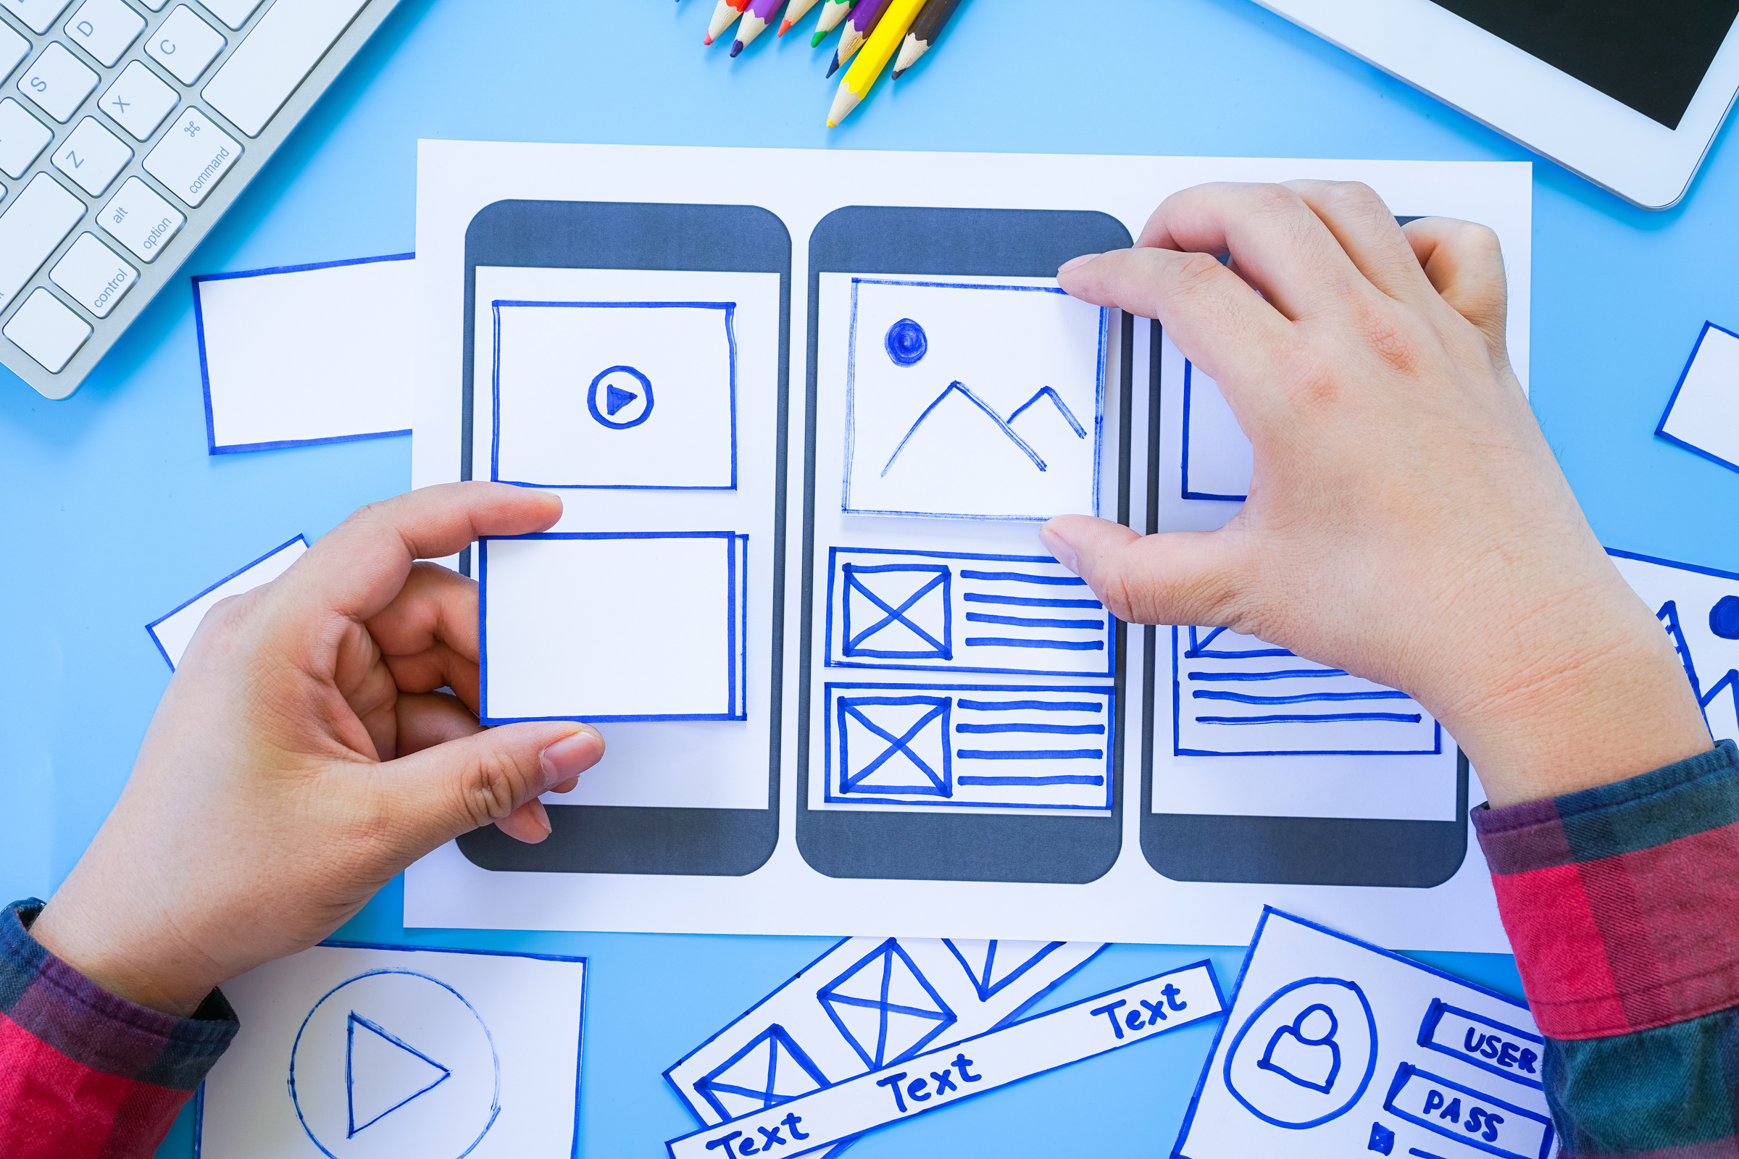
PAPER PROTOTYPING
Paper prototyping is a process where design teams create paper representations of digital products to help them realize concepts and test designs. They draw sketches or adapt printed materials and use these low-fidelity screenshot samples to cheaply guide their designs and study users’ reactions from early in projects.

Slide 8
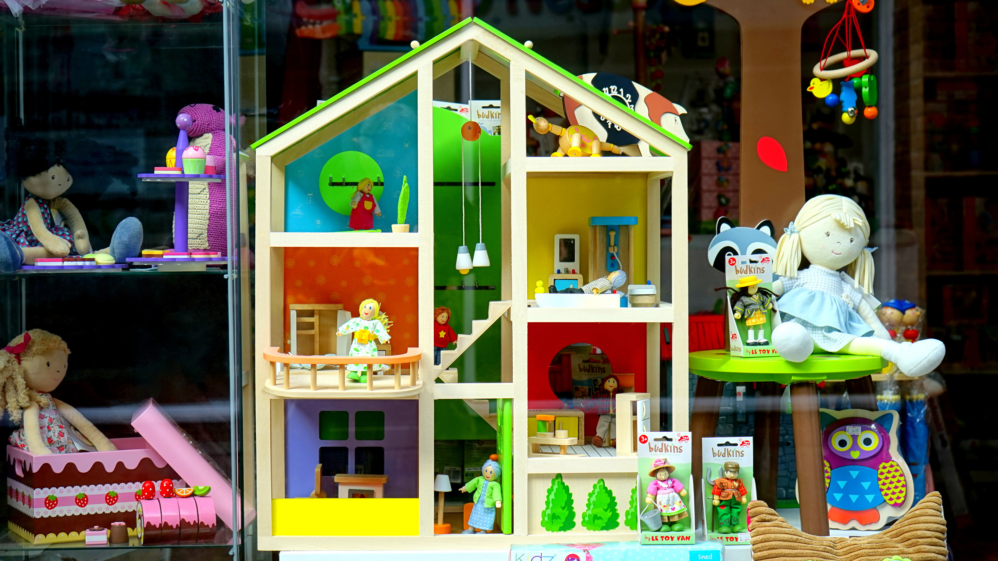
DESKTOP WALKTHROUGH
A desktop walkthrough helps the design team to quickly simulate a service experience using simple props like toy figurines on a small-scale stage (often built from LEGO bricks or cardboard), and test and explore common scenarios and alternatives. The critical deliverable is not the model of the map/stage but the experience of playing through the service experience step by step.

Slide 9
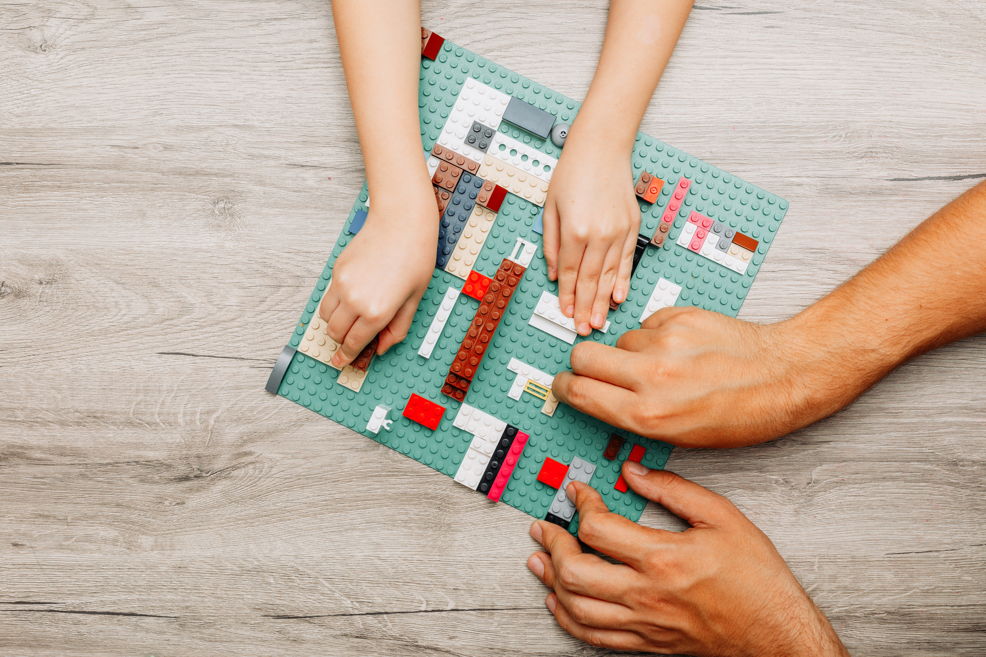
LEGO SERIOUS PLAY
LEGO Serious Play is a facilitated workshop methodology that uses LEGO bricks as a communication, problem-solving, and creative thinking tool to encourage active participation and collaboration among participants to explore complex issues and find innovative solutions.

Slide 10

DIGITAL WIREFRAMES & INTERACTIVE PROTOTYPES
A wireframe is a visual representation or skeletal outline of a web page, mobile app, or software interface that shows the basic layout, structure, and functionality of the final product.
It serves as a blueprint or prototype that helps designers, developers, and stakeholders to quickly visualize and test the user interface and user experience (UI/UX) design before investing time and resources into creating a fully functional product.

Slide 11

Get feedback!
LET PEOPLE TEST AND TOUCH YOUR PROTOTYPE AND USE INTERVIEWS OR OBSERVATIONS AS THEY ARE MUCH BETTER THAN SURVEYS.

Slide 12
THANK YOU!

Slide 13
BREAK (15 MIN)

