Slide 1




The need for change
Why it's important to adapt and go with the times
The RESIST project is co-financed by the European Union (European Regional Development Fund) under the Interreg Baltic Sea Region Programme.

Slide 2



THE FEAR OF THE NEW

Slide 3

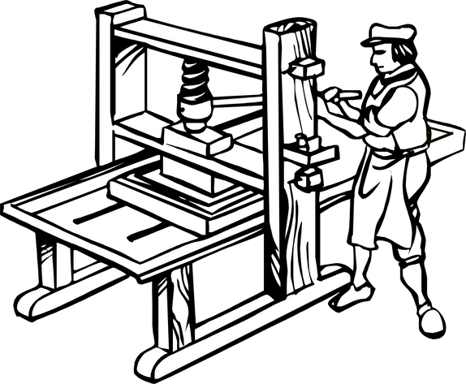




The Printing Press (15th century) - The printing press allowed for the mass production of books and information sharing. Some feared this would lead to the spread of heresy and religious dissent, a challenge to the established church's authority.
The Telephone (19th century) - Early telephones were seen as unnatural and even demonic by some. The disembodied voices and lack of visual cues caused unease. People worried about the breakdown of social interaction and potential for misuse.
Automobiles (Early 20th Century) - Horseless carriages were initially met with fear and suspicion. They were seen as dangerous and uncontrollable compared to horse-drawn carriages. People worried about accidents, noise pollution, and the impact on traditional ways of life.
Radio and Television (Early-Mid 20th Century) - These new forms of mass media sparked concerns about manipulation and control. Some feared the potential for governments or special interests to use them for propaganda. There were also worries about the impact on traditional social interaction and cultural values.

Slide 4


The common thread is that fear often stems from a lack of understanding and the potential for disruption to the established social order. However, as societies adapt and new technologies become integrated into everyday life, the initial fear often gives way to acceptance and even dependence.

Slide 5
THE SPEED OF TECHNOLOGICAL CHANGE

Slide 6




We are here
The speed of technological change is unlike anything we’ve ever seen before. Breakthroughs that once took decades are now achieved in a fraction of the time. This rapid pace of innovation means we need to be constantly learning, adapting, and evolving to keep up.
New inventions and discoveries disrupt industries and reshape entire landscapes in a matter of years and companies that fail to adapt risk becoming obsolete.
Beginning of time
Creation of telephone

Slide 7
DANGERS OF STAYING STILL

Slide 8

There are significant risks associated with failing to adapt to changing technological landscapes:
1.
Businesses that cling to outdated methods will struggle to compete with those who are embracing new technologies.
2.
Outdated technologies can lead to inefficiencies and lost productivity for your business.
3.
A lack of innovation can stifle creativity and hinder growth.

Slide 9
CHANGE IS INEVITABLE

Slide 10
Change is an inevitable part of life. Those who embrace change and adapt to new circumstances are more likely to thrive, while those who don't, regardless of their size and influence, often struggle. The same is true for technology. Companies that embrace new technologies and adapt their approach are more likely to succeed in the long run.

Slide 11
WHY CHANGE IS NECESSARY

Slide 12

There are several factors driving the need for change when it comes to technology use:
1.
The technological landscape itself is constantly evolving. New inventions and discoveries are made at an alarming rate, rendering outdated technologies obsolete.
Customer expectations are constantly evolving as well. Customers are becoming more tech-savvy and expect businesses to offer innovative solutions and experiences.
2.
The need to remain competitive in today’s global marketplace necessitates embracing change. Companies that fail to adapt risk being left behind by their competitors.
3.

Slide 13
BENEFITS OF EMBRACING CHANGE

Slide 14

Change is an inevitable part of life. Those who embrace change and adapt to new circumstances are more likely to thrive, while those who don't, regardless of their size and influence, often struggle. The same is true for technology. Companies that embrace new technologies and adapt their approach are more likely to succeed in the long run.

Slide 15


FAILED TO EMBRACE CHANGE
KODAK
NOKIA
Kodak, once a photography giant, fell by not embracing digital cameras. They clung to film, a fading technology, and missed the digital revolution.
Nokia, a mobile phone powerhouse, failed to adapt to smartphones. They dominated the feature phone market but missed the shift to touchscreens and app-driven functionality. This lack of adaptation to changing consumer trends led to their downfall.

Slide 16


EMBRACED CHANGE
AMAZON
NETFLIX
Started as an online bookstore, Amazon constantly embraced change. They revolutionized e-commerce, cloud computing (AWS), and continue to invest in AI and voice assistants (Alexa). Their adaptation keeps them on top.
From DVDs by mail, Netflix took a leap and became a streaming giant. They saw the potential of online video early on and built a dominant platform. They continue to innovate with original content and global reach. Their adaptation disrupted entertainment and made them a leader in streaming.

Slide 17
BUILDING A CULTURE OF CHANGE

Slide 18

Embracing change
To successfully embrace change, it's important to build a culture of change within your organization. This means creating an environment that is:
  Open to new ideas;
  Encouraging of experimentation;
  Supportive of risk-taking;
  Overall future-focused.

Slide 19

Leading by Example
Leaders play a crucial role in driving change within an organization. Leaders who embrace change and set a positive example will inspire others to do the same. Communicate the importance of change to your employees and be willing to adapt your own approach as needed.

Slide 20

Communication is key
Communication is key to successful change management. Keep your employees informed about the need for change and the benefits it will bring. Address any concerns they may have and be open to feedback. By openly communicating with your employees, you can help them to understand and embrace change.

Slide 21

Embrace Flexibility and Agility
The ability to adapt quickly to changing circumstances is essential in today's business environment. Develop processes and structures that allow you to be flexible and agile. This will enable you to respond to new challenges and opportunities more effectively.

Slide 22

Start Small and Scale Up
Change can be daunting, so it's important to start small and scale up. Focus on making small, manageable changes first and gradually increase the scope of your change initiatives as you become more comfortable. This will help to ensure a smoother transition for your employees.

Slide 23

Always Celebrate Successes
Change can be difficult, so it's important to celebrate successes along the way. Recognize and reward employees who are embracing change and making a positive contribution. This will motivate employees and help with a change-driven culture.

Slide 24
“EVERYONE THINKS OF CHANGING THE WORLD, BUT NO ONE THINKS OF CHANGING HIMSELF.”
LEO TOLSTOY

Slide 25

THANK YOU!

