Slide 1



The need for digital literacy
Train the trainers
The RESIST project is co-financed by the European Union (European Regional Development Fund) under the Interreg Baltic Sea Region Programme.

Slide 2

01.
THE NEED FOR DIGITAL LITERACY
02.
SELF-EVALUATION
03.
DIGITAL TOOLS FOR DAILY OPERATIONS
AGENDA

Slide 3




01
Understand the importance of digital literacy
One of the main goals is to help you understand why it's important to keep trying out and learning new digital tools
02
When to use which digital tools
Key Goals
Each digital tool has a specific purpose - it's important to understand what it is.
What are the planned outcomes of what we will discuss today.
03
How to select the best digital tools
What are the main principles based on which to choose digital tools that could benefit your organization.
04
Effectively implementing digital tools
What are the steps to take in order to effectively implement new digital tools within an existing organiztation.

Slide 4
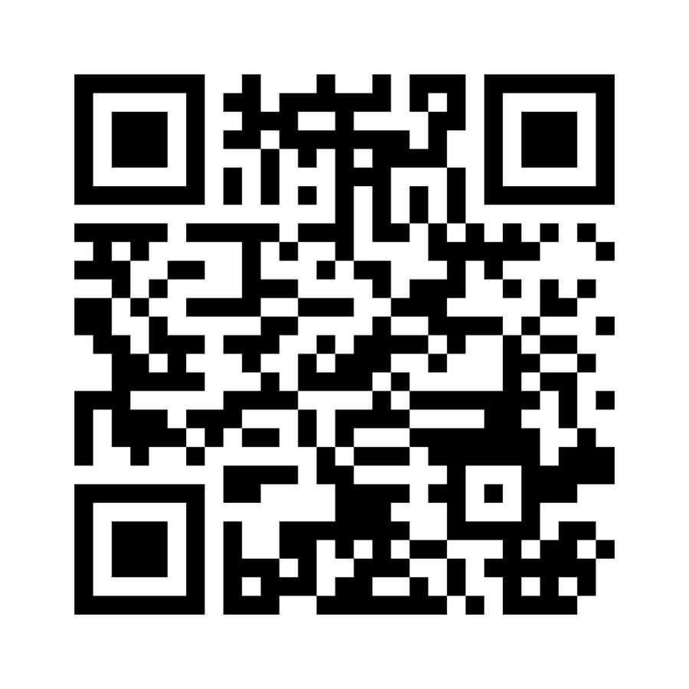
What tools do you already use?
Join at menti.com | use code 6260 4415

Slide 5

DIGITAL LITERACY

Slide 6



The importance of digital literacy
Digital literacy acts as a foundation for thriving in our increasingly digital world. It empowers individuals to confidently navigate the vast online landscape, from using technology for communication, learning, and creative pursuits to critically evaluating the information they encounter. This critical thinking allows them to discern fact from fiction, identify reliable sources, and avoid falling victim to misinformation or online scams. Digital literacy also equips users with the skills to protect their privacy and security online, fostering responsible digital citizenship. By understanding proper online etiquette and ethical use of digital tools, individuals can contribute to a more positive and productive online environment. In essence, digital literacy is the key to unlocking the full potential of technology while safeguarding oneself from its pitfalls.

Slide 7

Digital literacy for individuals
01.
EMPOWERMENT AND OPPORTUNITY:
02.
CRITICAL THINKING AND INFORMED DECISIONS:
Digital literacy unlocks a world of possibilities. It allows individuals to find better jobs, pursue online learning, and even start their own businesses. By being comfortable with technology, they can access a wider range of economic opportunities.
The internet is full of information, but not all of it is reliable. Digital literacy equips people with the skills to evaluate information sources, spot misinformation, and make informed decisions in their personal and professional lives.
03.
SAFETY AND SECURITY:
Digital literacy teaches people how to protect themselves online. This includes understanding cybersecurity threats, practicing good password hygiene, and avoiding online scams.

Slide 8

Digital literacy for social entreprises
01.
REACHING BENEFICIARIES:
02.
IMPACT MEASUREMENT AND COMMUNICATION:
Social enterprises aim to address social issues. Digital literacy allows them to connect with their target audience more effectively. They can leverage social media, online fundraising platforms, and digital tools to spread awareness about their cause and reach a wider range of beneficiaries.
Digital tools provide valuable data for social enterprises. With digital literacy, they can track the impact of their initiatives, measure progress, and communicate their achievements to donors and stakeholders.
03.
FUNDRAISING AND NETWORKING:
The digital world offers numerous fundraising opportunities for social enterprises. By being digitally literate, they can launch online campaigns, connect with potential donors, and build a strong online presence.

Slide 9

Digital literacy
in EU
The level of digital literacy in the European Union compared to other regions shows variations. In the EU, more than 90% of jobs require basic digital knowledge, but approximately 32% of Europeans lack basic digital skills. Eurostat data reveals that there is a significant disparity in digital skills across EU Member States, with differences based on factors like age, gender, education, and place of residence. For instance, individuals in urban regions tend to report higher levels of above basic digital skills compared to rural areas. Moreover, the EU has implemented policies and initiatives to address the digital skills gap, such as the European skills agenda and the Digital Skills and Jobs Coalition
Source: https://data.europa.eu/en/publications/datastories/digital-literacy-eu-overview

Slide 10
TECHNOLOGICAL CAPACITY

Slide 11

The importance of technological capacity
Technological capacity is the linchpin of success in today's tech-reliant world. It's not just about having the latest gadgets and software; it's about harnessing their potential to your advantage. This encompasses two key aspects: firstly, the technical foundation. This includes the physical tools (hardware) and the programs (software) needed, along with skilled individuals who can operate and maintain them. But technological capacity goes beyond mere operation. It also involves the strategic know-how to leverage technology for problem-solving and innovation. This could involve anything from utilizing sophisticated software for data analysis to even creating entirely new technological solutions. In essence, technological capacity allows you to graduate from simply using technology to strategically wielding it as a powerful tool to achieve your goals.

Slide 12
Where does it come from for an individual?
01.
EDUCATION AND TRAINING:
03.
ACCESS TO RESOURCES:
Formal education in computer science, engineering, or specific software programs provides a strong foundation. Online tutorials, workshops, and self-directed learning also play a big role.
Having the right tools – hardware, software, and reliable internet – is crucial for practicing and developing skills.
02.
EXPERIENCE:
04.
SAPTITUDE AND INTEREST:
Hands-on experience using technology for different purposes builds practical skills and problem-solving abilities. This can come from personal projects, hobbies, or professional work.
A natural curiosity and enjoyment of working with technology fuels the desire to learn and explore its possibilities.

Slide 13
Where does it come from for an organisation?
01.
INTERNAL INVESTMENTS:
03.
PARTNERSHIPS AND OUTSOURCING:
This includes financial resources dedicated to acquiring technology (hardware, software, licenses), hiring skilled personnel (IT specialists, data analysts), and providing training programs for existing staff.
Organizations can leverage external expertise by partnering with technology companies or outsourcing specific tasks like cloud management or cybersecurity.
02.
CULTURE AND LEADERSHIP:
04.
INDUSTRY AND MARKET PRESSURES:
A leadership that values technology and fosters a culture of innovation encourages exploration and adoption of new tools. This can involve promoting experimentation, having clear technology goals aligned with the overall strategy, and providing support for employees to develop their skills.
The competitive landscape within an industry can drive the need for technological advancements to stay ahead. Similarly, evolving customer demands and expectations often necessitate the adoption of new technologies to meet their needs.

Slide 14

Those who embrace it and those who don't
Organizations that dive headfirst into digital tools and technologies flourish in today's world compared to their lagging counterparts. They leverage automation and data for efficiency, solve problems creatively, personalize customer experiences, make data-driven decisions, attract top talent, and stay agile in a changing market. Conversely, those who resist risk falling behind, struggling to compete, meet customer needs, and ultimately achieve long-term success.

Slide 15


POSITIVE EXAMPLE
Ushahidi is a non-profit technology company that started as a website that allowed people to report on post-election violence via text message, email, or web, and visualize that information on a map. The use of technology was crucial to Ushahidi's growth and impact:
  Open-source software: Ushahidi developed an open-source software platform that allowed anyone to easily set up their own crowdsourcing and mapping initiatives. This made the technology widely accessible and customizable.
  Mobile integration: Ushahidi integrated mobile technology, allowing people to report information via SMS, which was crucial for reaching people in areas with limited internet access.
  Scalable cloud-based infrastructure: Ushahidi's platform was built on cloud-based infrastructure, enabling it to scale rapidly to handle large volumes of data and users during crises.
  Data visualization: Ushahidi's mapping and visualization tools made it easy to aggregate, analyze and display crowdsourced information, providing valuable situational awareness during emergencies.
Thanks to its innovative use of technology, Ushahidi has grown from a single website to a global non-profit organization. Its platform has been used in over 159 countries to support a wide range of initiatives, from election monitoring to disaster response.

Slide 16

What should you aim for?
Invest Strategically: Allocate resources for modern hardware, software, and skilled personnel (IT specialists, data analysts). Prioritize tools that align with your business goals.
Embrace Partnerships: Consider outsourcing specific tasks (cloud management, cybersecurity) or partnering with technology companies to leverage external expertise and resources.
1.
4.
Develop a Digital Culture: Foster a leadership that champions technology and encourages exploration. Promote experimentation, provide training, and clearly communicate the importance of digital adoption.
Stay Agile and Data-Driven: Monitor industry trends and adapt your technology investments accordingly. Use data analytics to gain insights into customer behaviour, and operational efficiency, and identify areas for improvement.
2.
5.
Upskill Your Workforce: Provide training programs and opportunities for employees to learn new skills relevant to the technologies being implemented.
Focus on Security: Prioritize cybersecurity measures to protect your data and systems from evolving threats. Implement robust data security protocols and employee training programs.
3.
6.

Slide 17

Where to begin?
1.
Building foundational skills
2.
Developing comfort and confidence
Identify your needs
Practice regularly
What do you want to achieve with technology? Is it communication, learning a new skill, or simply navigating the online world more confidently?
The key to building technological capacity is consistent practice. Use the skills you learn in real-world scenarios, even if it's just for personal projects or hobbies.
Explore free resources
Embrace the "learn by doing" approach
There are countless free online tutorials, courses, and even libraries offering workshops on basic computer skills, using specific software, or even cybersecurity.
Don't be afraid to experiment and make mistakes. Most technology is designed to be user-friendly, and there are online communities where you can ask questions and get help from others.
Start small
Find a tech buddy
Don't overwhelm yourself. Pick a single skill or application you want to learn and focus on mastering that first. There are plenty of beginner-friendly options available.
Learning with a friend or colleague can be motivating and provide a support system as you explore new technologies together.

Slide 18

Balancing act
The perfect amount of digital tools for an organization isn't a fixed number, but a sweet spot between too few (hindering efficiency) and too many (creating confusion and data silos). It depends on your organization's size, industry, and goals. Aim to identify your needs, prioritize goals, and consolidate and integrate tools.
Remember not to overwhelm your team. Implement a few core tools first, train employees effectively, and then consider adding more based on success and evolving needs.
Make sure you also regularly evaluate your digital toolkit. Are the tools being used effectively? Are they delivering the desired results? Be willing to remove or replace tools that aren't adding value.

Slide 19

The risks of overdoing it?
Even though you should aim to increase your technological capacity, there are real risks of overdoing it - using too many tools and technologies at the same time just for the sake of being tech savvy:
  Decreased Productivity: Instead of streamlining workflows, too many tools can create friction. Employees waste time logging in, switching between apps, and hunting for information scattered across different platforms.
  Information Silos: Disparate tools can lead to fragmented data, making it difficult to get a holistic view of projects, customers, or company performance.
  Employee Confusion and Frustration: Learning and juggling multiple tools can overwhelm employees, leading to frustration and potentially hindering morale.
  Security Risks: Each additional tool introduces a new attack vector for cybercriminals. Managing credentials and ensuring proper data security across a vast array of platforms becomes complex.
  Hidden Costs: Software subscriptions, training, and potential maintenance fees for all these tools can add up quickly, creating unexpected financial burdens.

Slide 20

How to maintain your digital literacy?
With the constantly evolving world, especially the digital world, it's important to keep yourself up-to-date in order not to fall behind. To maintain a decent level of digital literacy try to do the following:
  Keep learning: Embrace new tech and update your skills through courses or workshops.
  Be info savvy: Don't trust everything online, check sources and for biases.
  Stay secure: Protect yourself with strong passwords and keep your software updated.
  Practice makes perfect: Regularly use technology to stay comfortable.
  Don't be shy: Ask for help when you get stuck, there are plenty of resources available.
  Teach and explain: Share your knowledge with others. It will reinforce your own understanding and adaptability.

Slide 21
Task: self-evaluation (35 min)
To understand where you currently stand regarding digital literacy, please take the following test:
https://mydigiskills.eu/
Afterwards, share what you found out, what surprised you and what is your takeaway.

Slide 22
THANK YOU!

Slide 23
BREAK (15 MIN)

