Slide 1
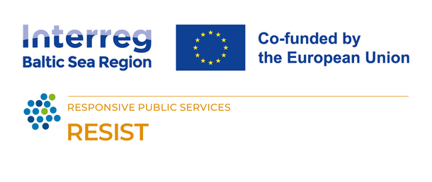
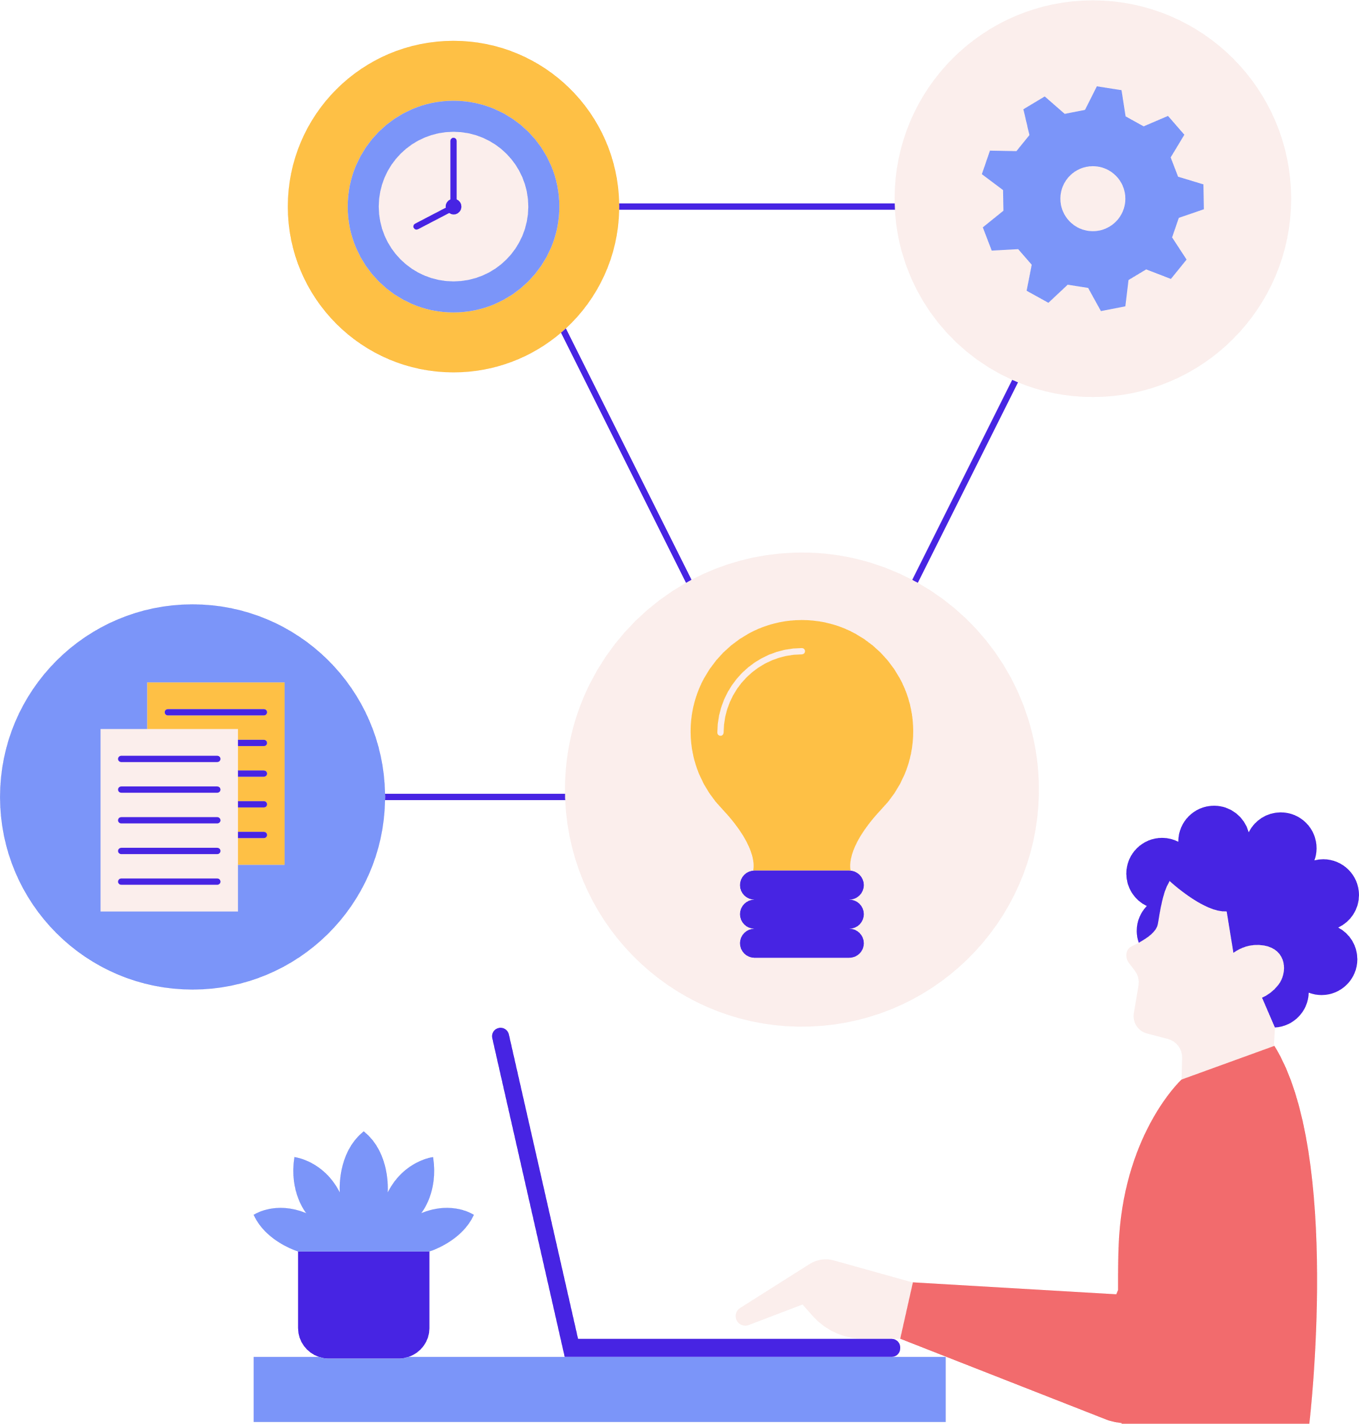
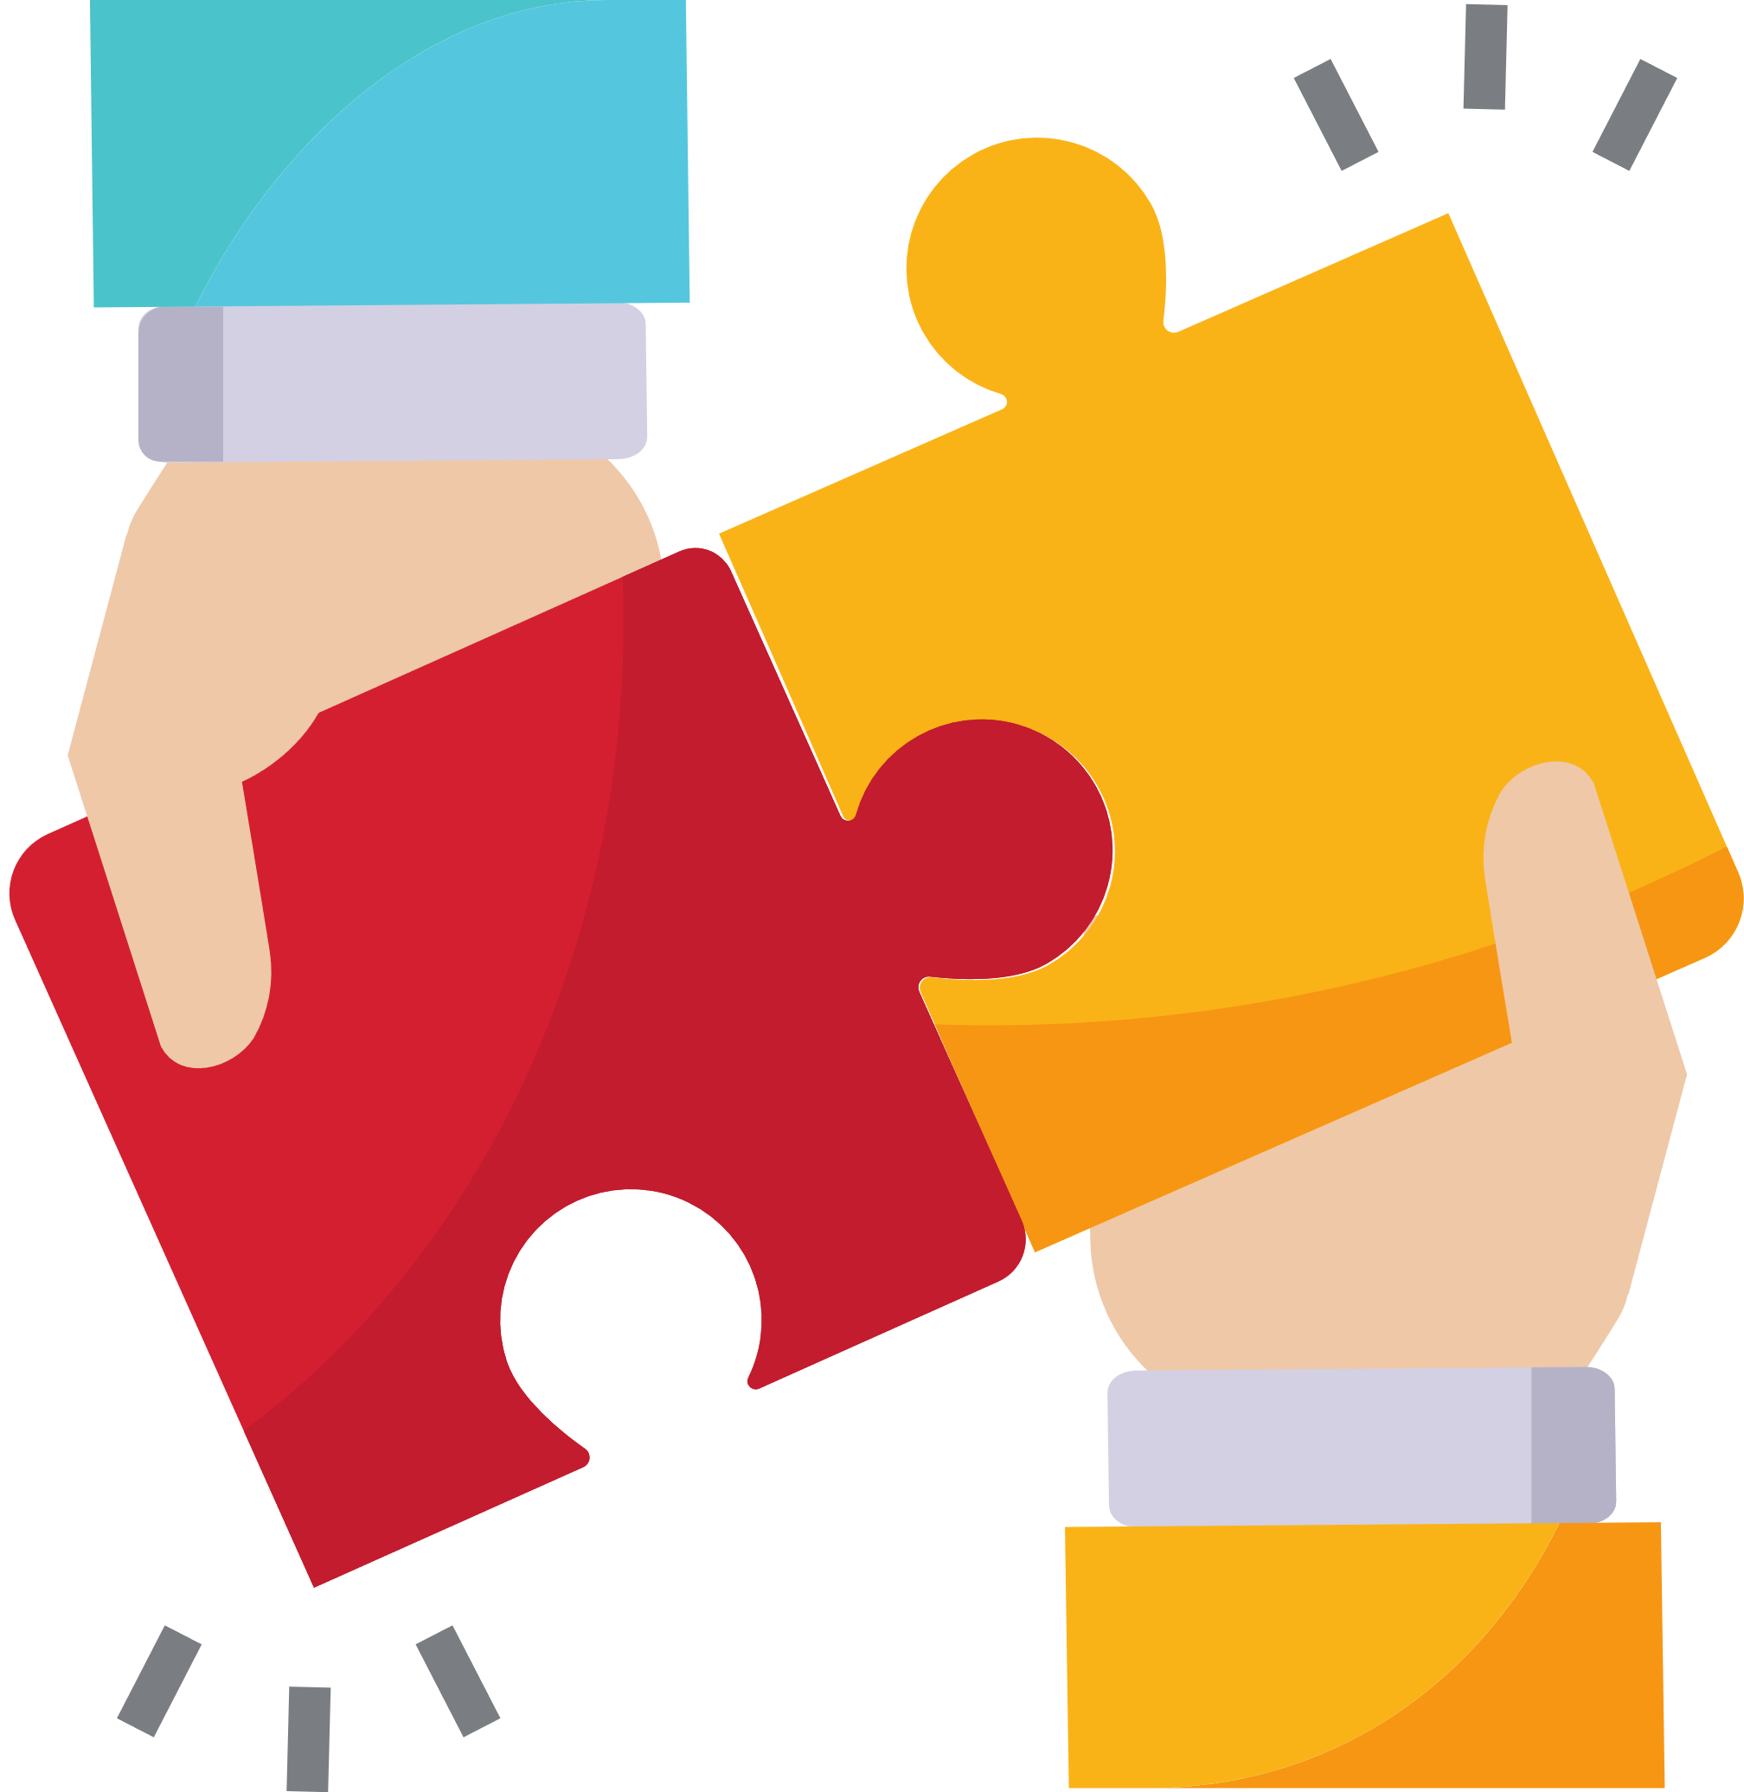

Digital skills and tools for daily operations
Tools for project management, data security, design, collaboration, efficiency and more
The RESIST project is co-financed by the European Union (European Regional Development Fund) under the Interreg Baltic Sea Region Programme.

Slide 2
Task: share with everyone (15 min)
What was the most difficult digital tool you've had to learn how to use?
What methods did you use to make the learning as effective as possible?

Slide 3



Digital skills and tools
In order to raise the technological capacity of an individual or an organization, one of the first steps to take is to start learning about what is available and how it can be used to your advantage. And it's not just about learning different digital tools that can be used for various situations but also about certain skills that have been widely adapted in the IT industry which can help with the processes within an organization. It's the combination of the two that will help raise your technological capacity.

Slide 4
For social entreprises
Social enterprises need digital skills and tools to supercharge their social impact. By understanding the online spaces their beneficiaries frequent, they can connect and deliver support more effectively. Furthermore, digital tools act as a megaphone for their mission, allowing them to tap into online fundraising platforms and social media to reach a wider audience and attract more supporters for their cause. In essence, digital fluency is key to maximizing their social impact.

Slide 5



PROJECT MANAGEMENT

Slide 6
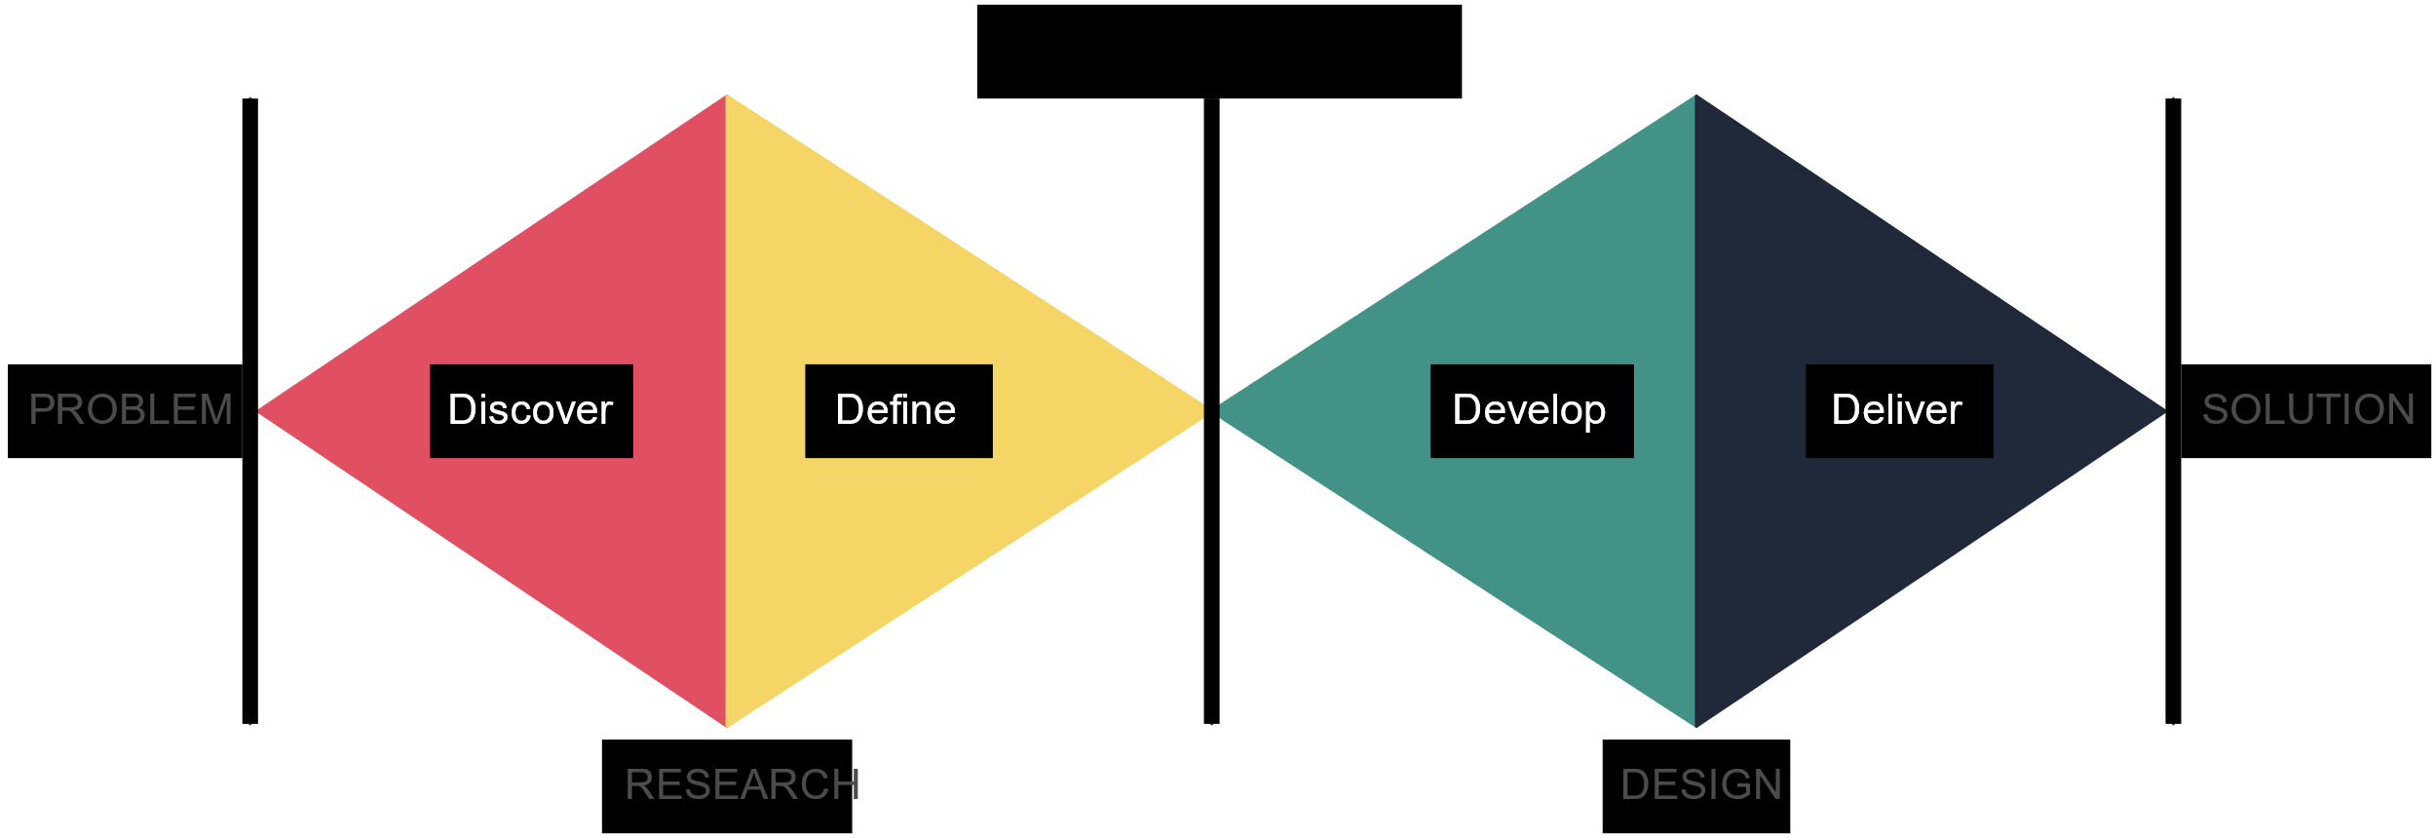
Design Thinking
Design thinking is a non-linear, iterative process that teams use to understand users, challenge assumptions, redefine problems and create innovative solutions to prototype and test. Involving five phases — Empathize, Define, Ideate, Prototype and Test — it is most useful to tackle problems that are ill-defined or unknown.
More: https://www.interaction-design.org/literature/topics/design-thinking

Slide 7

User Experience (UX)
UX stands for User Experience. Basically how a user feels and his/her demands getting fulfilled after using the software or automobile or any other gadget designed. In simple terms “is the user able to use the product efficiently, the way the developer has intended to use his artefact.” Creating a seamless and enjoyable experience for users while using the interface is the main aim of UX Design.
UX Design is all about the user interaction or overall experience of a user with the product, webpage, or application. How the customer feels about the product when he/she is using the service if he/she is facing any problem while interacting with the product or application, and how easy it is for a user to perform a certain task to use a product.
More: https://www.interaction-design.org/literature/topics/ux-design

Slide 8

Prototyping
A prototype is a draft version of a product that allows you to explore your ideas and show the intention behind a feature or the overall design concept to users before investing time and money into development. A prototype can be anything from paper drawings (low-fidelity) to something that allows click-through of a few pieces of content to a fully functioning site (high-fidelity).
Creating a prototype for your product can save you both valuable time and money, as you will discover the product's strengths and weaknesses before actually finishing and launching it.
More: https://www.interaction-design.org/literature/topics/prototyping

Slide 9
Project management methodologies
There are many project management methodologies used today. Probably you're already using one of them possibly without knowing it. It's valuable to learn about them all in order to decide which one would be most beneficial for you. The three most popular methodologies are:
  WATERFALL - Traditional, linear project planning method best suited for situations where change is uncommon. The model typically includes five or six dependent phases, with each phase relying on the deliverables of the previous one.
  LEAN - The lean project management methodology specializes in creating a culture of continuous improvement by eliminating waste and empowering employees. It helps reduce costs, increase efficiencies and improve quality and employee morale.
  AGILE - Agile project management methodologies developed as a response to the rigidity of the waterfall model and were inspired by the speed and flexibility of lean methods. They’re intentionally iterative and collaborative, and they put emphasis on creating good products for customers.
More: https://www.forbes.com/advisor/business/project-management-methodologies/

Slide 10

Digital marketing
Digital marketing is the promotion and marketing of goods and services to consumers through digital channels and electronic technologies. These digital channels can include the internet, mobile devices, social media platforms, webinars, search engines, online customer communities and other digital platforms.
Here are the Top 5 reasons why you should use digital marketing:
  Easier to reach the right audience;
  You can reach a much wider audience;
  You can engage with your audience;
  You can motivate your audience to take action;
  Money-wise, it's more efficient than classical marketing.
More: https://business.adobe.com/blog/basics/digital-marketing

Slide 11
SEO
SEO stands for Search Engine Optimization. The primary goal of SEO is to increase the quantity and quality of organic (non-paid) traffic to a website.
It consists of:
  Keyword Research: Identifying and targeting relevant keywords and phrases that users are likely to search for in search engines.
  On-Page Optimization: Optimizing individual web pages by incorporating keywords into the content, meta tags, headings, and URLs, and ensuring that the website is user-friendly and mobile-responsive.
  Off-Page Optimization: Building high-quality backlinks from other websites to improve the website's authority and trustworthiness.
  Technical SEO: Addressing technical aspects of a website, such as site speed, mobile-friendliness, and ensuring that search engine crawlers can index and understand the site's content.
  Content Creation: Creating high-quality, valuable, and relevant content that addresses users' needs and interests.
  User Experience: Ensuring that the website provides a positive user experience, which includes easy navigation, fast loading times, and mobile responsiveness.
  Local SEO: Optimizing a website to appear in local search results, which is crucial for businesses targeting a local audience.
  Analytics and Monitoring: Using tools like Google Analytics to track website performance and adjust strategies accordingly.
More: https://www.semrush.com/blog/seo-basics/

Slide 12
DATA

Slide 13

Data security
Data security is the practice of safeguarding digital information from unauthorized access, accidental loss, disclosure and modification, manipulation or corruption throughout its entire lifecycle, from creation to destruction.
This practice is key to maintaining the confidentiality, integrity and availability of an organization's data. Confidentiality refers to keeping data private, integrity to ensuring data is complete and trustworthy, and availability to providing access to authorized entities.
Aspects to consider:
01.
Make sure you use strong passwords and don't use the same one everywhere
04.
Make sure you always update your phone, computer and other devices on time.
02.
Make sure you use backups, especially for the data that is essential to your operations.
05.
It can be useful to encrypt the data that is private and of high importance to your operations.
03.
Think of your privacy online. Do not share what doesn't need to be shared!
06.
Always delete the data you don't need and the files you've added to devices other than your own.
More: https://www.techtarget.com/searchsecurity/Data-security-guide-Everything-you-need-to-know

Slide 14
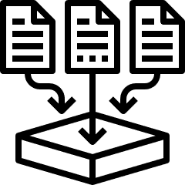
Data analysis
In short, data analysis involves sorting through massive amounts of unstructured information and deriving key insights from it. These insights are enormously valuable for decision-making at companies of all sizes.
An introduction to the data analytics process:
  Define the question or goal behind the analysis: what are you trying to discover?
  Collect the right data to help answer this question.
  Perform data cleaning/data wrangling to improve data quality and prepare it for analysis and interpretation–getting data into the right format, getting rid of unnecessary data, correcting spelling mistakes, etc.
  Manipulate data using Excel or Google Sheets. This may include plotting the data out, creating pivot tables, and so on.
  Analyze and interpret the data using statistical tools (i.e. finding correlations, trends, outliers, etc.).
  Present this data in meaningful ways: graphs, visualizations, charts, tables, etc. Data analysts may report their findings to project managers, department heads, and senior-level business executives to help them make decisions and spot patterns and trends.
More: https://learntocodewith.me/posts/data-analysis/

Slide 15
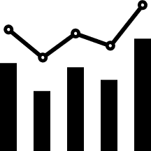
Data usage
The term “usage data” refers to any data about how a product or service is used. In the past, the term might only have referred to a visitor’s actions on a website, or tell you how many minutes someone has used their phone. Today, however, usage data is an essential part of a wide variety of services, across industries.
Think of usage data like an event log that tracks predetermined units of measurement. Anything from:
  Computing resources (like data and connectivity)
  Physical telemetry (like distance travelled)
  Product consumption (like materials, ingredients and chemicals)
  Service utilization (like licenses, software features and support).
Data can be used:
  Externally, to influence stakeholders, get more funding & support
  Internally, to facilitate data-driven decision-making & improve performance
Telling a persuasive story (based on and with data) that creates public value helps social enterprises to:
  Get the resources they need to operate and grow
  Influence behaviour change across stakeholders
More: https://www.digitalroute.com/blog/usage-data/

Slide 16


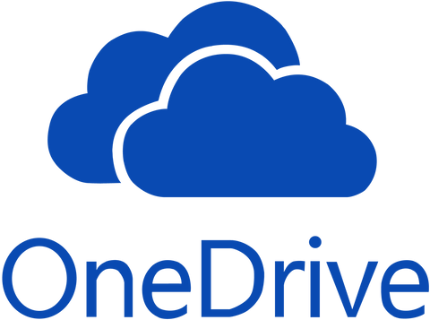

Cloud storage
Cloud storage allows you to save data and files in an offsite location that you can access either through the public internet or a dedicated private network connection.
The data that you transfer off-site for storage becomes the responsibility of a third-party cloud provider. The provider hosts, secures, manages and maintains the servers and associated infrastructure and ensures you have access to the data whenever you need it.
Most popular tools for data storage:
  Google Drive
  OneDrive
  DropBox
More: https://www.ibm.com/topics/cloud-storage

Slide 17
DIGITAL TOOLS FOR SPECIFIC PURPOSES

Slide 18



For collaboration
Online collaboration tools are apps, software programs, or platforms that help businesses and their people streamline the creative process, and work together more effectively, and efficiently. Otherwise known as team collaboration tools, they enable managers and employees to assign tasks, update on progress, report on outcomes and generally improve workflows and communication, both internally and externally.
Some great tools for collaboration:
  Slack (communication)
  Discord. (communication)
  Miro. (brainstorming/teamwork)
  Whimsical. (project management)
  Notion. (project management)
Slack tutorial: https://youtu.be/o3HJuPaITWk?si=N8SGnLTHrFYMFUSb

Slide 19



For efficiency
The web provides users with a great variety of software useful for improving time management in work activities, establishing and achieving daily objectives in a practical manner, actively collaborating, quickly searching for information, staying up to date and many other things.
Some great tools for efficiency:
  Trello (project management)
  Asana. (project management)
  Toggl Track. (time management)
  Clockify. (time management)
  Monday. (CRM)
Trello tutorial: https://www.youtube.com/watch?v=geRKHFzTxNY

Slide 20



For design
Nowadays it's not mandatory anymore to be a professional designer with the know-how of how to use such great tools as Adobe Illustrator or Photoshop if all you need is just a simple banner. Currently, there are plenty of free tools available that can assist nearly anyone with the creation of simple designs.
Some great tools for design:
  Canva (basic, everyday designs)
  Figma (more complicated designs)
  Postermywall (basic designs)
  Piktochart (infographics)
Canva tutorial: https://www.youtube.com/watch?v=6M8axhCQP7M

Slide 21


For presentations
We all know PowerPoint and Apple users definitely know Keynote. But as you can guess, those are not the only tools that can be used to make beautiful and effective presentations! There are plenty of free, online tools that will not only get you to a finished presentation but will also help you along the way!
Some great tools for presentations:
  Prezi
  Canva
  Google Slides
  Gamma
Prezi tutorial: https://www.youtube.com/watch?v=ur9dkLsN7Pw

Slide 22



For website creation
Want a professional website without the coding headaches? No-code website builders empower anyone to create stunning, functional websites with drag-and-drop tools and pre-designed templates. This means you can focus on your content and design vision, while the platform takes care of the technical aspects. It's perfect for entrepreneurs, small businesses, or anyone who wants a beautiful online presence without needing programming skills.
Some great no-code tools for website creation:
  WIX
  Bubble
  Squarespace
  Tilda
  Mozello
WIX tutorial: https://www.youtube.com/watch?v=nIKbN5pBSXo

Slide 23


AI tools
Nowadays Artificial Intelligence tools are around every corner but for good reason. These intelligent assistants can handle repetitive tasks, analyze data for valuable insights, and even generate creative text formats. Imagine an AI assistant that writes compelling marketing copy, analyzes customer data to predict trends, or helps you brainstorm new ideas. When used properly, AI tools can truly make your workday more efficient.
Some great AI tools for different uses:
  Chat GPT (Text and image generation)
  Midjourney (Image generation)
  Perplexity (Text generation with sources)
  Grammarly (Grammar correction tool)
  FireFlies (Takes meeting notes and creates transriptions)
Chat GPT tutorial: https://www.youtube.com/watch?v=AXn2XVLf7d0

Slide 24
Saving money on tools
Even though all of the tools previously mentioned are free of charge, it is mainly for the basic functions. There can come a moment when you will need to use the functions hidden behind a pay wall. But if you are working on a social cause or you are a non-profit, there are ways how you can get the paid versions free of charge:
  TechSoup: This global network equips you with discounted or donated software, training resources, and a community of like-minded organizations. By leveraging TechSoup, you can stretch your budget further, gain access to powerful technology tools, and empower your team to better serve your mission.
  Tech To The Rescue: This non-profit connects NGOs with tech companies, offering pro bono or low-bono tech solutions. They can match you with skilled developers to build a custom app, or data analysts to help you understand your impact. By using Tech To The Rescue, you gain access to expertise you might not have in-house, allowing you to scale your positive impact and empower your organization.

Slide 25
Experiment, experiment, and experiment!
In today's overflowing digital toolbox, finding the perfect tool isn't a one-size-fits-all situation. Experimenting with different options is crucial for several reasons:
  It allows you to discover functionalities that best suit your specific needs and workflow. Imagine trying to paint a masterpiece with only a screwdriver – exploring different tools ensures you have the right brush for the job.
  Experimentation fosters a deeper understanding of your own preferences. Do you prioritize a sleek interface or robust analytics? Trying different tools helps you identify what matters most to you.
  The digital landscape is constantly evolving. By testing new options, you stay ahead of the curve and ensure you're leveraging the latest advancements to maximize your efficiency and effectiveness.

Slide 26
Don't be afraid to ask for help!
Just like learning a new language, having a guide can accelerate your progress. Asking questions clarifies confusing aspects, while experienced users can offer valuable tips and tricks you might not discover on your own. This not only saves you time and frustration, but also opens doors to a network of support that can empower you to unlock the full potential of the tool. So, whenever needed, do not be afraid to reach out and ask for help!

Slide 27
Reflection (15min)
Please share what will be your key takeaways from today and if there is something, what will be the thing you'll start doing differently.

Slide 28

THANK YOU!

