Slide 1



RURAL & LOCALIZED SOCIAL INNOVATION: IDENTIFYING, SHARING & SCALING
Train the trainers
The RESIST project is co-financed by the European Union (European Regional Development Fund) under the Interreg Baltic Sea Region Programme.

Slide 2

01.
IDENTIFY RURAL INNOVATION
Where to look, what to spot
02.
METHODS AND TOOLS TO MAP
Selection of three methods
03.
WHY SHARING MATTERS
Do not reinvent the wheel
04.
SCALING AND IMPACT
Methods and approaches
TABLE OF
CONTENT

Slide 3
Local challenges need local solutions.
Why Rural & Local Innovation Matters?
Rural communities often create innovative, sustainable responses.
How can we identify, share, and scale these solutions?

Slide 4


What is Rural Social Innovation?
Definition: Locally driven solutions addressing rural challenges in sustainable & scalable ways.
Key Characteristics:
Community-led
Sustainable & resource-efficient
Embedded in cultural & social realities
Addresses systemic challenges

Slide 5
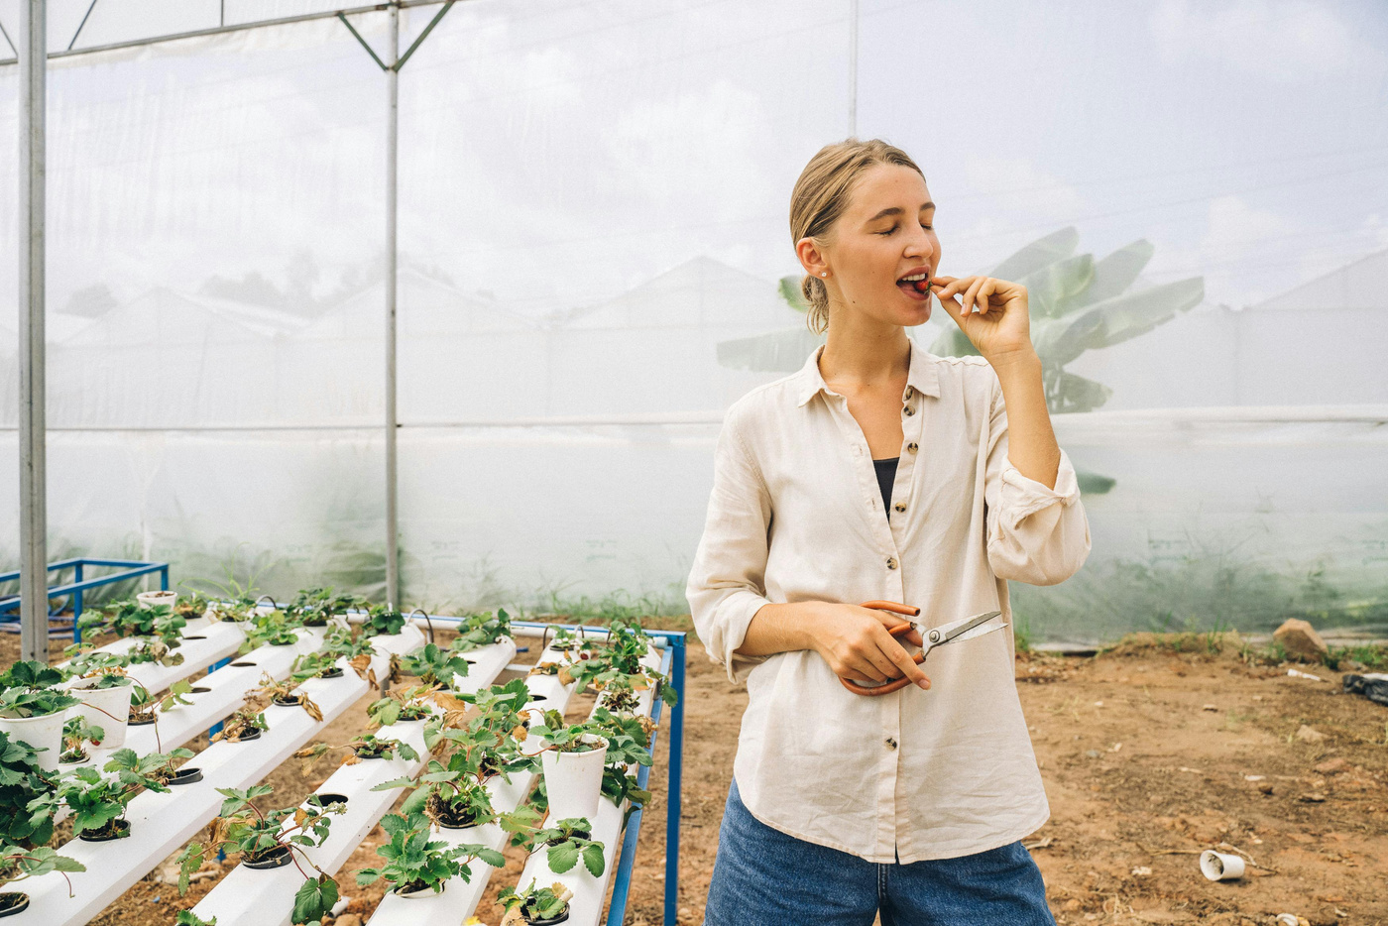
Identifying social innovation in rural context
Where to look?
Traditional knowledge & practices
Informal networks & grassroots leaders
Community-driven problem-solving
Survival innovations (necessity-based solutions)

Slide 6

How to Spot a Promising Innovation?
Addresses a real community need
Developed by or with the community
Scalable to other rural settings

Slide 7
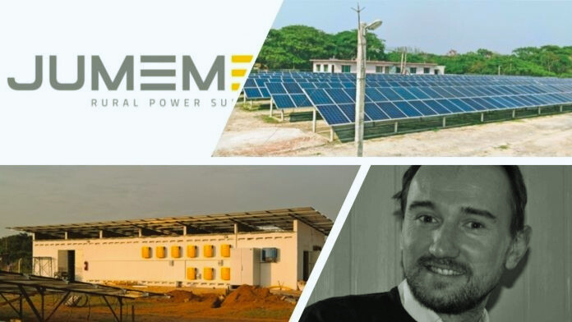
Local Solar Microgrids for Off-Grid Communities (Global example)
Challenge:
Millions of people in rural and remote areas lack access to reliable electricity.
The Innovation: Local Solar Microgrids – Small, community-managed solar power systems that generate and distribute electricity to local households, schools, and businesses.
Why It Works –
Affordable & Sustainable;
Scalable & Replicable;
Empowers Local Communities

Slide 8

Tools & methods to map rural innovation

Slide 9



Community Innovation Mapping
What It Is
How It Works
Benefits
A participatory mapping exercise where community members collectively identify and document local social innovations within their environment.
Engage local stakeholders (villagers, NGOs).
Map out social innovations on a physical or digital map.
Assess key factors such as adoption, sustainability, and impact.
Identifies hidden innovations within rural areas.
Helps policymakers and funders support high-potential solutions.
Strengthens community knowledge-sharing and collaboration.

Slide 10


Storytelling & Oral History Interviews
What It Is
How It Works
Benefits
A method to capture local knowledge, wisdom, and social innovations by recording personal experiences and success stories.
Surfaces grassroots solutions.
Strengthens community identity and ownership over solutions.
Builds trust between social innovators and decision-makers.
Conduct in-depth interviews with community representatives.
Record and document stories of past innovations, resilience, and creative problem-solving.
Use materials to preserve and share knowledge.

Slide 11
Participatory Rural Appraisal (PRA)
What It Is
How It Works
Benefits
A community-based research approach that enables rural populations to analyze their own challenges and develop solutions.
Empowers local people to be active problem-solvers.
Ensures that solutions are culturally appropriate and sustainable.
Increases local adoption of social innovations.
Facilitators use visual tools like mapping, diagramming, and ranking exercises.
Community members actively participate in identifying social issues and designing solutions.

Slide 12



Replicates Success & Prevents Re-Inventing the Wheel
Many communities face similar social challenges, from access to clean water to sustainable farming. When one group develops a solution, sharing it helps others avoid wasting time and resources on trial-and-error approaches.
Why Sharing Matters?
Strengthens Rural Networks & Collaborations
When local innovations are shared, rural communities build stronger connections with neighboring villages, NGOs, and policymakers.
Collaboration leads to funding opportunities, joint problem-solving, and a greater pool of expertise.

Slide 13
Best methods to share local innovation

Slide 14


Peer Learning Networks
How It Works
Benefits
What it is
A structured way to bring local innovators together to exchange ideas and best practices.
Local innovators participate in knowledge-sharing circles, workshops, and trainings.
Encourages mentorship, where experienced changemakers guide new social entrepreneurs.
Can be facilitated by NGOs, universities, or local government agencies.
Encourages direct knowledge transfer between practitioners.
Strengthens local leadership and innovation capacity.
Ensures that knowledge is contextually relevant to the community.

Slide 15
Community Innovation Hubs
How It Works
Benefits
What it is
Physical or digital spaces where local innovators gather, experiment, and share ideas.
Provides makerspaces, digital tools, and access to mentors.
Facilitates collaborative problem-solving and partnership building.
Supports prototyping and piloting of social innovations.
Provides a structured environment for idea exchange.
Encourages cross-sector collaboration (e.g., tech + agriculture + sustainability).
Helps turn prototypes into scalable solutions.

Slide 16
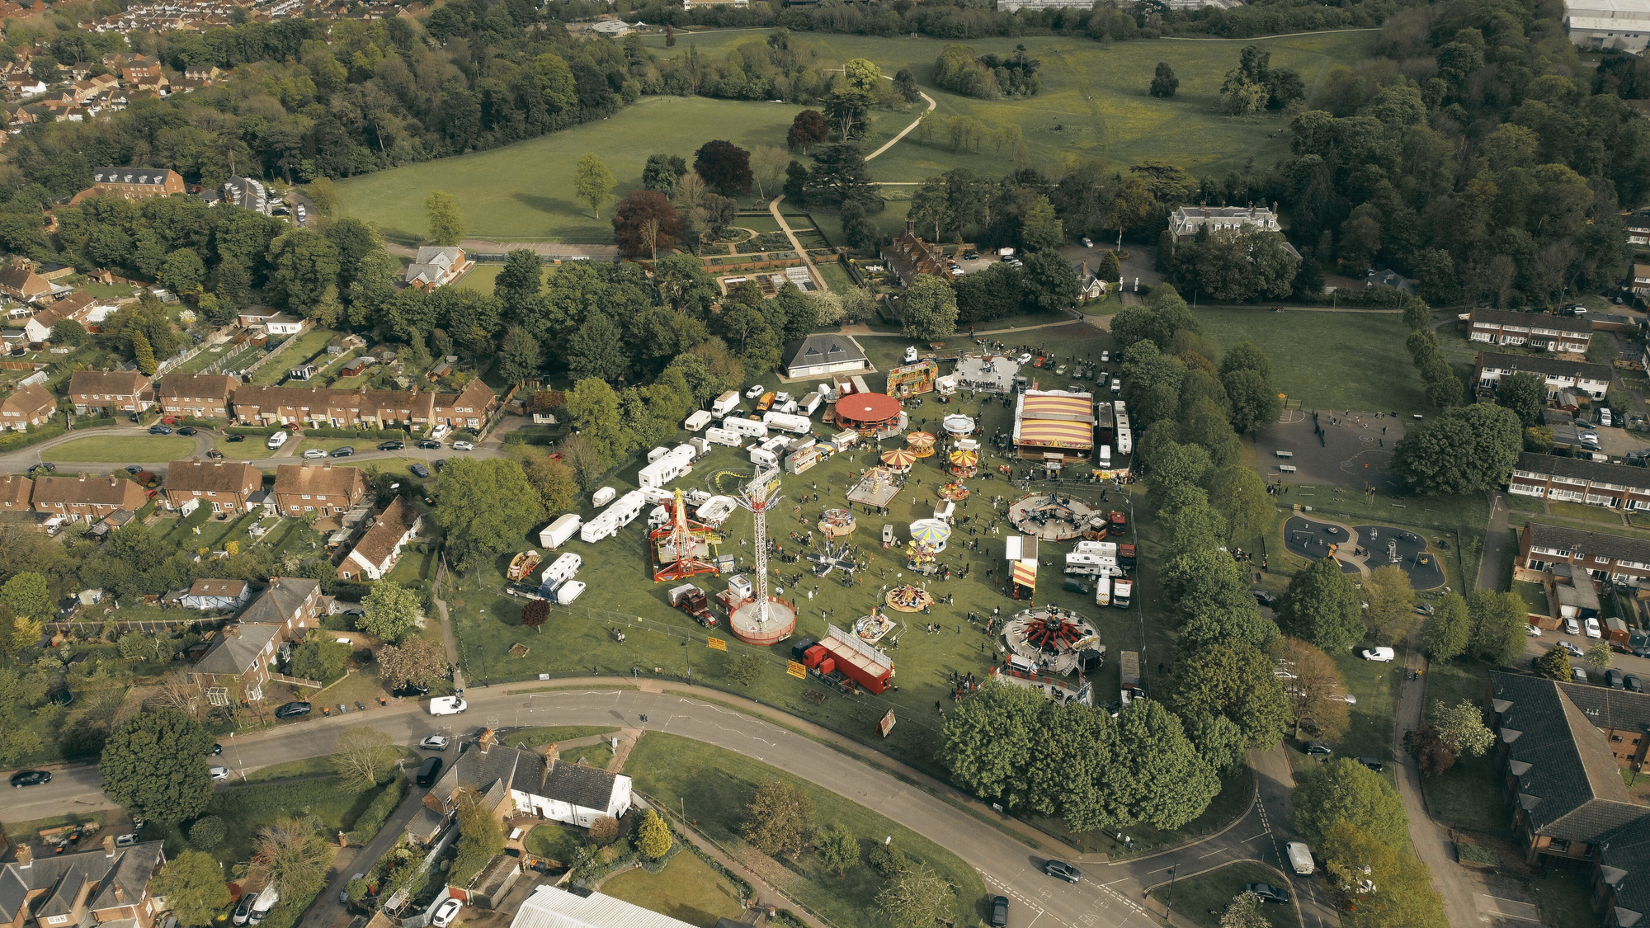
DIGITAL & OFFLINE STRATEGIES FOR SPREADING INNOVATION
DIGITAL
Social media groups (e.g., WhatsApp farmer networks)
Online open-source knowledge platforms
OFFLINE
Rural Innovation Fairs
Hands-on Demonstration Projects

Slide 17


Why Co-Creation?
Ensures relevance & sustainability
Strengthens community ownership
Co-Creation & Community-Led Innovation
How to Foster Co-Creation?
Involve locals in problem-solving
Use participatory design methods
Ensure long-term stakeholder engagement

Slide 18



Training Rural Social Innovators
Who Are Local Change Agents?
Rural leaders, educators, community organizers
Peer-learning workshops
Hands-on field projects
Long-term mentorship programs

Slide 19




Scaling Rural Social Innovation – Growth Without Losing Identity
Challenges of Scaling:
Many solutions are context-specific
Risk of losing local ownership
How to Scale Without Losing Local Value:
Adaptation, Not Copy-Pasting
Train Local Change Agents
Government & Policy Support

Slide 20

Evaluating Local Innovation for Impact
Does it solve a pressing community challenge?
Is it scalable beyond one village?
Can it be sustained without external funding?
Does it empower local leadership?

Slide 21

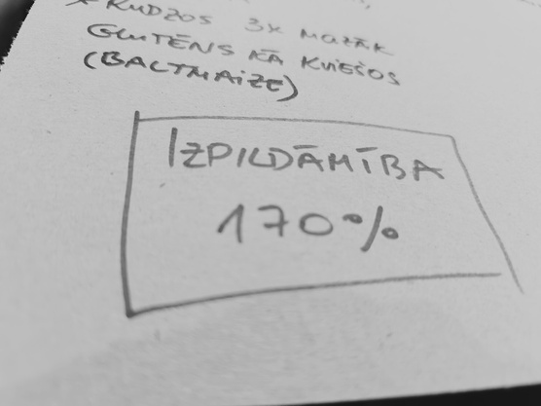
Community adoption & engagement
If a rural innovation is not widely adopted by the community, it is unlikely to create sustained impact.
Measuring community engagement helps determine whether the solution is culturally relevant, accessible, and user-friendly.
Measuring the Impact of Rural Social Innovation
Economic impact & livelihood improvement
Rural social innovations should lead to better economic opportunities for local communities.
A successful innovation helps people increase income, find stable jobs, or reduce living costs.

Slide 22

Sustainability of the Solution
If an innovation cannot sustain itself over time, it risks collapsing when external funding or support ends.
Long-term impact depends on local ownership, financial sustainability, and adaptability.
Measuring the Impact of Rural Social Innovation

Slide 23

THANK YOU
Have any question?

