Slide 1



COMMUNITY POWER-BUILDING IN SOCIAL INNOVATION
Train the trainers
The RESIST project is co-financed by the European Union (European Regional Development Fund) under the Interreg Baltic Sea Region Programme.

Slide 2

01.
GOVERNANCE, LEADERSHIP & OWNERSHIP
Where to look, what to spot
02.
POWERSHIFTS & POWERBUILDING
Why those matter
03.
MECHANISMS & METRICS
Selection of main methods
TABLE OF
CONTENT

Slide 3

Governance, Leadership & Ownership
This presentation explores how shifting power to communities transforms social innovation. We will look at governance models, leadership development, ownership structures, and the ethics of power-sharing, while drawing on case studies and practical strategies.

Slide 4

Why Community Power-Building Matters
Social innovation often fails when decision-making power remains concentrated in external institutions or organizations. Without community ownership, initiatives risk being temporary and ineffective.
Building power ensures that communities are not only participants but active decision-makers, strengthening both legitimacy and trust.
Long-lasting governance structures give resilience, allowing communities to continue shaping change long after funding cycles end.
Empowered communities cultivate the skills, confidence, and collective energy needed to address both current and future challenges.

Slide 5

Innovation without power transfer creates extractive programs, where communities are treated as subjects rather than partners.
Real innovation redistributes decision rights, positioning communities as co-creators instead of passive recipients.
Sustainable change depends on embedding local ownership at every stage.
Social Innovation Requires Power Shifts
When innovation is carried out without structural shifts in decision-making, it risks reinforcing inequities rather than dismantling them. Programs might achieve measurable outputs, but they rarely transform systems. Lasting social innovation must transfer power alongside resources, ensuring communities drive the process as well as the outcomes.

Slide 6

Community power-building is the practice of shifting authority to those who are most directly affected. Instead of institutions prescribing solutions, residents define the problems, design the responses, and govern the structures that carry them forward.
This creates ownership of both resources and outcomes, ensuring social innovation is not imposed from the outside but emerges from within.
By rooting innovation in lived experience, communities create solutions that are culturally grounded, more relevant, and sustainable.
What is community-power building

Slide 7

Clients vs. co-owners: Traditional service delivery treats residents as clients, while power-building positions them as co-owners of solutions.
Short-term outputs vs. durable governance: Service programs measure outputs; power-building creates governance structures that persist.
External control vs. community decision rights: Programs are often controlled by outside agencies, but true empowerment comes from local decision-making authority.
Service provision vs. structural change: Delivering services solves immediate needs, while shifting power addresses root causes and transforms systems.
Program delivery vs. power-building

Slide 8

Asset-Based Community Development (ABCD)
Asset-Based Community Development begins by mapping what already exists within a community: the skills of individuals, the associations they belong to, and the institutions rooted in the area.
By focusing on abundance rather than deficits, communities build strength and resilience. ABCD connects neighbors, strengthens informal networks, and invests in leadership capacity.
The shift from a deficit mindset to an abundance mindset helps communities recognize and use their own power as the foundation for innovation.

Slide 9
Identify: Use talent scouting and peer nominations to bring forward emerging leaders who may not hold formal titles.
Leadership Pipelines
Train: Provide community members with skills in organizing, governance, facilitation, and negotiation.
Support: Offer stipends, coaching, and peer networks to ensure leaders can sustain their engagement.
Sustain: Create long-term succession plans and mentorship systems to continuously renew leadership.

Slide 10

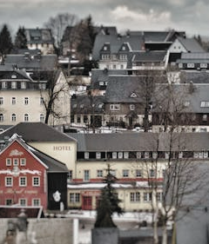
Ownership Structures for Power
Ownership determines who ultimately holds decision-making rights.
Community benefit agreements bind developers to community priorities, while mutual aid networks and solidarity economies demonstrate how communities can own and control the means of resilience and support.

Slide 11

Ethics of Power-Sharing
Consent, compensation, and credit are non-negotiable when involving community members.
Avoid tokenism and co-optation, where participation is symbolic but not substantive.
Respect community sovereignty and protect privacy, particularly when handling data.
Sharing power requires not only giving seats at the table but transferring resources to communities as well.

Slide 12

Barriers to power-building
Communities face many barriers in building power. Institutional resistance and gatekeeping often limit access to decision-making spaces.
Short-term funding cycles create instability and pressure to prioritize compliance over innovation.
Many communities lack training and capacity-building support, leaving leaders overstretched. Sustaining volunteer energy without proper resources is difficult, leading to burnout and loss of momentum.

Slide 13

Overcoming barriers
Build broad coalitions to pressure institutions into making structural changes.
Secure multi-year, flexible funding that allows communities to plan for the long term.
Invest in leadership development infrastructure so capacity grows sustainably.
Create peer support networks and mutual aid systems to prevent burnout.

Slide 14

From participation to shared power
Moving beyond involvement toward real community decision-making.
Consulted – communities asked for feedback
Co-Designed – locals shape solutions
Co-Governed – communities hold decision rights & some budgets
Power-sharing is the true metric of innovation.

Slide 15

Community Power in Action
Examples that Shift Power to the People
BSI_4Women Empowers refugee women through entrepreneurship and community networks — demonstrating communities shaping their economic future.
SEMPRE (and its extension “SEMPRE Accelerators”) Created local empowerment networks combining social-service providers + vulnerable communities.
BSR Cultural Pearls
Engages smaller cities/regions to strengthen community culture and sense of belonging — emphasising community-led cultural activities as innovation.
Real-world models where communities lead, not follow.

Slide 16
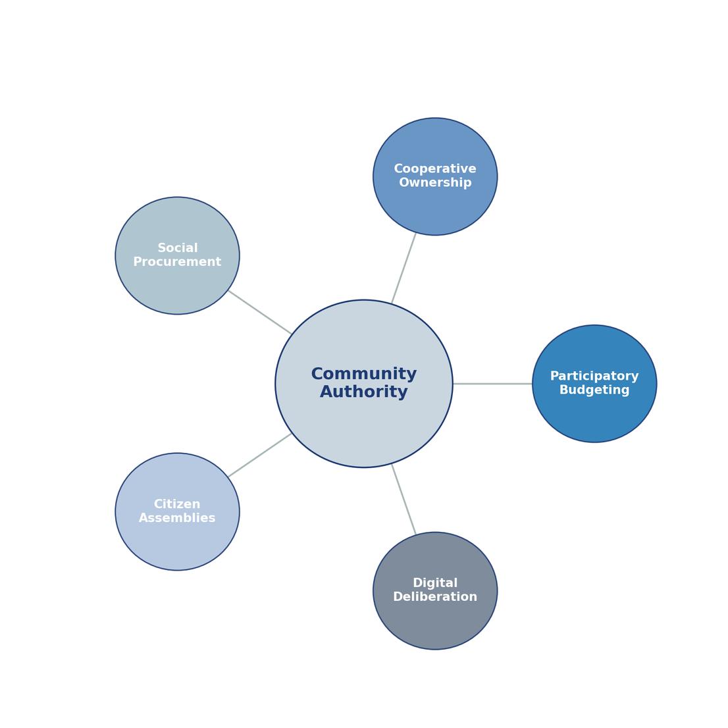
Mechanisms that redistribute Power
Tools that Shift Who Decides
Participatory budgeting
Cooperative & mutual ownership
Social procurement clauses
Citizen assemblies
Digital deliberation platforms

Slide 17
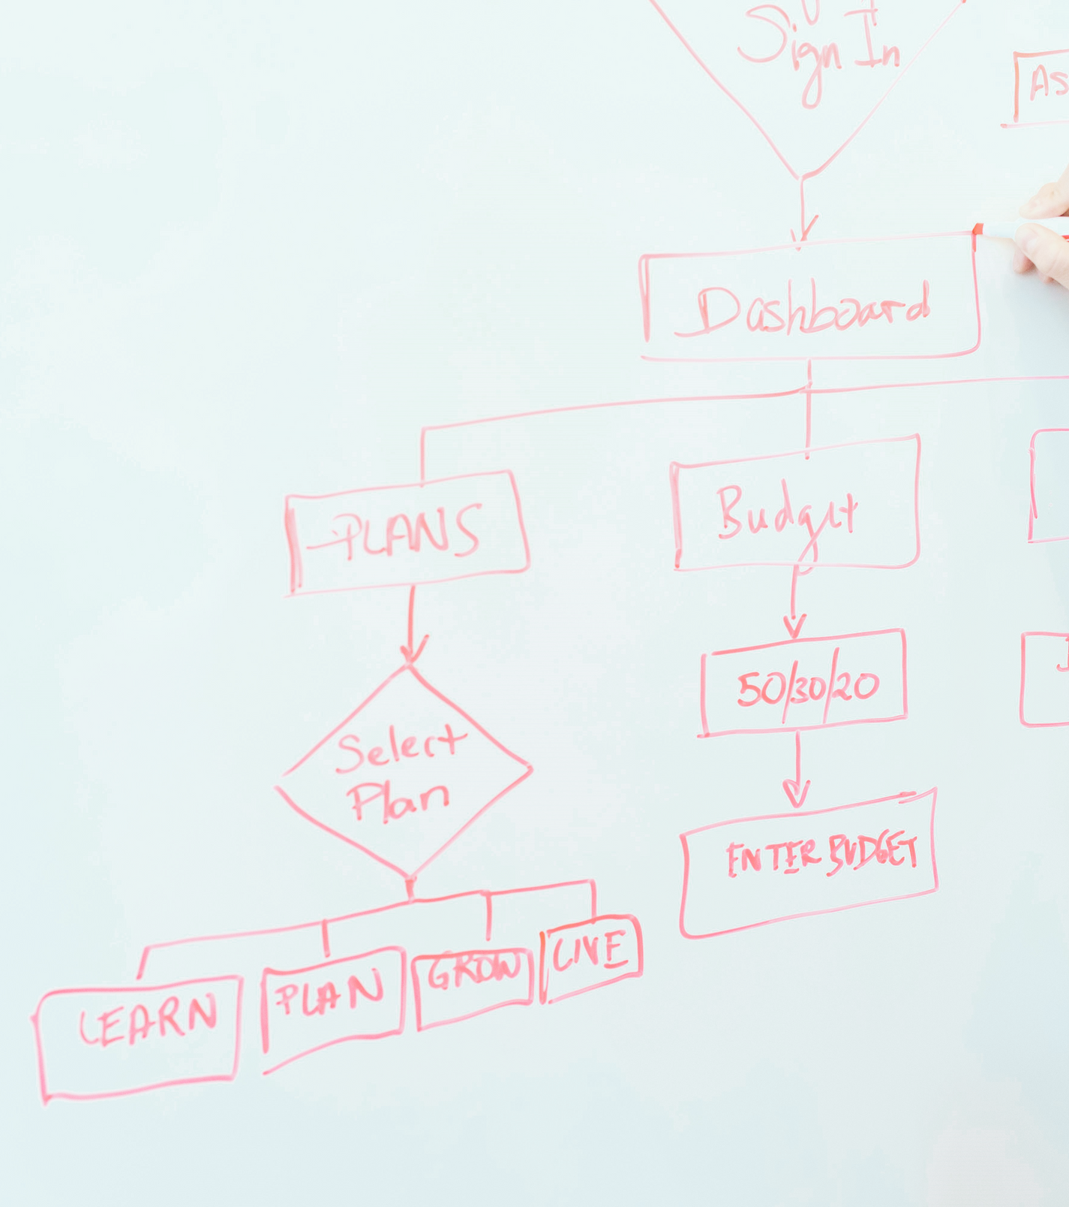
How to Know When Power Has Shifted?

Slide 18
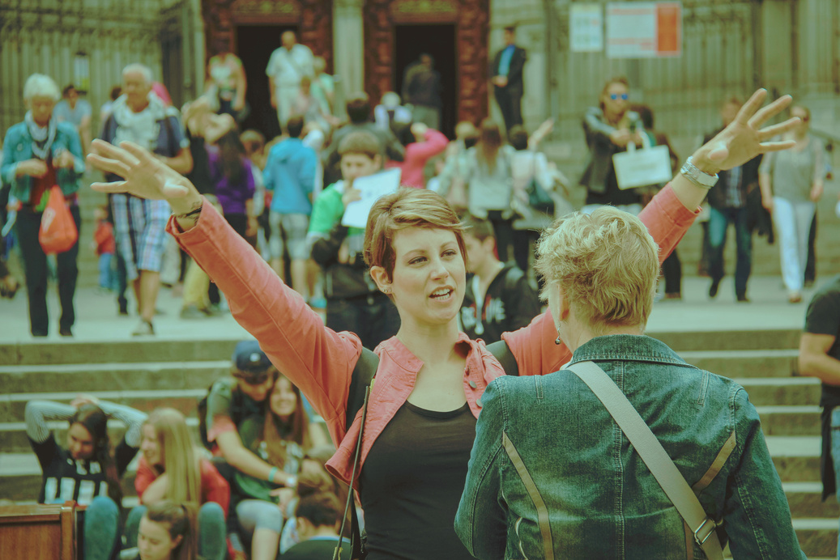



Measuring Community Power
Track deeper indicators than participation counts.
Decision Rights – who approves or vetoes
Representation – diversity in leadership
Capacity – local skills & resources
Accountability – feedback loops & transparency

Slide 19

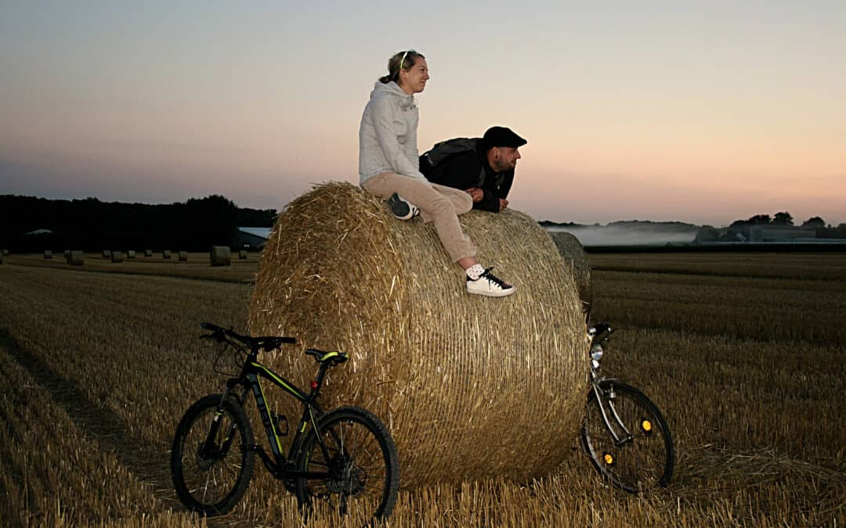
Community wealth-building as social innovation.
Main points:
Cooperative and community-share models retain value locally.
Each reinvested euro builds circular benefit.
Shared ownership = long-term sustainability.
The economics of shared ownership
When Ownership Stays Local, Impact Multiplies

Slide 20

The Future: Power as Infrastructure

Slide 21
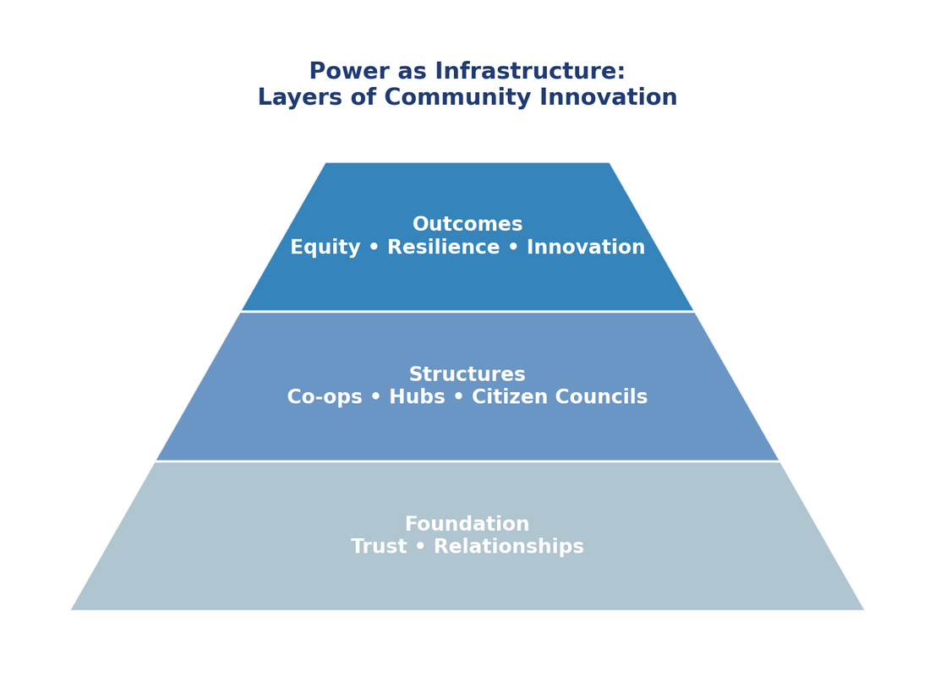
Power is not a project —it’s the system itself
Building ecosystems where authority, trust, and capacity are embedded.
“Communities are not beneficiaries — they are architects of change.”

Slide 22

THANK YOU
Have any question?

