Slide 1



IDENTIFYING SOCIAL INNOVATION: SPOTTING WHAT WORKS
Train the trainers
The RESIST project is co-financed by the European Union (European Regional Development Fund) under the Interreg Baltic Sea Region Programme.

Slide 2

01.
RECOGNISE AND SPOT SOCIAL INNOVATION
Traditional innitiatives vs social innovation
02.
DEFINITION, CHARACTERISTICS, CRUCIALITY
Impact, sustainability, scalability
03.
OBSTACLES
Know the osbstacles
04.
SHIFTING THE FOCUS TO COMMUNITIES AND OWNERSHIP
Other way around; grassroots
05.
COLLABORATIVE NETWORKS, ETHICS, CULTURE
Networks; ethical & cultural perspective
TABLE OF
CONTENT

Slide 3
Many impactful innovations exist, but not all are scalable or effective.
Why Identifying Social Innovation Matters
How do we recognize what works and avoid investing in ideas that fail?
Train-the-Trainer Focus: Teaching others to identify, evaluate, and scale social innovation.

Slide 4


What is Social Innovation?
Definition: Social innovation refers to new ideas, methods, or solutions that address pressing social challenges more effectively and sustainably than existing approaches.
Key Characteristics:
Novelty: Introduces a fresh perspective or an unconventional solution.
Effectiveness: Solves a problem in a more impactful way than current methods.
Scalability: Can be expanded or replicated in different contexts.
Sustainability: Maintains impact over time without continuous reliance on external funding.

Slide 5

EXAMPLE
Providing food aid vs. developing a local, self-sustaining food cooperative.
TRADITIONAL INITIATIVES VS. SOCIAL INNOVATION
Traditional initiatives often focus on short-term relief, whereas social innovation aims for systemic change.

Slide 6

Understanding Social Innovation
Let's discuss!
What makes an idea a social innovation rather than just a project?

Slide 7



Hype vs. Real Impact: Not every idea is an innovation
True social innovation requires measurable, long-term impact beyond initial hype. To differentiate, we must assess whether a solution effectively addresses root causes, scales sustainably, and produces verifiable benefits rather than just capturing interest.
Why Do We Fail to Recognize Social Innovation?
Short-Term Wins vs. Long-Term Change: Is it just a pilot, or can it scale and sustain?
Short-term wins in social innovation often come from pilot projects or temporary interventions that show quick results but may not be sustainable or scalable in the long run.In contrast, long-term social innovation focuses on systemic solutions that address root causes and can be expanded or adapted across different regions or contexts.

Slide 8
Who Benefits? If the community is not involved, it’s not a real innovation.
For social innovation to be truly impactful, it must be designed with and for the community it aims to serve, rather than imposed from the outside. Many well-intended projects fail because they are developed by external organizations without consulting local stakeholders, leading to solutions that don’t fit cultural, economic, or social realities.
Why Do We Fail to Recognize Social Innovation?

Slide 9

Overcoming the Hype Trap
Ensuring solutions are developed with a deep understanding of the community’s needs.
Distinguishing between projects that sound appealing vs. those that create real, lasting change.

Slide 10
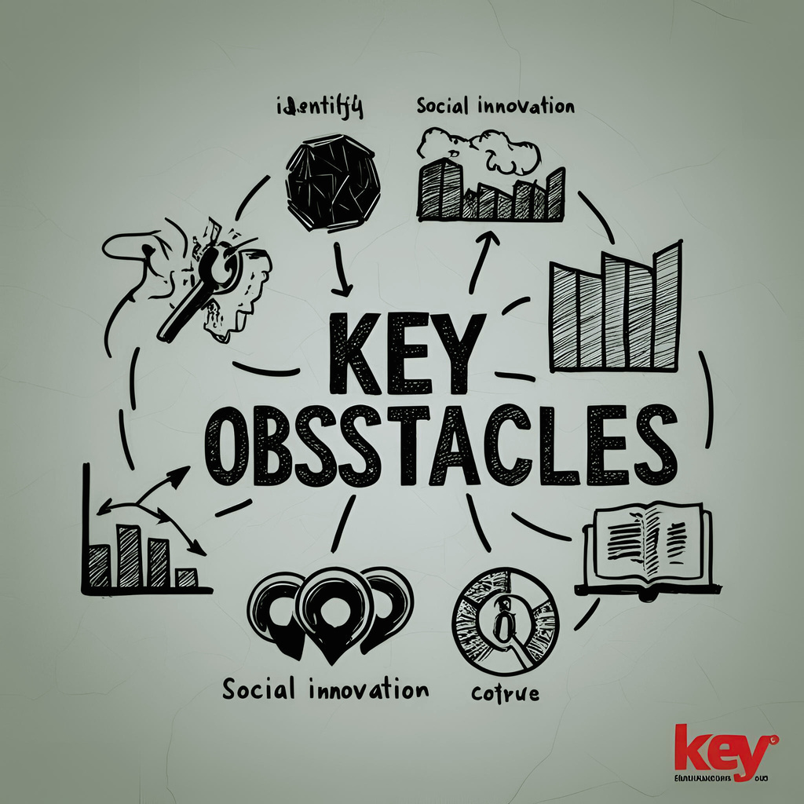
Key obstacles in identifying social innovation.
Lack of Data & Evidence – Many projects claim impact but lack proof.
Bias Toward Tech-Driven Solutions – Social innovation isn't just about new apps!
Resistance to Change – Many existing institutions resist adopting new models.

Slide 11


Why Identifying Social Innovation is Crucial
Many social programs receive funding, but not all create meaningful change.
Identifying true social innovation helps direct investments where they have the highest impact.
Social innovation addresses root causes rather than symptoms.
A robust strategic plan is the compass that guides organizational growth. Evaluate your current strategic planning processes and refine them for agility and adaptability.
SYSTEMIC CHANGE
EMPOWERMENT
EFFICIENCY

Slide 12





How to Spot Social Innovation
01
02
03
04
05
Step 1: Identify a clear, urgent social problem.
Step 2: Look for new, systemic solutions (not just band-aid fixes).
Step 3: Test for impact – does it really work?
Step 4: Assess for scalability & sustainability.
Step 5: Involve multiple stakeholders (community, policymakers, funders).

Slide 13



Three Critical Factors for Identifying Social Innovation
Scalability
Sustainability
Impact

Slide 14

Community-Led Solutions vs. Imposed Solutions:
Innovations that emerge from within the community are more likely to be sustainable and impactful compared to solutions imposed by external organizations.

Slide 15

Ensuring Local Ownership
Successful social innovations empower local stakeholders to take ownership of the solution, fostering long-term success.

Slide 16


Example 1:
A high-tech water purification system deployed in rural areas but abandoned due to lack of maintenance training.
Case Study: Technology-Based vs. Grassroots Innovation
Example 2:
A simple rainwater harvesting system designed by local communities that remains in use for decades.
Lesson: Simplicity and community involvement often lead to sustainable impact.

Slide 17


Why Networks Matter:
Social innovation thrives on collaboration between NGOs, governments, businesses, and grassroots organizations.
Partnerships bring diverse expertise, funding opportunities, and policy support.
Building Collaborative Networks for Social Innovation & scaling
The Role of Mentorship:
Experienced social innovators can guide emerging changemakers.
Mentorship bridges the gap between theory and real-world application.

Slide 18
Ethical Considerations
Avoiding Biases in Identifying Innovation
Transparency
Accountability
Ensuring inclusivity and cultural relevance in social innovation selection.
Avoiding the assumption that Western models work globally.
Social innovation should be assessed through open, ethical evaluation criteria.
Ensuring that projects don’t unintentionally create dependency.

Slide 19


The Challenge of One-Size-Fits-All Solutions
Social innovations need to be adapted to different communities, traditions, and infrastructures.
Example: Microfinance models differ between Asia, Africa, and Latin America.
Adapting Social Innovation to Different Cultural Contexts
Strategies for Cultural Adaptation
Engaging local leaders in the innovation design process.
Conducting cultural feasibility studies before launching an initiative.

Slide 20
The Future of Social Innovation
Emerging Trends:
Hyper-Personalization of Solutions: AI-driven social programs that adapt to individual community needs in real time.
Regenerative economy models focusing on sustainability.
Decentralization & Community Empowerment

Slide 21
The Future of Social Innovation
The Role of Young Innovators:
Encouraging youth entrepreneurship in social impact.
University incubators and hackathons driving the next wave of solutions
Interdisciplinary Collaboration:
a. Encouraging youth in social impact.
b.The merging of technology, policy, and community engagement to drive systemic change.

Slide 22
KEY TAKEAWAYS & LESSONS LEARNED
UNDERSTANDING SOCIAL INNOVATION
SCALING & SUSTAINING IMPACT
Innovation is not just about new ideas but about sustainable, scalable solutions that create real impact.
Successful innovations are those that can be adapted, replicated, and sustained over time.
Policy, funding, and mentorship are key to scaling social innovations.
IDENTIFYING WHAT WORKS
YOUR ROLE MOVING FORWARD
Avoiding hype and focusing on measurable, evidence-based innovations.
Ensuring community involvement in every stage of development.
Whether as a practitioner, policymaker, investor, or community leader, you have a role in shaping the future of social innovation.

Slide 23

Final Reflection & Next Steps
Reflect on Key Questions:
What social innovations have inspired you the most?
How can you apply the lessons learned in your own work or community
Commit to Action:
Identify one step you can take to support or implement a social innovation.
Engage with networks, share knowledge, and advocate for innovative solutions.

Slide 24

THANK YOU
Have any question?

